Slide 1
Long-run Trends in Wealth Inequality and the Role of Inheritance
Daniel Waldenström
Uppsala University
Winter School in Inequality and Social Welfare, Canazei, 2012

Slide 2
Outline of talk
Introduction: Role of wealth in inequality trends
Wealth concentration over the path of development
  Cross-country evidence, 1774-2006
  The case of Sweden, 1873-2006
Inheritance − the role of "old wealth"
Concluding remarks

Slide 3
(Part of the) Income/Wealth relationship
Savings
(sY)
Wealth
(Level, distribution)
Income
(Level, distribution)
Inheritance
Capital income
(rW)
Other processes
(opportunity, insurance etc)

Slide 4
Capital income share in total income, Sweden, top decile, 1912-2004

Slide 5
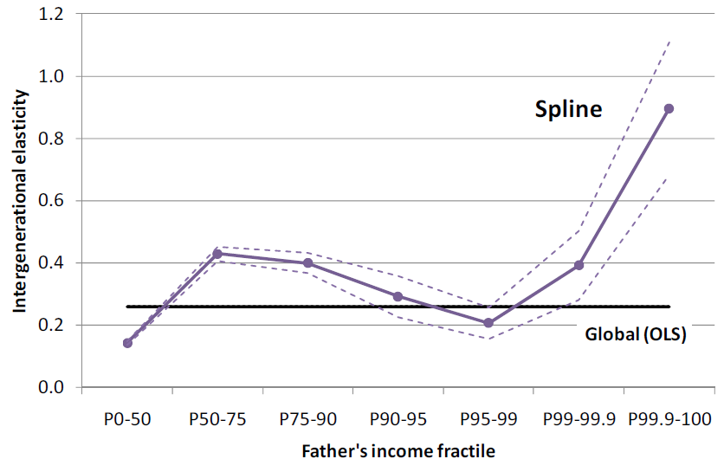
Wealth matters to income mobility: Intergenerational transmission in Sweden
Björklund, Roine and Waldenström (2011), “Intergenerational Top Income Mobility in Sweden – Capitalist Dynasties in the Land of Equal Opportunity?”,

Slide 6
Wealth matters to income mobility: Intergenerational transmission in Sweden
1.0
Income
3.5
3.0
0.8
FinAss
2.5
0.6
2.0
0.4
1.5
1.0
0.2
0.5
Educ
0.0
Non-cog
0.0
IQ
-0.2
-0.5
P90-95
P95-99
P99-99.9
P99.9-100
Björklund, Roine and Waldenström (2011)

Slide 7
Link between inequality and development
Large literature − no consensus
  Equalization view (Stiglitz 1969; Becker & Tomes; Loury 1981)
  Disequalization view (Ray; Mookherjee & Ray 2003)
  History matters (Banerjee & Newman 1993; Galor and Zeira 1993)
Kuznets (1953, 1955): Structural change
  Shift from agericultural (trad.) to industrial (modern) sector generates inverted U-like relationship
  Also: concentration of capital and savings boost inequality
Inequality
Time

Slide 8
Is there a Kuznets Curve in income inequality?
Kuznets
inverted-U?
What about wealth inequality?

Slide 9
Long-run trends in wealth concentration: Cross-country evidence
Ohlsson, H, J. Roine and D. Waldenström (2008), “Long-Run Changes in the Concentration of Wealth: An Overview of Recent Findings”, in Davies, J.B. (ed.), Personal Wealth from a Global Perspective, Oxford, Oxford University Press. Link

Slide 10
Starting point
Main question: Is there a long-term linkage between development and inequality? (cf. Kuznets)
Further questions:
  Common vs. specific trends across countries
  Potential heterogeneity within the top wealth decile
This study:
  Reviews recent empirical findings of others
  Presents new evidence on Nordic countries

Slide 11
Measurement and data
Estate data
  Incentives to minimze tax - but also to divide fairly
  Homogenous source over time
  Problems: Sample size, W of deceased (mortality multipl.)
Wealth tax data
  Large samples; Relatively homogenous over time
  Problems: tax incentives, asset valuation, excludes items
Survey data
  Covers most asset items; Scattered points; Short history
  Problems: sample size, response rates, top-coding

Slide 12
Measurement and data
Wealth concept: Net worth
  Real + financial assets less debts (excl. pensions, human cap.)
Wealth owners:
  Wealth tax data: Households (tax units; >18yrs)
  Estate data: Adults (18 yrs + ); deceased
  Survey data: Households (everyone in dwelling)
  Historically, households difficult to define

Slide 13
Measurement and data
Main methodology:
Compute shares of total household wealth (using Pareto interpolation) that goes to the top 1%, top10% etc of all potential wealth holders
The shares of both wealth and population are defined in relation to reference totals
  Reference total for wealth: All personal wealth in the economy (not only taxed wealth)
  Reference total for the population: All potential tax units (not just those who file tax returns)

Slide 14
French wealth concentration, 1807-1994

Slide 15
U.K. wealth concentration, 1774-2001
Lindert (2000)
Atkinson et al
IRS (2006)

Slide 16
U.S. wealth concentration, 1774-2001
Shammas (1993)
Lindert (2000)
Kopzcuk & Saez (2004)
Wolff (1987, etc)

Slide 17
Swiss wealth concentration, 1913-1997

Slide 18
Danish wealth concentration, 1789-1996

Slide 19
Norwegian wealth concentration, 1789-2002

Slide 20
Swedish wealth concentration, 1800-2002

Slide 21
Cross country top percentile (P99-100)

Slide 22
Cross-country "next four" (P95-99)

Slide 23
Heterogeneity between countries and within the top
Period: | ≈1780-1914
Fractile: | Top1% | Next 4%
France | Increase | Flat
Switzerland | - | -
UK | Increase | Decrease
US | Increase | Flat?
Denmark | Decrease | Flat
Norway | Decrease | Increase
Sweden | Flat | Flat
1914-2000
Top1% | Next 4%
Decrease | Flat
Flat | Flat
Decrease | Flat
Decrease | Flat?
Decrease | Flat
Decrease | Decrease
Decrease | Decrease*
23

Slide 24
Summing up cross-country evidence
Industrialization: no uniform impact on wealth inequality
  Inequality increased in the US, UK (top1%), France
  Flat (or decreasing) inequality in Nordic countries
  Role of country size? Timing of industrialization?
Other factors matter (20th experience)
  Geopolitical shocks, Crises, Redistribtion
Little support for Kuznets-type "inverse-U"
  Trends rather look like an inverse-J (or inverse-S)

Slide 25
Wealth concentration in Sweden, 1870-2006
Roine, J. and D. Waldenström (2009), “Wealth Concentration over the Path of Development: Sweden, 1873–2006”, Scandinavian Journal of Economics, 111(1), 151–187. Link

Slide 26
Questions
Closer at changes in wealth concentration
Evolution during episodes:
  Industrial take-off (1870-1910)
  Rise of the welfare state (educational reforms, home ownership, redistribution) (1930-1970)
  Globalization and deregulation (1980- )
Role of offshore wealth

Slide 27
Top wealth decile in Sweden
Top 10%

Slide 28
Wealth distribution in Sweden, 1870-2005
Education, welfare state,
home ownership
Industrial take-off
Top 1%
Top 10-1%
Bottom 90%
28

Slide 29
Interwar era: High-wage earners accumulate wealth
40
35
30
25
Wealth shares (%)
20
15
10
5
0
1911
1916
1921
1926
1931
1936
1941
1946
1951
P99.9-100
P90-99
P99-99.9

Slide 30
Wealth distribution in Sweden, 1870-2005
Education, welfare state,
home ownership
Globalization,
deregulation...
Industrial take-off
Top 1%
?
Top 10-1%
Bottom 90%
30

Slide 31
What has happened since 1980?
Sweden in the 1980s and 1990s:
  High taxes on wealth, inheritance, property
  Booming financial markets
  Liberalized capital account (since 1989)
Potential impact: Capital flight
  Private wealth (and wealth owners) leaves Sweden
  Wealth is moved to closely held companies
If so, what is the effect on the wealth distribution?

Slide 32
Wealth concentration in Sweden since 1950 (official series)
Bottom 90%
Top 1%

Slide 33
Wealth concentration in Sweden since 1950
(adjusted for foreign wealth of Swedish hh's)
Bottom 90%
incl. foreign wealth
Top 1%

Slide 34
How estimate the wealth of the rich?
We add wealth to the top percentile (≈50,000 hh's)
Three additions:
  Household wealth abroad
    Accumulated mismatches in Balance of Payment
    Unaccounted savings in the Financial Accounts
  Wealth of super-rich Swedes in Sweden
    Unlisted wealth; Source: Rich Lists in magazines 1983-
  Wealth of super-rich Swedes abroad
    Unlisted wealth; Source: Rich Lists in magazines 1983-

Slide 35
Balance of Payments mismatch, six countries
70%
60%
50%
Switzerland
40%
30%
Accumulated BoP mismatch as share of GDP
20%
10%
USA
0%
Denmark
-
Finland
10%
-
20%
Sweden
Norway
-
30%
1975
1980
1985
1990
1995
2000
2005

Slide 36
Comparing top wealth percentile: Sweden vs USA
45
40
+ Rich Swedes abroad
35
+ BoP error, dom.
and for. super-rich
USA
Share of total wealth (%)
+ Rich Swedes at home
30
+ BoP mismatch
25
20
Official series
15
1945
1955
1965
1975
1985
1995
2005

Slide 37
Summing up: Swedish wealth inequality trends
Industrial take-off had a small effect on wealth concentration
  But possibly larger on the composition of the wealthy ...
20th century: Equalization
  Before 1950 the top 1% lost to the medium-rich
  1950-1980 rise of "popular wealth"
  After 1980, wealth compression halts
Adding estimates of foreign wealth and large domestic unlisted fortunes reverses trend 1980-

Slide 38
The Importance of Old Wealth: Estimating Long-Run Flows of Inheritance
Ohlsson, H., J. Roine and D. Waldenström (2012), “The Role of Inheritance in Sweden, 1860–2010”, mimeo.
Waldenström (2012), “Household Wealth in Sweden, 1810–2010”, mimeo.

Slide 39
How important is inheritance?
Next question: How important are inheritances relative to other sources of income?
Households get rich from two sources:
  they save out of their income (new wealth)
  they receive transfers from others (old wealth)
Conventional story: Old wealth mattered in the past, today new wealth (growth-based) is all that matters.
But is this really true...?

Slide 40
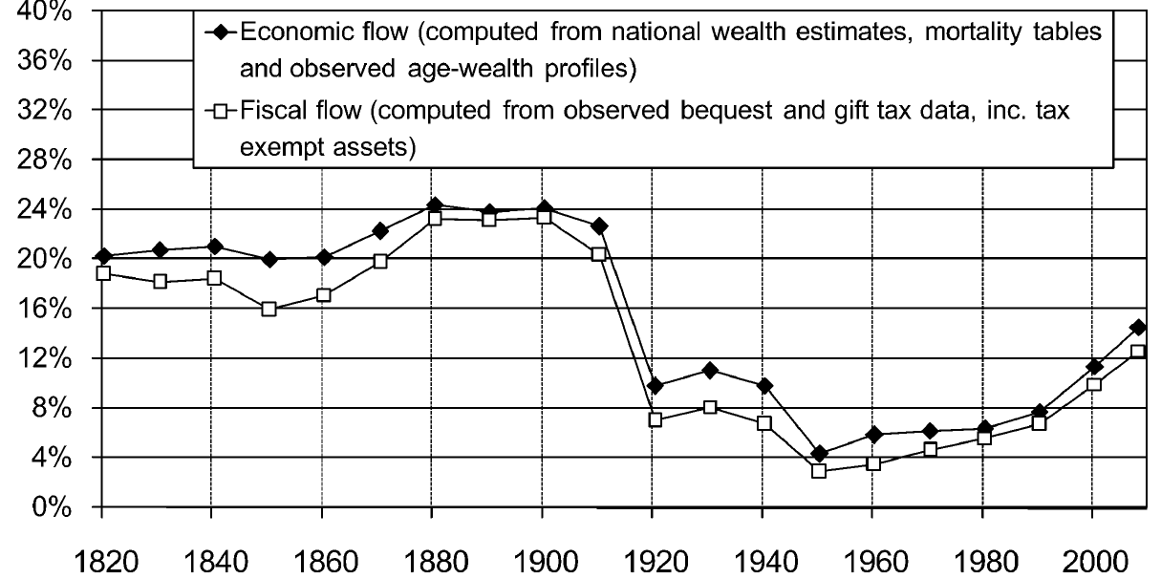
Annual inheritance flow as share of national income: France, 1820-2008
Source: Piketty, Thomas (2011), “On the Long-Run Evolution of Inheritance: France 1850–2050”, Quarterly Journal of Economics 126(3), 1071–1131.

Slide 41
Annual inheritance flow as share of national income: Sweden, 1860-2010

Slide 42
Basic approach
Piketty (2011): the importance of inheritance depends on ratio between economic growth rate g and returns to capital r.
  With r > g, old wealth accumulates faster than new wealth is created
Let
  B = Aggregate inheritance flow
  Y = national income,
  W = aggergate private wealth
  m = mortality rate
  μ = ratio aveW of deceased/aveW of the living.

Slide 43
Basic approach
Then, compute the inheritance flow over income as:
B/Y = μ ∙ m ∙ W/Y
In a dynastic model, heirs save a fraction g/r of the return on their inerited wealth, making the wealth-income ratio W/Y stationary.
Steady-state bequest flow B/Y = (W/Y)/H
  H = generation length
If W/Y = 400% and H = 30, then B/Y = 13%.

Slide 44
B/Y = μ ∙ m ∙ W/Y (France)
Source: Piketty (2011)

Slide 45
Constructing W, Y, m, μ for Sweden
Y: National income data exist (disposable less so)
m: Decendents over population. Data exist.
μ: AveW of decendents/living. Difficult. Estimated from estate and wealth tax sources.
  Gift-correction: +15%
W: Real and financial assets less debts. No solid annual data prior to 1970 (1950). Construct new series back to early 19th century...

Slide 46
Constructing W: Real assets

Slide 47
Constructing W: Financial assets

Slide 48
Constructing W: Debt

Slide 49
Debt components up to 1970.

Slide 50
Asset composition

Slide 51
Swedish household wealth over GDP, 1810-2010

Slide 52
Wealth-Income ratio (W/Y): Sweden

Slide 53
B/Y = μ ∙ m ∙ W/Y (Sweden)

Slide 54
So, does inheritance have a role?
Evidence from France and Sweden suggests that:
  Inheritance was important up to WWI
  After 1950, inheritance did not matter (small W/Y)
  Today, inheritance flows are again become more significant (W/Y is growing)
Piketty's main lesson:
  "with r > g (say, r=4-5% vs g=1-2%), then wealth coming from the past is being capitalized faster than growth, and inherited wealth dominates self-made wealth"

Slide 55
4. Concluding remarks
Before industrialization, wealth was highly unequal
Wealth equalized during 20th century
  But not due to Kuznets-curve
  Instead: Political shifts (education, redistribution) and Exogenous shocks (wars, crises)
Current globalization and modest growth rates in Western world suggest increased future role of wealth and inheritance

