Slide 1
Introduction to Economic History :
Capital, Inequality, Growth
(Master APE & PPD)
(EHESS & Paris School of Economics)
Thomas Piketty
Academic year 2021-2022
Lecture 6: Post-communist societies (Russia, China, Eastern Europe) and the rise of global capitalism
(check on line for updated version)

Slide 2
Roadmap of the lecture
Inequality & growth in communist societies: Soviet Russia
Post-communist societies: the case of Russia
From public to private property: the case of China
Eastern Europe, foreign assets and the East-West divide in the EU
Interest rates and the North-South divide in the Euro area
Global inequality in the early 21c: between modernity & archaism
Environmental inequality, financial opacity
The (very) slow decline of gender inequality
Uneven state building in developing countries
The return of central banks and money creation: a long-run view

Slide 3
Inequality & growth in communist societies: Soviet Russia
Soviet Russia: complete abolition of private property of means of production in late 1920s-early 1930s (>>1936 Constitution)
Very low level of monetary inequality 1920s-1980s, but huge political repression & enormous non-monetary inequalities
1950s: 5% of adult population in prison, vs 1% in USA today (5% for black males) and 0,1% in Europe today (see Cadiot 2019)
Living standards: catch-up with the West 1920s-1950s, but stagnation in 1960s-1980s (even a slight decline in life expectancy: Todd 1976)
See F. Novokmet, T. Piketty, G. Zucman, From Soviets to Oligarchs: Inequality & Property in Russia 1905-2016, JOEI 2018 (WID.world WP)

Slide 7
Post-communist societies: the case of Russia
1990-1993: shock therapy, hyper-inflation, voucher privatization, loans-for-shares >> transfer of ownership of large parts of Russia’s national wealth and natural ressources to a small group of « oligarchs »
1992-2018: 10% GDP of trade surplus per year on average (oil, gas), but only 20%-30% of foreign reserves by 2018, while they should be at least 200%-300% of GDP (like in Norway)
Official Balance of Payment: huge negative returns on Russian foreign investment, huge positive returns on foreign investment in Russia
But major anomalies: missing wealth (capital flight) = at least 100% GDP
At least 50% of total financial assets held via tax havens: world’s highest levels together with Gulf countries (oil-based monarchies)
Russia 1990s-2010s: flat income tax at 13%

Slide 10
From public to private property: the case of China
The share of public property in national wealth seems to have stabilized at about 30% since 2007-2008: China has become a mixed-property economy (comparable to Western countries in 1950s-1970s)
Inequality increased since 1980s, but still more equal than US (according to available sources)
But huge opacity: almost no data from progressive income tax system; complete absence of inheritance tax and registration system
See F. Novokmet, T. Piketty, L. Yang, G. Zucman, From Communism to Capitalism: Private vs Public Property and Inequality in China and Russia, AEA PP, 2018 (WID.world WP); Capital Accumulation, Private Property and Rising Inequality in China, 1978-2015, AER 2019 (WID.world WP)

Slide 14
Eastern Europe, foreign assets and the East-West divide in the EU
Post-communist transition in Eastern Europe: more gradual than in Russia; the rise of inequality & oligarchs was less spectacular (bigger share of foreign investment in privatized industries)
Total inequality in West+East Europe is still much smaller than in the USA (and a lot smaller than in USA+Mexico+Canada)
But Europeans do not compare their inequality levels to USA, Mexico or Brasil: they compare to previous decades in Europe
Eastern Europe 2010s: very large outflows of foreign profits (stagnating wages >>> large profits for German or French investors), much larger than inflows of public EU transfers
The view that market prices are always fair and that we should focus on public transfers is incomplete: market prices like wages and profits depend on bargaining power, legal system, etc. A large federal community cannot rely on « market discipline » as the only coordinating device.

Slide 17
Interest rates and the North-South divide in the Euro area
Same problem of market sacralization with public-debt interest rates
2000-2009: same interest rate for all public debts in Euro area
2009-2019: speculative attacks on Southern Europe, following 2009 announcement that ECB will not support Greece if rating agencies downgrade the country
New budgetary treaties (TSCG, ESM) in 2012-2013, stabilization of Euro area by ECB, but new recession and sluggish recovery
The winners of the market equilibrium often tend to present market prices as being fair and balanced, but most markets need to be regulated, and some need to be closed. It is difficult to have a single currency without a common budget and public debt (i.e. a single interest rate).

Slide 19
Global inequality in the 21c: between modernity & archaism
Extreme inequality in the early 21c: legacies of ancient inequality regimes (slavery, discrimination: South Africa, USA, Brasil, India, etc.) and modern economic forces (Middle East: highest inequality level in the world, based upon the transformation of oil ressources into global financial wealth funds via international legal system and capital markets) (also: key role of colonial frontier system)
F. Alvaredo, L. Assouad, T. Piketty, Measuring Inequality in the Middle East, 1990-2016: the World's Most Unequal Region?, RIW 2019 (WID.world WP)

Slide 26
Environmental inequality, financial opacity
Two defining characteristics of the early 21c inequality regime:
Enormous environmental inequality: top 10% carbon emitters are responsible for close to half of world emissions, top 1% carbon emitters emit more than the bottom 50% world emitters. In principle, corrective taxation of externalities should imply large sanctions on the US.
Extreme financial opacity: the lack of transparency on international ownership patterns makes it very difficult to track the evolution of global wealth concentration. Legacy of the free-capital-flows treaty adopted in the 1980s-1990s. See e.g. K. Pistor, The Code of Capital. How the Law Creates Wealth and Inequality, Princeton UP 2019

Slide 32
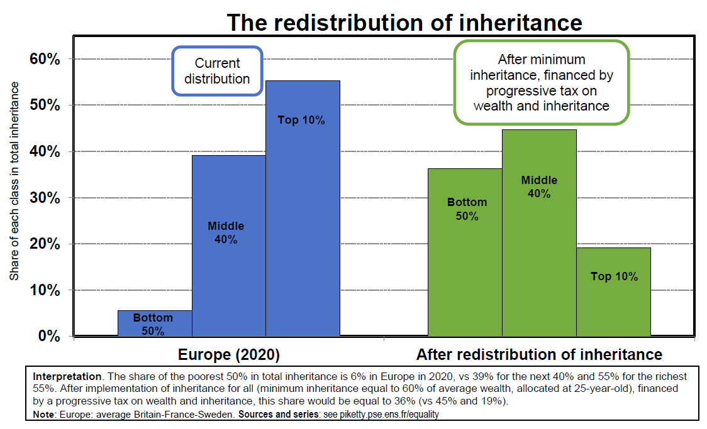

Slide 33
The (very) slow decline of gender inequality
Female suffrage: New Zealand 1893, Britain 1928, Turkey 1930, Brasil 1932, France 1944, Switzerland 1971, Saudi Arabia 2015…
Very slow access of women to high ranking occupations and high paying jobs. Without quotas/reservations, this might never work.
Female share in top 1% earnings in France: 10% 1995, 16% 2015, 50% in 2102?
Same slow evolution in the US
See DINA series for France and the US

Slide 35
Uneven state building in developing countries
In 15c-20c Europe, the process of state building has been a central and complex component of the process of modernization and socioeconomic development. It involves the construction of shared norms of trust and justice across territories and social classes.
In many world regions, e.g. Africa, Middle East, etc., the process of state building is still going on. And it is taking new routes in Europe (EU) and with the rise of transnational governance.
In low-income countries, state capacity declined during the 1980s-1990s due to accelerated trade liberalization (>> loss in trade tax revenues) without sufficient investment in alternative fiscal capacity
See Cage-Gadenne, « Tax revenues and the fiscal cost of trade liberalization (1792-2006) », EEH 2018

Slide 37
The return of central banks and money creation: a long-run view
Post-2008 money creation: back to central bank balance sheet size observed after WW1 and WW2
Central banks are the only public institutions which can create ressources instantaneously and intervene immediately if needed
Large post-2008 intervention: legacy of 1929 trauma
(post-Friedman consensus: both the right and the left concluded from the experience of 1930s that central banks should play a role of banker of last resort) (≠ orthodox liquidationist view)
(see M. Friedman, A Monetary History of the US 1867-1960, PUP 1963)
But the large post-2008 intervention also reflects a lack of consensus about other public policies: progressive taxation, Green New Deal, transnational democracy in Europe & elsewhere, etc. >> too much is asked to central banks

