Slide 1
Economic History (Master PPD & APE, Paris School of Economics) Thomas Piketty Academic year 2016-2017
Lecture 8: The rise of the fiscal, social and capital state
(check on line for updated versions)

Slide 2
Roadmap of lecture 8
State formation & government regulation in history
State power and extreme inequality regimes
State power and the evolution of ternary societies
The rise of the modern social and fiscal state
The rise and fall of tax progressivity
Why doesn’t democracy always lead to declining inequality?
Political beliefs & attitudes toward inequality
Regulating property: financial transparency & participatory governance
Organizing democracy: electoral & party systems, nations-states, federations, empires
History and the dimensions of political conflict

Slide 3
State formation & government regulation in historical perspective
The rise of the fiscal and social state (taxes<10% of national income Y until WW1, vs. 30-50% Y in all rich countries today) is a crucial evolution that we will adress today: from minimal state to educational, developmental and welfare state; major social, economic & political transformation
But: (1) In order to appreciate this transformation, one needs to look into aggregate taxes & spendings. Tax progressivity or regressivity? Who really benefits from public spendings?
We have seen many historical examples where the fiscal & social state has been used to reinforce elite domination rather than to reduce inequality. Key question: who controls the state & why?
Exemples. 19^{c}: fiscal system used to transfer ressources from average taxpayers to property owners (public debt, slave compensation, colonial coercion, etc.) (e.g. UK). 21^{c}: very unequal access to higher education spendings (meritocratic myth).

Slide 4
(2) The rise of fiscal & social state represents only one aspect of state formation & government regulation. As we’ve seen in this course, the general set of laws and rules enforced by govt can be even more important than the fiscal system and public spendings.
Basic civil & political rights: forced vs free labor, restrictions on mobility, occupational & voting rights (major historical role)
Property regimes: legal system shapes balance of power between owners & non-owners; public vs private property; workers rights & labor law (co-determination, unions); tenants rights & inheritance; intellectual property rights; monetary regimes & capital controls
→ there are many different complementary ways to evaluate the size & importance of governement regulation Exemple: should we look at share of govt tax revenues in national income Y, or at the share of govt property in national capital K?
China vs Europe: Chinese govt has smaller tax share in Y, but higher share in K ownership. Which state is most powerful?

Slide 5
Family vs government roles: conflict about marriage, fertility, gender, education, etc.
Political regimes and the organization of governement: electoral & party systems, nations-states, federations, empires
→ the capital & democratic state (the set of legal rules and institutions governing property, labor and political relations between individuals) encompasses the fiscal & social state and allows for a broader view of state formation & government regulation
During 21^{c}, just like in previous centuries, the evolution of fiscal and social institutions will be largely determined by the evolution of legal and political institutions: financial transparency & participatory governance; international legal systems; democracy vs automatic rules on property or debt; development of supranational (un)democratic institutions?

Slide 6
State power & extreme inequality regimes
Today we tend to view the state as a force to reduce inequality and enforce equal rights
However historically state power has often been used as a tool for the elite to enforce extreme inequality regimes, often based upon extreme forms of property: slavery, serfdom, forced labor
State power can still be used as a tool of elite domination today and in the future (possibly via more subtle forms than in the past: e.g. protection of wealthy via legal system, tax havens, gated communities and universities, etc.).
So it is important to put the study of state power and inequality into a broad historical perspective

Slide 7
If we look at countries with extreme inequality levels in the world today, we find that they are usually associated by an historical legacy of state-sponsored racial discrimination and rigid inequality of status.
South Africa. Apartheid until 1994, no right to property or mobility for 90% of the population, no redistribution since the end of Apartheid (no land reform, no wealth redistribution).
Brasil. Slavery until 1887 (last country to abolish slavery, with slaves = 30% of pop in 1887), huge regional disparities.
US. Slavery until 1865 in the South (40% of pop), legal racial discrimination until 1960s.
There are exceptions, but they also involve state power.
E.g. Middle East: the most unequal region in the world, due to different factors: geographical concentration of oil ressources, arbitrary frontiers drawn and protected by the West since 1916 (until recently…), role of sovereign wealth funds and global financial markets to transform oil rent into perpetual financial rent. Oil and finance can be more powerful inequality-generating mechanisms than slavery and racial discrimination.

Slide 8
If we measure income inequality at the level of the region taken as a whole, then the Middle East appears as the most unequal region in the world.
Top 10% income share ≈ 60% of total income in Middle East
(lower bound, i.e. assuming low within-country inequality)
≈ 35% in Europe, 45-50% in USA, 55-60% in South Africa or Brasil
This is due to huge inequality between Middle East countries, itself due to concentration of oil ressources in small territories with limited population. E.g. total educational investment of Egypt (80m pop) is 100 times smaller than oil revenues in UAE-Qatar (1m pop).

Slide 11
Ideally, the Middle East would need regional political integration and redistribution of oil and other ressources.
Very difficult to organize peacefully… especially if Western countries do everything they can to preserve the high-inequality status quo (support to oil regimes and gun trade rather than development).
Regional European funds: some redistribution from Western and Northern Europe to Eastern and Southern Europe.
Not a perfect system, but still a better mechanism than Egypt begging Saudi king.
But huge opposition to regional redistribution (big issue in Brexit campaign)

Slide 12
State power & the evolution of ternary societies
State power also played a key role in the organization of ancient societies into classes and castes. See Lecture 5 on the « trifunctional hypothesis » : Dumezil « Métiers et classes fonctionnelles chez divers peuples indo-européens », Annales ESC 1958 : « There is a common origin to all three-class Indo-European social structures: a clerical class, a warrior class, a commoner class (workers) »
There are large differences in ternary societies depending on religious ideology and family structures, e.g. depending on whether the clerical class can self-reproduce itself (Hinduism, Buddhism, Shia and Sunni Islam, Judaism) or not (Christianity), and whether the warrior class is ruling (easier to maintain higher prestige of the clerical class – Brahmans - in India because warrior class – Kshatryas - was often not ruling)

Slide 13
Other large differences are due to the complex and sometime incomplete process of « unification » of labour: the third class (commoners, workers) is sometime divided into two or three (peasants/rurals vs traders/craftsmen, or peasants/rurals vs traders/craftsmen vs untouchables), so that there four or five basic classes instead of three.
E.g. India: see Dumont, Homo Hierarchicus, 1966, on the origin of the caste system: Shudras used to be slaves or serves outside the three-class sytem who were finally integrated as a fourth basic class, while Dalits (untouchables) were left out as quasi-serves suffering massive prejudice and discrimination
See also discussion in Lecture 5 on the unification of labor in medieval Europe (M. Arnoux, Le temps des laboureurs)
See also the discussion on Meiji Japan the end of Burakumin discrimination: the developmental state can put an end to ancient discrimination (≠ India under British colonial rule)

Slide 14
Maybe the most important historical variation in ternary societies has to do with the interaction between the rise of centralized state power and the endogenous size of each social group: e.g. why does the elite sometime represent 1% and sometime 10% of the population?
E.g. the fact that the Indian warrior class was often not ruling (Muslim rulers) raised the relative prestige of clerical class (Brahmans) (Dumont). In the same way the lack of strong state power made it critical for elite groups (Kshatryas and Brahmans) to be numerically important (10-20%, rather than 1-2%, like French nobility in 1789) in order to enforce local domination over worker class
Evidence suggests that size of nobility declines with the rise of centralized state power in France and Europe between 1500 and 1800 (e.g. big reduction in size of nobility under Louis XIV in late 17c)
Rise of centralized state power can allow a smaller elite to rule, but at the same time it can facilitate the removal of this elite via Revolution (easier to get rid of a 1% elite than a 10% elite: end of European nobility vs relative perpetuation of Indian upper castes?)
Mechanisms behind engeogenous size of elite group: fertility behavior, marriage strategies, inheritance rules, entry rules, etc.
Difficult but not impossible to collect data to test such hypothesis

Slide 15
The rise of the modern fiscal & social state
During 20^{c}, huge rise of tax revenues (from 10% to 30-50% of national income Y) = rise of the modern fiscal and social state, partly as a response to high inequality generated by free market capitalism
This rise of the modern fiscal state corresponds both to a change in the form of taxation (from indirect & trade taxes to income taxes and social contributions) and to a change in the type of spending, i.e. the rise of the social state: rise in education, health & welfare spendings (pensions, unemployment insurance)
Since the 1980s-1990s: stabilisation of T/Y in all rich countries (regardless of political evolutions), but at different levels (Sweden > France > Germany > UK > US : here politics matters)
More on the different forms of taxes & spendings: see Lindert, Growing Public- Social Spending and Economic Growth since the 18th Century, OUP 2004, and Public economics course

Slide 17
This « great leap forward » of tax revenues from 10% to 30-50% Y is not going to happen again: during 21^{c}, tax revenues are likely to stabilize or to rise a little bit (or maybe to decline if rising tax competition & continuing anti-state ideological shift), not to rise again to 70-80% GDP
The 21^{c} challenge is probably not to make govt bigger (at least in rich countries); this does not mean that nothing can be changed; for a given T/Y, there are many ways to organize the structure of taxes and public spending, and there are many changes in regulatory, property and legal regimes that make an enomours difference; but this explains why the post-2008 legacy is complicated (both markets and govt were accused)

Slide 18
The rise and fall of tax progressivity
Tryptic of progressive taxation: income tax, inheritance tax, wealth tax
Little or no progressive taxation until WW1
General decline in tax progressivity since 1980s, in spite of the rise (or stabilisation) in total tax burden
Progressive income tax: basic pillar for financing public goods and social spendings (together with social contributions)
Progressive inheritance tax: lower tax revenue than income tax (say, <1% Y vs 10% Y), but important role to limit perpetuation & concentration of wealth & power in the same families
The US invented very steeply progressive taxation of income and inherited wealth in the 1920s-1930s, partly because the US did not want to become as unequal as Europe
See Fisher 1919 about the “undemocratic” concentration of wealth (top 2% owned 50% of US wealth at the time: less than in Europe, but already too much according to mainstream US economists of the time)

Slide 20
Over 1930-1980 period, top marginal income tax rate = 82% in the US
Extreme income tax progressivity at the very top is critical not so much to raise revenue, but mostly to keep top labor incomes and rent extraction under control
Top US & UK inheritance tax rates also reached 70-80% during 1930-1980 period, much more than in Germany and France (where wealth redistribution was largely carried out via other means: destruction, inflation, nationalization)
Progressive taxation = a US-UK invention
On the social, political and cultural history of taxation in the US and France, see Huret, American Tax Resisters, HUP 2014, and Delalande, Les batailles de l’impôt – Consentement et résistance de 1789 à nos jours, 2011
See also Beckert, Inherited wealth, PUP 2008

Slide 22
Why doesn’t democracy always lead to declining inequality?
In the US, rising inequality since 1980 did not generate a democratic reaction to raise progressive taxation & redistribution. Why?
Maybe not so surprising in light of Europe’s experience 1870-1914: huge inequality, universal suffrage, but strong & largely successful resistance to fiscal-social reforms by the economic & political elites until the 1914-1945 shocks
Main response given in recent work by US political scientists: capture of the political process by the wealthy

Slide 23
See Hacker-Pierson, Winner-Take-All Politics: How Washington Made the Rich Richer-and Turned Its Back on the Middle Class, 2010
Gilens, Affluence and Influence: Economic Inequality and Political Power in America, 2012; « Testing Theories of American Politics: Elites, Interest Groups, and Average Citizens », PoP 2014
Kuhner, Capitalism vs Democracy: Money in Politics and the Free Market Constitution, 2014
Bonica-Rosenthal, « Why Hasn’t Democracy Slowed Rising Inequality », JEP 2013; « The Wealth Elasticity of Political Contributions by the Forbes 4000 », WP 2015
Maybe work on political contributions & campaign finance more convincing than work on polarization

Slide 24
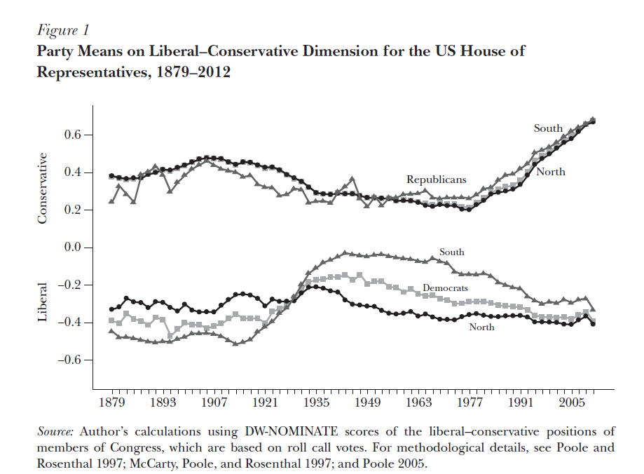

Slide 25
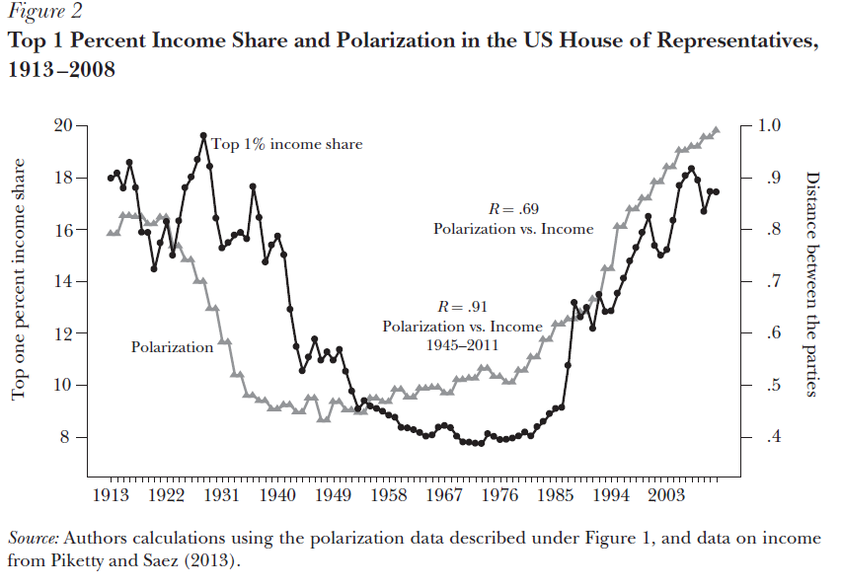

Slide 26
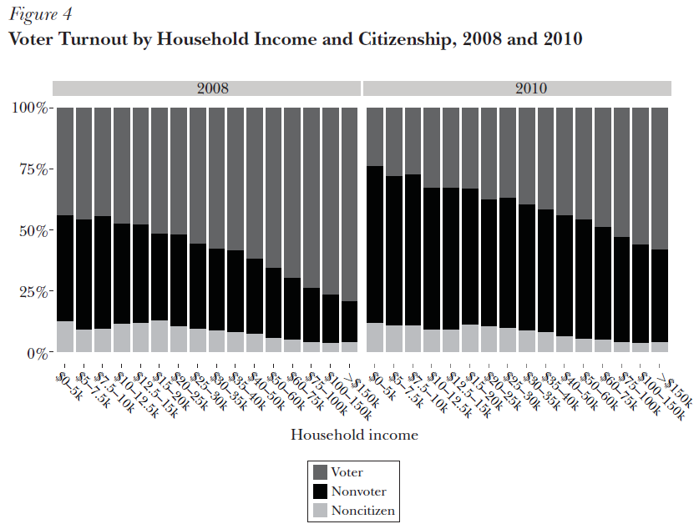

Slide 28
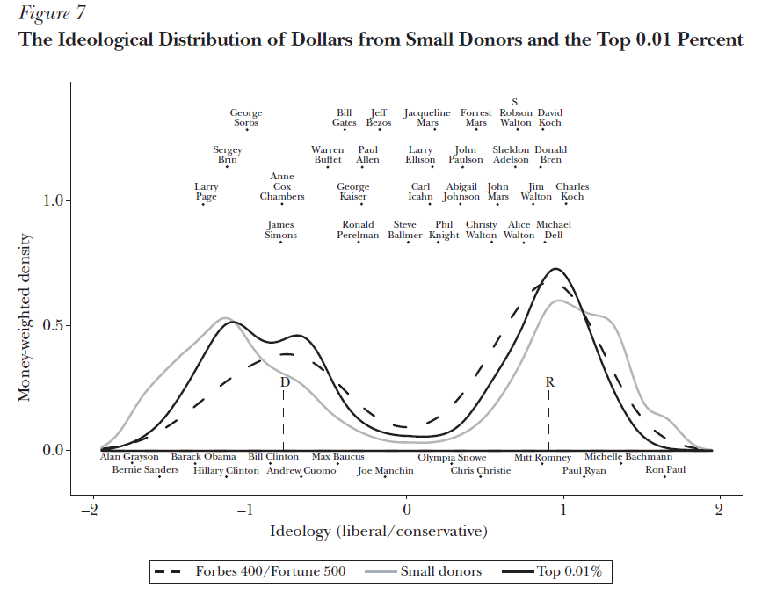

Slide 29
Political attitudes toward inequality
Capture by the wealthy: important but not enough
Beliefs about inequality involve self-serving beliefs, but also consistent narratives and sincere beliefs, or at least partly sincere beliefs (Arrighi: « power is the grey zone between coercion and consent; it requires moral leadership »; this is true both in international & domestic politics)
Beliefs systems also involve national identities and trajectories: US 1900-1920 did not want to become like Ancien Régime or Belle Epoque Europe; US 1990-2010 do not want to become like post-Soviet Europe
See Saez-Stantcheva at al, « How Elastic are Preferences for Redistribution? », AER 2015 : information about inequality can change views, but lack of trust in governement can be even more important

Slide 30
Regulating property: financial transparency & participatory governance
Progressive taxation and other institutions aimed at limiting the concentration of wealth and power (legal system, workers rights, etc.) should be viewed as complementary, not substitutes
By producing more transparency, progressive taxation can contribute to more democratic property relations and participatory governance
Progressive wealth tax: with imperfect k markets, progressive inheritance tax is not enough; also, independantly of inheritance, wealth can be a better indicator of ability to pay than income
In order to counteract high r for top w, top rates would need quite large (5-10% rather than 2-3%? = a big difference with previous wealth taxes)
But the main objective behind wealth tax is to deliver international financial transparency and global wealth registration: automatic exchange of information between countries, world registry of financial assets, public statistics on wealth, etc.; critical role for democratic debate

Slide 31
Organizing democracy: electoral & party systems, nations-states, federations, empires
Proper fiscal-social policies depends critically of the organization of the political process: electoral systems, party systems, bicameralism,etc.
Again, critical importance of national learning processes (France: long presidential/parliamentary/bicameralism cycles since 1789)
Limits of electoral competition: parties, social security funds, monarchy
With unanimity rule about fiscal decisions in Europe, there’s little chance to see a rise in tax progressivity and financial transparency
Current debates about Euro-zone Parliamentary Chambers: this is only the beginning… here again, there’s a lot to learn from historical experiences & non-nationalist perpectives

Slide 32
Reflections about the limit of nation-states, the need to develop new forms of supranational democratic institutions
See Beck-Grande, Cosmopolitan Europe, 2007 (Pour un empire européen, 2007)
See Cooper, Citizenship between Empire and Nation: Remaking France and French Africa, 1945-1960, PUP 2014; Africa and the World – Capitalism, Empire, Nation-State, HUP 2014
In 1945-1960, a number of African leaders (Senghor, Houphouët-Boigny, etc.) would have preferred a democratic federation with France, including one-man-one-vote representation in a federal Parliament in Paris
« With small African nation-states we will not be large enough to regulate global capitalist forces and to implement an equitable development strategy » → long constitutional discussions with France about new « French Union » → but French leaders were afraid to be put in a minority in such a federal Parliament… → A West Africa federation would probably have been a more realistic and viable strategy
→ An interesting historical episode to re-visit today’s European & global debates regarding federal political union

Slide 33
History, development & inequality: what have learned from this course?
Basic idea pursued during this introduction to economic history = how each country deals with inequality & property relations is central for the construction of a legitimate government, state formation, and the development process
Pb = each country tends to be self-centered (not enough learning from comparative and historical experience) + power of self-serving ideology (without large political or international shocks, elites are very resistant to change)
Domestic property relations (forced labor, etc.) used to play central role in historical inequality regimes. With globalisation, international property relations have come to play key role during 18^{c}-21^{c}. They are particularly complicated to regulate peacefully.
Learning to live with inequality, beliefs systems about the ideal institutions: the dimensions of political conflict

Slide 34
The dimensions of political conflict
Political regime (organization of government: monarchy, democracy, empires, automatic rules, restraint on govt). La question du régime politique.
Foreigners vs citizens (frontiers, national identity, basic civil and political rights, etc.). La question de l’étranger.
Family (marriage, children, education, perpetuation of inequality, etc.). La question de la famille.
Property (regulation of relations between capital & labor, public vs private property, taxation and public services, etc.). La question de la propriété.
A complete study of these different dimensions goes well, well beyond the scope of this course. But preparing this course helped me to think more about these issues. I hope it helped you as well.
Thank you for your attention !

