Slide 1
Economic History (Master PPD & APE, Paris School of Economics) Thomas Piketty Academic year 2016-2017
Lecture 7: Money, finance and crisis in historical perspective
(check on line for updated versions)

Slide 2
Roadmap of lecture 6
Business cycles in historical perspective
The Great Recession vs the Great Depression
Rising inequality & the financial crisis
What do central banks do?
Central bank balance sheets in the long run
Financial globalization in action: gross foreign assets and liabilities vs net positions
Money & inflation in history
Financial development & regulation in history

Slide 3
Business cycles in historical perspective
Until now the course focused upon long run evolutions: growth, capital accumulation, inequality of labor income & capital ownership, slavery & forced labor, historical demography & family structures
Today we focus upon short run evolutions, recessions & crisis, money & finance
Per capita world GDP growth 1913-2012: 1.6%
(≈1.5% 1990-2015) (+ ≈1.5% pop growth) (= world g ≈ 3%)
But there are always very large short run variations: in practice, growth is not a steady process; we always observe a sequence of booms and recessions, with large deviations around the mean growth rate = the « business cycle »

Slide 4
The Great Recession = GDP fall of about 5% in all major developed economies in 2008-2010
= the biggest world recession since WW2
(usually recessions involve -1%/-2% output contractions at most, or simply a lower positive growth, and they do not happen everywhere at the same time)
≠ The Great Depression = GDP fall of about 20-30% in all major developed economies in 1929-1933
→ rise of Nazism, WW2
→ major trauma in world history & economic thinking
→ rise of postWW2 Keynesian demand management and growth stabilization policies, rise of government, complete change of attitudes towards laissez-faire capitalism & self-regulated markets (Keynes 1936)
Govt: small in 1929, large in 2008 → more complex legacy after 2008 crisis: both makt & govt were accused

Slide 8
Was the Great Recession really smaller than the Great Depression, and why?
In the major developed economies (US, Germany, France, Japan, Britain, etc.), the Great Recession was indeed much smaller, and the recovery was faster (about 5% GDP drop 2008-2009). Unlike in 1929, central banks took action in 2008 so as to avoid the complete collapse of the financial sector.
But starting in 2009-2010, the Great Recession was followed by the Euro zone public debt crisis: lack of confidence in single currency with 19 different public debts, housing bubbles and interest rate speculation in Southern Europe:
Euro-zone: 2015 GDP close to 2007 GDP = lost decade (whereas US 2015 GDP/2007 GDP = +10%) (Long Stagnation)
in Italy/Spain/Portugal 2015 GDP is 5-10% below 2007 GDP
in Greece, 2015 GDP is 25% below 2007 GDP = as big as the Great Depression (but in a much smaller economy)

Slide 13
Rising inequality & financial crisis
« Keynesian » account of 1929 crisis: declining labor share & rising inequality in 1920s, imbalance btw demand & supply → recession, rise of « Fordist » model: workers need to be paid enough in order to be able to purchase cars → postWW2 growth model
Similar story for 2008 financial crisis: rising top income shares and stagnant median incomes have probably contributed to rising household debt and financial fragility in the US (and possibly also to current account deficit) (see Kumhof-Rancière-Winant 2013)
Also the rise in the capital share may have contributed to a rising current account surplus in a number of countries (e.g. Germany) and therefore to global imbalances; see Behringer-Van Treeck 2013

Slide 14
But: Europe’s financial system is also very fragile (in spite of the fact that top income shares ↑much less than in the US), so rising inequality cannot be the only explanation for macro-financial instability
Other factor: the rise of wealth-income ratio and of cross-border gross financial positions, i.e. financial globalization with insufficient policy coordination
Modern financial systems are inherently unstable, & can crash even without rising inequality: there is structural financial instability, which requires careful financial regulation & central bank intervention, with or without rising inequality

Slide 15
Why was the Great Recession so cataclysmic?
Combination of factors:
Central banks decided to let banks collapse one by one; « liquidationist » view of recessions: bad banks must fail… but this led to complete collapse of economy and society
Global trade collapse, rise of trade tariffs & protectionism
Absence of « automatic stabilizers »: unemployment insurance, social transfers, welfare state, public sector, etc.
Conversely, there is evidence that output volatility has become structurally smaller in the post-1945 period than in the 19^{c} and interwar period: impact of « automatic stabilisers », & more pragmatic monetary policy (central banks as lenders of last resort, end of liquidationist view)
There is some disagreement about the relative importance of the different factors; but everybody now agrees that central banks should never make the same mistake again

Slide 16
However the view that we have now learned to deal with recessions in a socially harmless manner is exagerated:
Reduced volatility partly comes from data problems (pre-1945 GDP estimates might be excessively volatile)
Great moderation of 1980s-2000s was largely an illusion
Business cycles still exist and they hurt
See US macro historical series: GDP volatility indeed seems to be higher before 1950 (recessions around -5/-10%, booms around +5/+15%) than post 1950 (-2/-3% vs +4-5%); but unemployment cycles still alive: unemployment rate can go from 3-4% to 10-12% in a few years; this is clearly involontary unemployment
Central banks are not equipped so solve all problems

Slide 18
Slavery in historical perspective
US, Brasil, Greece, Rome.

Slide 20
Rheinart-Rogoff, This Time is Different: Eight Centuries of Financial Folly, PUP 2009
Historical perspective on financial, public debt and banking crisis: public and private actors always find reasons to believe that « this time is different »
Exemple: US conventional thinking in 2004-2007: global saving glut & US superior financial system → housing & financial bubble is justified & sustainable
But in practice financial crisis come back again and again; & banking crisis always end up causing large rise in unemployment & public debt
Except in 1950-1980: no major banking crisis because of financial regulation? Or « financial repression »? I.e. private banks forced to purchase public bonds, etc.
Rheinart-Rogoff point out that post-1980 financial deregulation contributed to the return of banking crises, but they are not entirely clear about optimal financial regulation vs repression

Slide 21
Friedman-Schwartz, A Monetary History of the United States 1867-1960, PUP 1963 = new interpertation of 1929 crisis = « all what we need is a good Fed in order to preserve financial stability & stable inflation; we do not need any welfare state »
Monetary policy yes, welfare state no; central bank as lender-of-last-resort yes, New Deal no
Monetarist revolution (what matters is monetary stability & low inflation): very powerful political message in US 1960s-70s
Maybe we want both: a good Fed & a good welfare state?
Modern consensus: central banks as lenders of last resort, accepted by both right-wing & left-wing parties
After 2008 crisis, very fast response of monetary policy: interest rates down to zero, quantitative-easing policies (QE)
→ central banks printed currency in order to avoid complete collapse of the private financial system & public finance
→ huge increase in central banks balance sheets
→ but what do central banks do exactly ?

Slide 22
What do central banks do?
By definition, central banks create money (bank notes & immaterial currency) & lend it to other economic actors: banks, firms, govt, households (usually not directly)
In normal times, central banks lend money mostly to banks, and mostly over very short durations (one day, one week, one month, three months, etc.)
Justification: over short run horizons, private banks are never fully balanced (withdrawals & deposits are huge and not exactly equal for each bank); usually this balances out over slightly longer run horizons
After 2008 crises, private banks started to experience longer run liquidity problems & central banks started to lend money over much longer run horizons: 6-months, 1-year, 5-years, etc. (QE)
Central banks balance sheets are still modest as compared to national wealth balance sheets (W/Y≈600-700%), but are getting bigger & bigger:<10% Y before 2008, 20-30% Y 2015
→ but how far will this go ?
→ monetary policy vs other forms of government policies?

Slide 23
Analyzing central bank balance sheets
When central banks expend their balance sheet (i.e. create more money in order to purchase broader classes of public and/or private financial assets) (=what recently came to be called « quantitative easing », QE), this has no immediate impact on national wealth: by definition, the new financial assets and liabilities are exactly equal, so net national wealth (and national income) are unchanged
To the extent that the new lending allows to avoid bankruptcies & soften the recession, then money creation can in the end contribute to raise national income and national wealth
But if the new lending does not go to the right actors, it could aggravate the recession & reduce national income and wealth
Central banks have infinite power to redistribute wealth, but not to create new wealth: depending on how they use this power, they can raise or reduce national wealth → this infinite power needs to be carefully regulated

Slide 24
Before 2008, ECB balance sheet was less than 1tr € (1 trillion = 1 000 billions = 1 000 000 millions); it is now over 2.5tr €, and rising fast
Before 2008, Federal Reserve balance sheet was also less than 1tr $; it is now almost 4.5tr $, and stable
In a few weeks after september 2008 (Lehman), both the Fed & the ECB each created around 1tr $ & 1tr €
These absolute amounts look very large, but it is important to compare them to GDP: in effect, central bank balance sheets have increased from 10% of GDP to 20-30% of GDP in US, EU, UK, Japan
This is a very large policy intervention: only central banks can mobilize such large ressources in such a short time; this would be impossible to do with the tax system (rule of law)
But this is still relatively small as compared to national balance sheets (national capital sock = 600-700% GDP)
Central banks publish their balance sheets each week; let’s have a look

Slide 25
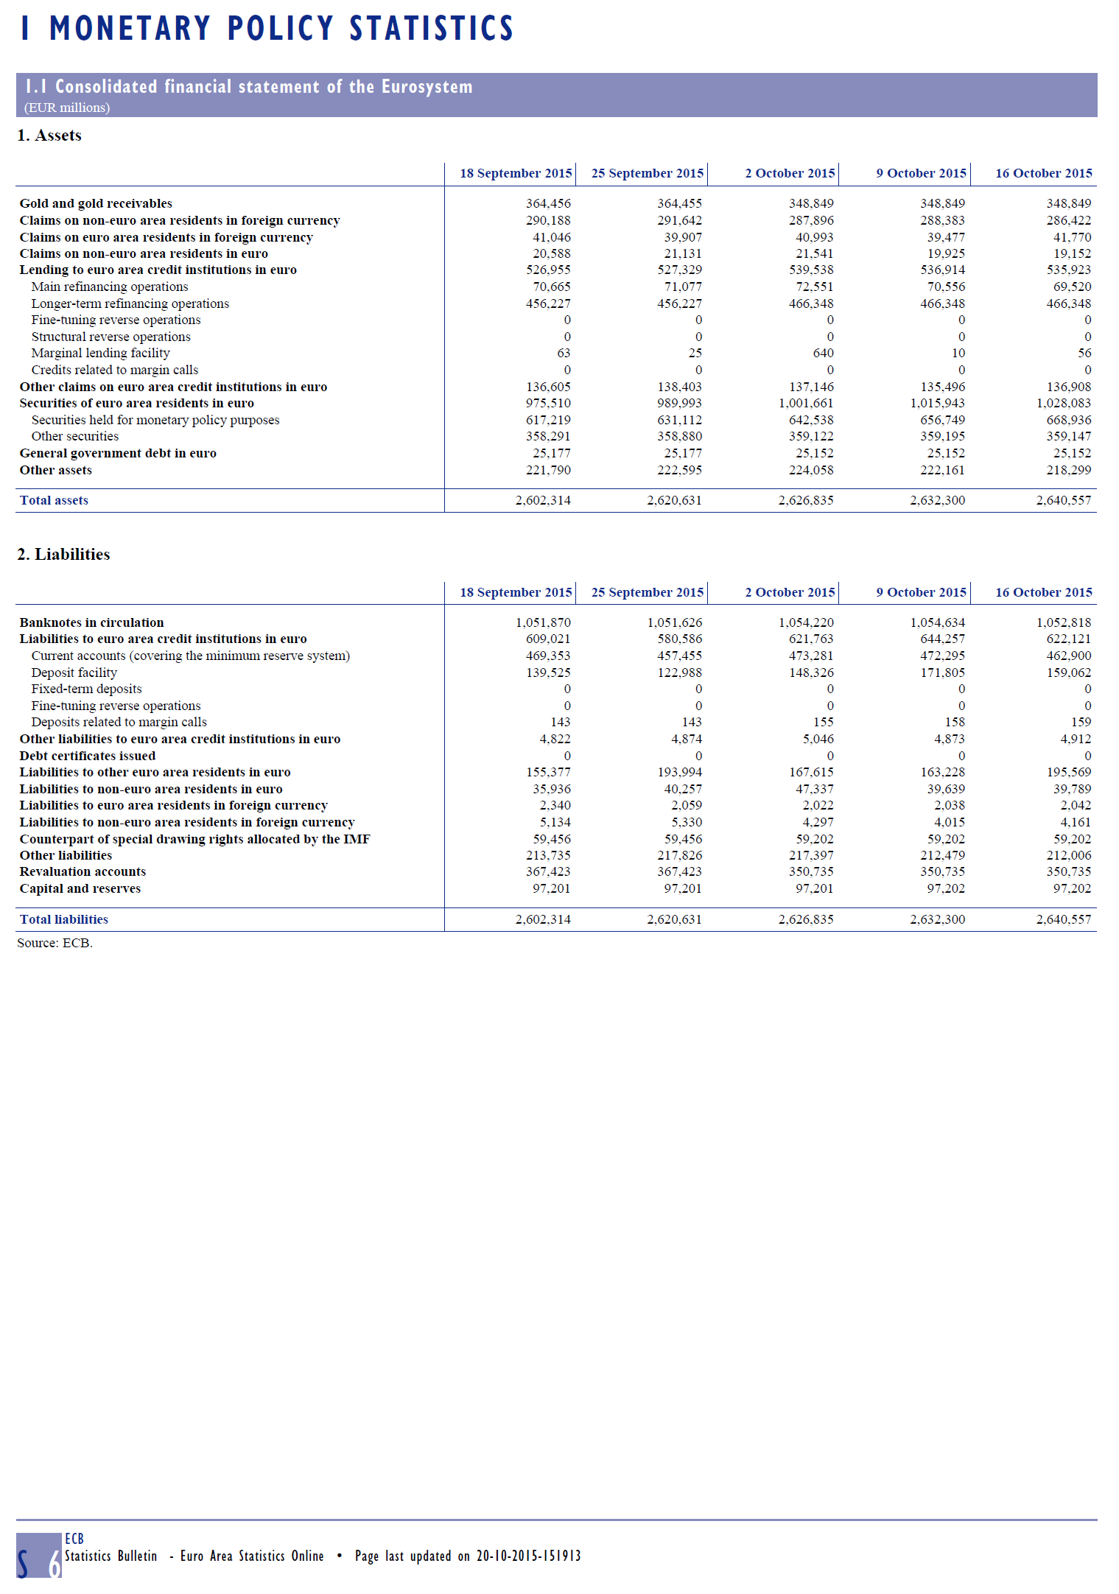

Slide 26
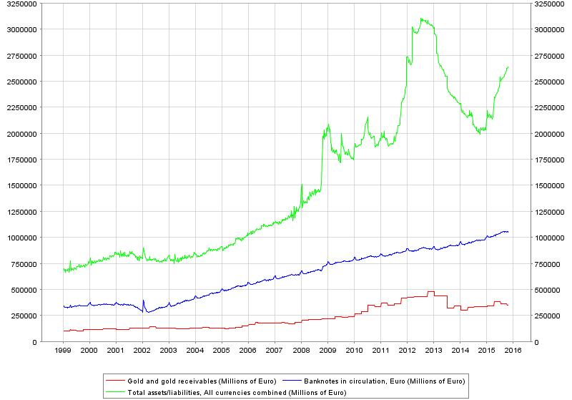
ECB Balance sheet: weekly series (www.ecb.europa.eu, 26-10-2015) Note: EZ GDP: 7.8tr€ 2000, 9.4tr€ 2008, 10.2tr€ 2015 I.e. ECB balance sheet size ≈ 10% GDP 2000, 12% 2008, 25% 2015

Slide 27
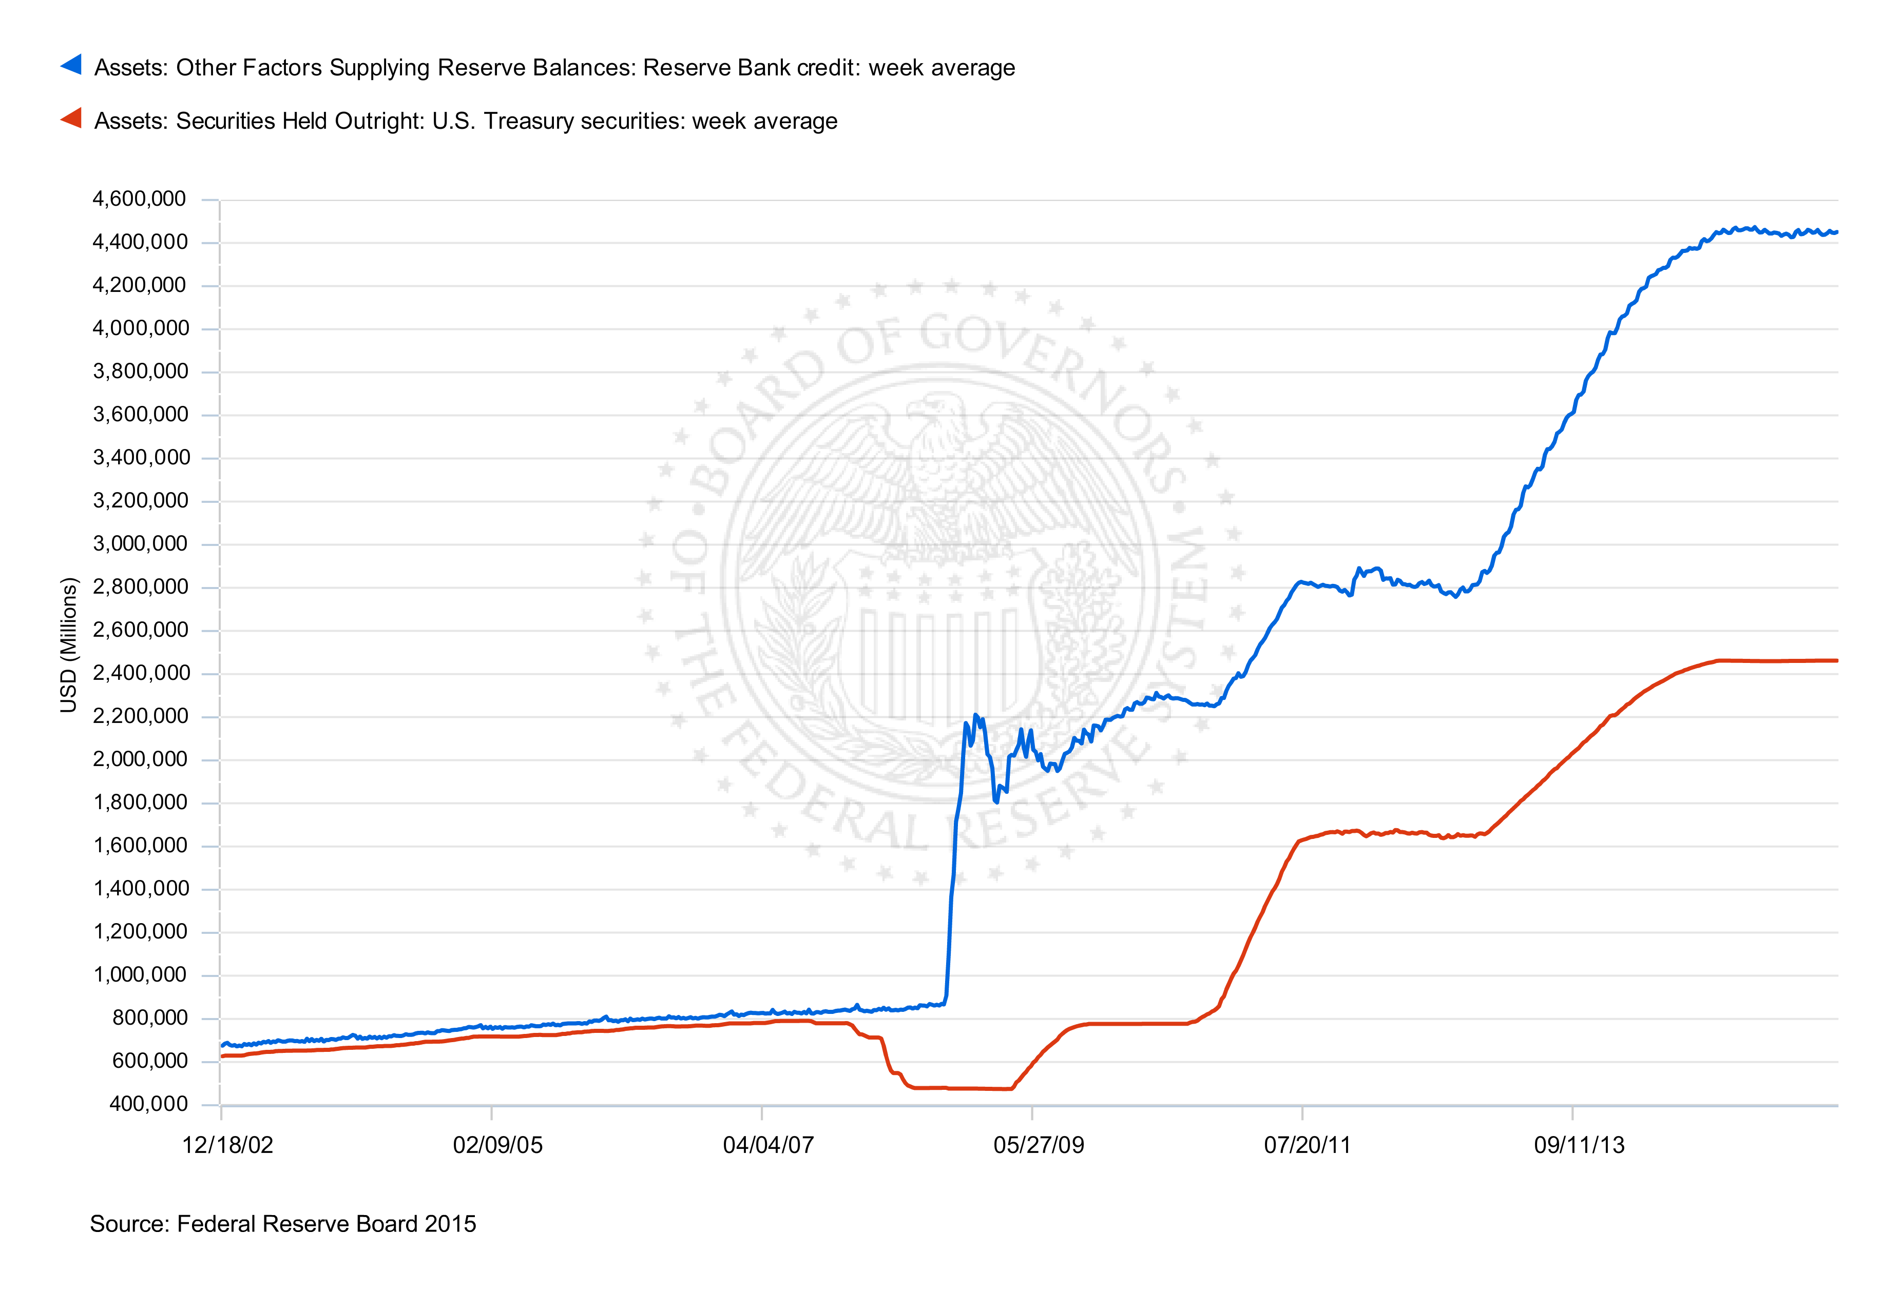
Fed Balance sheet: weekly series (www.federalreserve.gov , 26-10-2015) Note: US GDP: 11.0tr$ 2002, 14.7tr$ 2008, 17.5tr$ 2015 I.e. Fed balance sheet size ≈ 7% GDP 2002, 15% 2008, 25% 2015 (incl. >half in US treasury bills)

Slide 30
In principle, central banks could print enough money to buy the entire national capital sock (600-700% GDP): printing money is simple → but what would be the associated democratic governance system if central banks were to own entire economy?
With 20-30% of GDP in assets rather than 10%, this already raises serious governance issues
One key issue: should central banks purchase public or private financial assets? US-UK-Japan vs Euro-zone
It is easy to agree about the short-run interest rate (policy interest rate); but agreeing about 10-year interest rates on vast quantities on public or private debt from different countries is another issue → major divergence between Euro-zone interest rates in 2010-11, with insufficient ECB action until 2012 to stabilize the process → major recession in Southern Europe (other reason: excessive public and/or private debt before 2008)
For an attempt to quantify the respective role of insufficient ECB action & excessive prior debt, see e.g. Martin-Phillippon 2015

Slide 31
From C. Romer, « The aftermath of financial crises: each time really is different », John Hicks Lecture, 2015

Slide 32
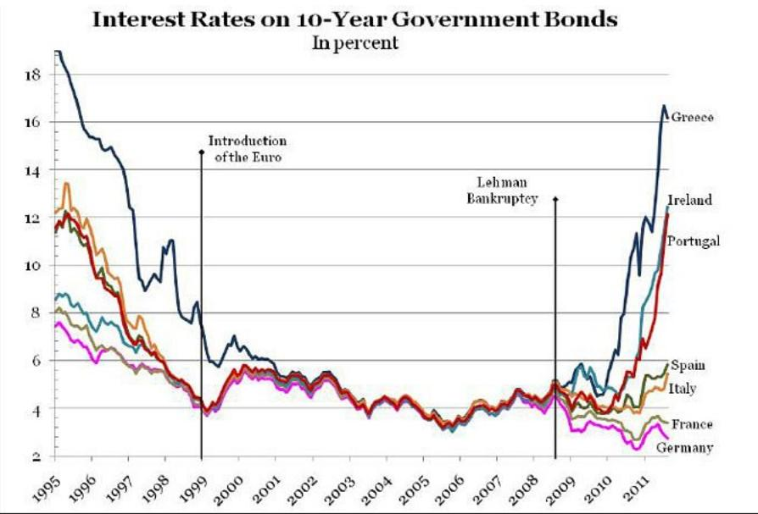

Slide 33
Central bank balance sheets in history
Is recent rise in central banks balance sheet unprecedented?
No. History suggests that central bank balance sheets could get even bigger in the future. Especially given that this is one of the only policy tools on which there is consensus & adequate majority-based decision making rules: there is little consensus on common tax or spending policy in EU right now, & even less on new political institutions (though this would probably the right solution); in the meantime, at least ECB can take majority decisions
Look at Bank of England & Banque de France balance sheets over 1810-2010 period
England: post-2008 reaction bigger & faster than post-1929, but comparable to 1940s-1950s
France: balance sheet reached 100% GDP during 1940s → 50% inflation rates in 1945-1949? Not automatic.
More historical work on central banks balance sheets is highly needed; lack of transparency in monetary policy is a major pb, including in recent asset expension by Federal reserve and ECB

Slide 36
Should monetary expansion necessary lead to consumer price inflation? Not necessarily.
If new money creation is used to purchase existing assets rather than to consume or invest, then it might just lead to asset price inflation (housing or stock market bubble): in spite of huge QE, Euro zone is still close to consumer price deflation (=very dangerous)
And if monetary expansion involves no redistribution at all between actors, then it might lead to no inflation at all
Simple theoretical exemple: assume K/Y=600% (say, pure housing capital stock, with r=5%, so that α=30%), and that the central bank decides to print 300% Y in money in order to buy half of the capital stock
Q.: What will happen?
A.: It all depends on what the central bank does with the rental income it now receives (15% Y). If it used to replace the tax revenue previously paid by capital owners (assume that they were paying half of their rental income in taxes), then by definition nothing happens.
→ Central banks can redistribute wealth (very fast, but very crudely); they can have an impact if they redistribute between heterogenous agents, e.g. btw liquidity-constrained firms and cash-heavy agents; with representative-agent models, it is very difficult to assess their impact

Slide 37
Gross vs net foreign assets: financial globalization in action
Net foreign asset positions are smaller today than what they were in 1900-1910
But they are rising fast in Germany, Japan and oil countries
And gross foreign assets and liabilities are a lot larger than they have ever been, especially in small countries: about 30-40% of total financial assets and liabilities in European countries (even more in smaller countries)
This potentially creates substantial financial fragility (especially if link between private risk and sovereign risk); this destabilizing force is probably even more important than rising inequality (→Europe’s fragility)
If we compare the rise of central bank balance sheets with the general rise of financial assets & liabilities (domestic + cross-border), then the new size and scope of central banks look much less impressive

Slide 47
Money and inflation in history
Until 1914-1929, gold standard: currency was tied to gold (and silver: bimetallism)
On pb with Gold standard: in the long run there’s no reason to expect gold stock to rise at the same speed as world GDP → risk of structual deflation or inflation
Existing estimates suggest that total world gold stock was 20% world GDP in Antiquity, 10-20% in 19^{c}, and 6% today (but large variations: only 2% in 1970s) (see Capital 21c, appendix chap.5)
20^{c}: invention of paper money (& then digital money) and of sustained inflation
Inflation: close to 0% in 1815-1914 in rich countries, very high during 20^{c}, down to about 2% over 1990-2015

Slide 49
Pre-19^{c} inflation via debasement was non-negligible: average silver content of European currencies was divided by 2.5-3 between 1400 & 1800
« The long march toward fiat money » (Reinhart-Rogoff 2009, chap.11)
Interesting, but note that 3^{1/400} = 1.002, i.e. this corresponds to (at most) 0.2% inflation/year; large but infrequent debasement of 20-50% when monarchs want to get rid of their debt, zero inflation the rest of the time
19^{c} = only period with monetary sacralization (private property sacralization, Polanyi)

Slide 50
Financial regulation in history
Financial regulation is not only about short-run crisis: it also involves structural, long-run issues
Financial development: central component of economic and social development
See Hoffman-Postel-Vinay-Rosenthal, Priceless Markets: The Political Economy of Credit in Paris, 1660-1870, 2001; Surviving Large Losses: Financial Crises, the Middle Class, and the Development of Capital Markets, 2009
And proper financial devt requires proper financial regulation
See Ott, When Wall Street met Main Street: The Quest for an Investors’ Democracy, 2011; Hyman, Debtor Nation – The History of America in Red Ink, PUP, 2013

Slide 51
About the long run evolution of the financial sector, see also Philippon, T., A. Reshef, “Wages and Human Capital in the U.S. Financial Industry: 1909-2006,” QJE 2012; Philippon, T., « Has the US Finance Industry Become Less Efficient? », AER 2015
Huge rise of financial sector size and relative wages during 1980-2008 period is very difficult to explain on the basis of productive services to the real economy; this seems to have more to do with excessive financial deregulation & rent extraction of banking sector from the non-financial sectors
Is new financial regulation & downsizing observed since 2008 enough? Not clear yet

Slide 52
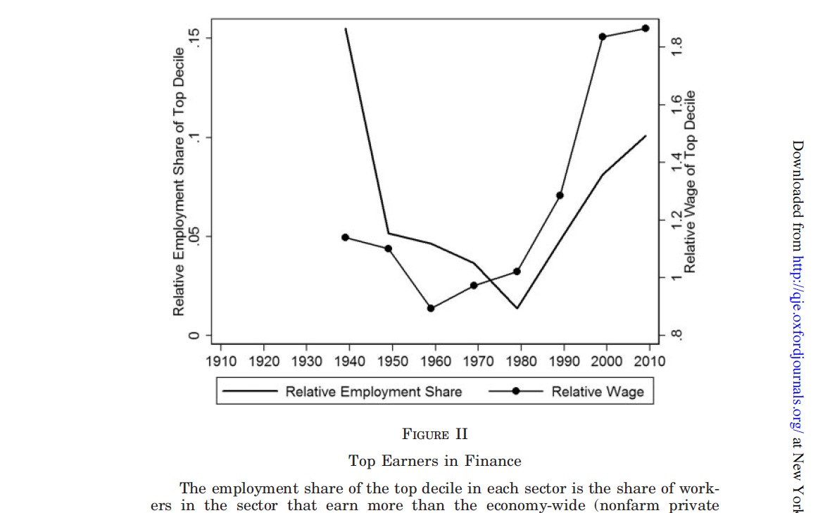

Slide 53
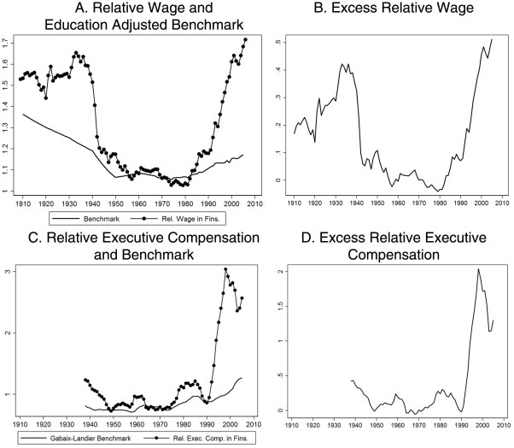
FIGURE X
Financial Sector Wage Premium: Historical Evidence

Slide 54
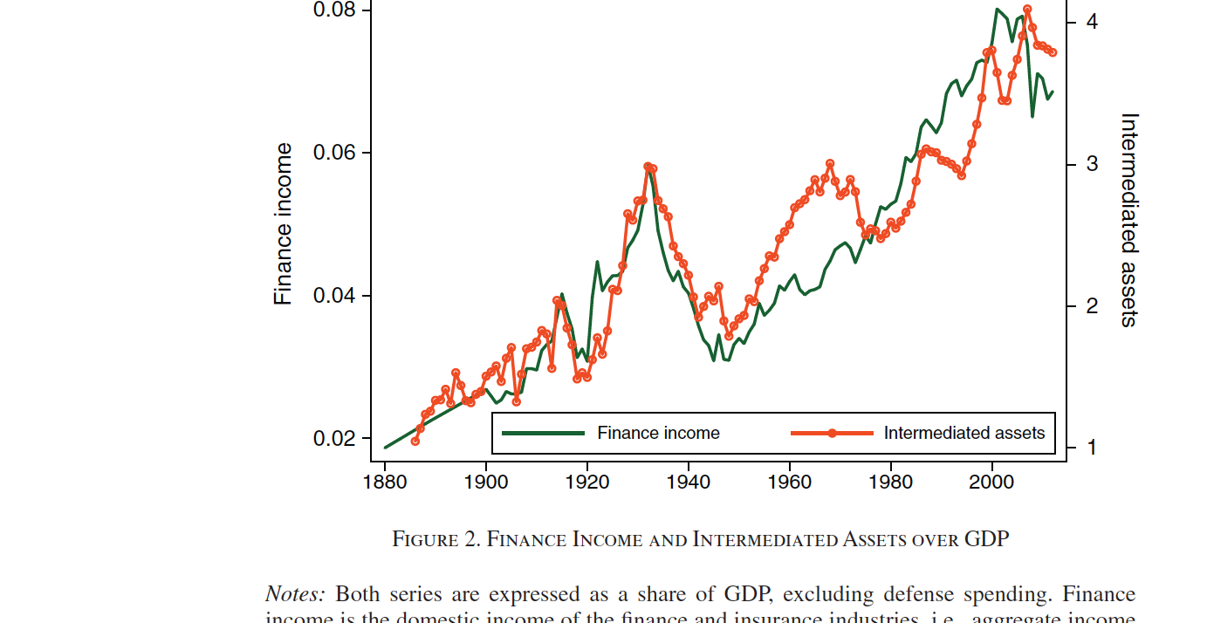

Slide 55
