Slide 1
Economic History
(Master PPD & APE, Paris School of Economics)
Thomas Piketty
Academic year 2016-2017
Lecture 3: The dynamics of capital accumulation: private vs public capital and the Great Transformation
(check on line for updated versions)

Slide 2
Roadmap of lecture 3
The measurement of national wealth
The very long run: Britain and France, 1700-2010
The rise and fall (and return?) of foreign assets
Private vs public capital: the Great transformation
France, Britain, Germany, US: similarities & diffs
Market vs book corporate values: capital & power
Property regimes in history: from feudal to social
Natural capital and environmental damage
Intellectual property and the public domain
From capital-income ratios to capital shares

Slide 3
A quick summary of lecture 3
Today we study the historical evolution of capital accumulation
Brief consensus during 1950s-1980s: steady-state balanced-growth model, constant capital-output ratios β=K/Y and capital shares α=Y_{K}/Y
However if we take a longer run historical perspective, we find large variations in both β and α, due to many economic and political factors
Main lesson: asset prices and capital shares depend on the state of property relations, legal systems and bargaining power
« The Great Transformation » (Polanyi 1944): radical changes in attitudes toward private property during 1914-1945 period: Great depression, bolshevik revolution, etc.
1980s-1990s: fall of communism, financial deregulation, etc.: return to 19^{c} private-property-sacralization regime? Yes to some extent, but not so simple

Slide 4
The measurement of national wealth
Long tradition of national wealth estimates in Britain and France in the 18th-19th centuries: Britain: Petty, King, Giffen, etc.; France: Vauban, Lavoisier, Colson, etc. (see Giffen 1889)
National balance sheets = estimates of all assets and liabilities held by residents of a country (and by the government) (« Bilans patrimoniaux par pays ») (see Goldsmith 1985, 1991)
Historical estimates are not sufficientely precise to study short-run fluctuations; but they are fine to study broad orders of magnitudes and long-run evolutions
Recent estimates can be used to study short-run fluctuations: return to national balance sheets since 2008 financial crisis
See official UN methodological guides for measurement of national income and wealth: System of National Accounts 2008
See Piketty-Zucman « Capital is Back – Wealth-Income Ratios in Rich Countries 1700-2010 », QJE 2014, Data Appendix, Database, for detailed bibliography and methodological issues

Slide 5
The very long-run: Britain and France 1700-2010
Longest series: Britain and France national wealth/national income ratio β_{n}=W_{n}/Y over 1700-2010
National wealth W_{n} = Private wealth W + Public (or government) wealth W_{g}
W_{n} = Domestic capital K + Net foreign assets NFA
Domestic capital K = agricultural land + residential housing + other domestic k (=offices, structures, machines, patents, etc. used by firms and administrations)
Two major facts: (1) huge U-shaped curve: β_{n}≈700% over 1700-1910, down to 200-300% around 1950, up to 500-600% in 2000-2010
(2) Radical change in the nature of wealth (agricultural land has been gradually replaced by housing, business and financial capital), but total value of wealth did not change that much in the very long run

Slide 6
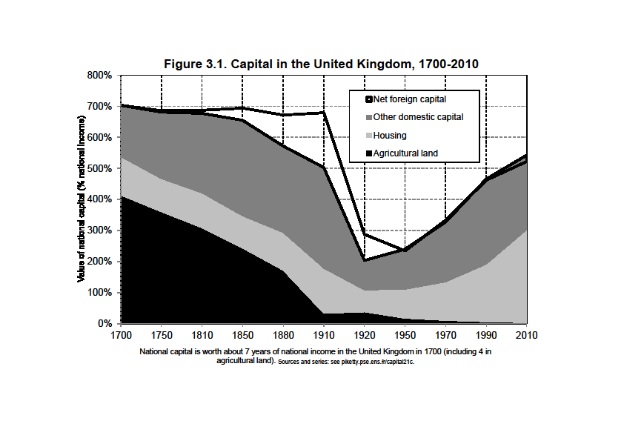

Slide 7
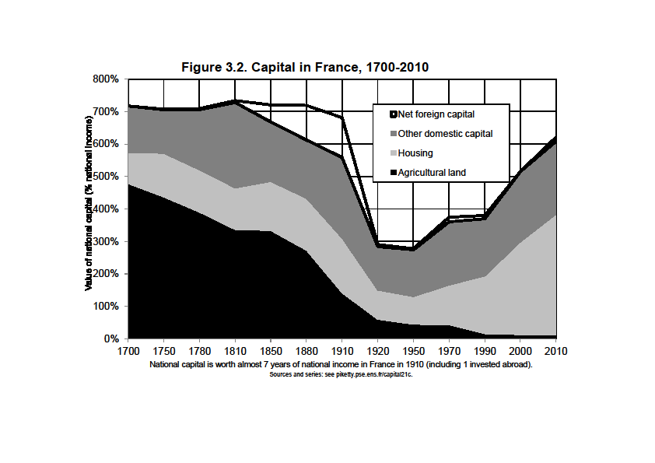

Slide 8
The rise and fall of foreign assets
NFA close to 0 in 1700-1800 and 1950-2010, but very large in 1870-1910 = the height of the « first globalization » and of colonial empires
In 1910, NFA≈200% of Y in UK, ≈100% in France
These enormous net foreign assets disappeared between 1910 and 1950 and never reappeared (but large cross-border gross positions developed since 1970s-80s: « second globalization »)
2010: Y ≈ 30 000€, W_{n} ≈ 180 000€ (β_{n}≈ 6), including 90 000€ in housing and 90 000€ in other domestic k (financial assets invested in firms and govt)
1700: assume Y ≈ 30 000€, then W_{n} ≈ 210 000€ (β_{n}≈ 7), including 150 000€ in agricultural land and 60 000€ in housing and other domestic capital
1910 (UK): assume Y ≈ 30 000€, then W_{n} ≈ 210 000€ (β_{n}≈ 7), including 60 000€ in housing, 90 000€ in other domestic capital and 60 000€ in net foreign assets

Slide 9
With NFA as large as 100-200% Y, the net foreign capital income is very large: around 1900-1910, as large as 5% Y in France and 10% Y in Britain (average rate of return r=5%)
In effect, both countries were able to have permanent trade deficits (about 2% Y in 1870-1910) and still to have a current account surplus and to accumulate more foreign reserves; i.e. they were consuming more than they what were producing, and at the same time they were getting richer
Today’s NFA for Japan-Germany-China (50-100% Y) are smaller than Britain-France 1910, but are rising fast (more on this below, see figures 1970-2010)
Three conclusions: (1) it’s nice to be a owner; (2) there’s no point accumulating trade surpluses for ever; (3) capital & property relations are also about power

Slide 10
The return of foreign assets ?
How big were foreign assets in 1913, and how do they compare to today? Some simple computations (see Capital…, chap.1)
In 1913, rich countries (Europe-America) made about 70% of world GDP, but about 75% of world income; poor countries (Asia-Africa) made about 30% of world GDP, but 25% of world income; this would mean that about 15% of poor countries’ output output went abroad, i.e. 50% of their k income (assuming k share ≈ 30% GDP ): rich countries owned about 50% of poor countries capital in 1913
Today: in Africa, GNI/GDP ratios have fluctuated around 95% over 1970-2010 period according to WB series; this would mean that rich countries own about 20% of Africa’s capital today (and maybe 30-50% if we exclude housing & land) (aid flows here)
Very approximate, ignores tax havens, includes only official flows

Slide 11
Gross vs net foreign assets: financial globalization in action
Net foreign asset positions are smaller today than what they were in 1900-1910
But they are rising fast in Germany, Japan and oil countries
And gross foreign assets and liabilities are a lot larger than they have ever been, especially in small countries
This potentially creates substantial financial fragility (especially if link between private risk and sovereign risk)
This destabilizing force is probably even more important than the rise of inequality: see lecture 6
The structural evolution of NFA is determined not only by volume effects (trade & income balance) but also by price effects: capital gains and losses on foreign assets & liabilities (see PZ QJE 2014 and Gourinchas-Rey 2007)

Slide 12
Private versus public wealth
National wealth W_{n} = Private wealth W + Public wealth W_{g}
Private wealth = private assets – private debt
Public wealth = public assets – public debt
Today, in most rich countries, public wealth close to 0 (public assets ≈ public debt ≈ 100% Y), and private wealth ≈ 95-100% of national wealth
But it has not always been like this: sometime the govt owns a significant part of national wealth (20-30% in 1950s-60s in W. Europe; 80% in USSR); sometime govt wealth<0 (huge debt), so that private wealth is significantly larger than national wealth

Slide 13
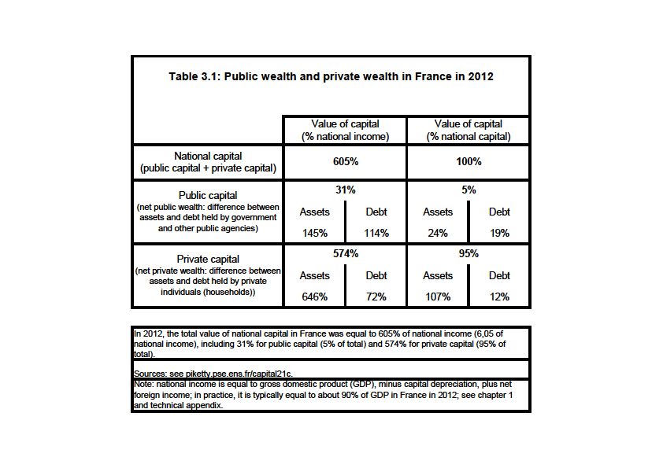

Slide 14
Britain: public debt and Ricardian equivalence
Britain = the country with the longest historical episodes of public debt: about 200% of Y around 1810-1820 (it took a century to reduce it below 50% by 1910, after a century of budget surpluses), and about 200% of Y again around 1950 (it was reduced faster, thanks to inflation)
Big difference with France (large inflation and/or repudiation during 1790s & World Wars 1 and 2) and Germany (the country with the largest inflation in 1910-1950, even excluding 1924)
Britain always paid back its debt (limited inflation, except 1950-1980); this is why it took so long to reduce debt, especially during 19c

Slide 15
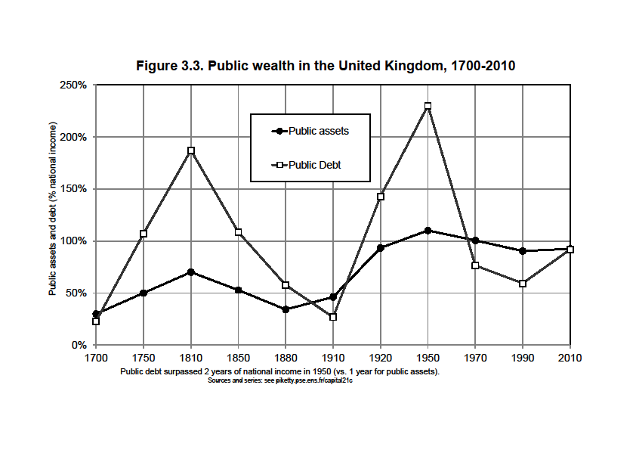

Slide 16
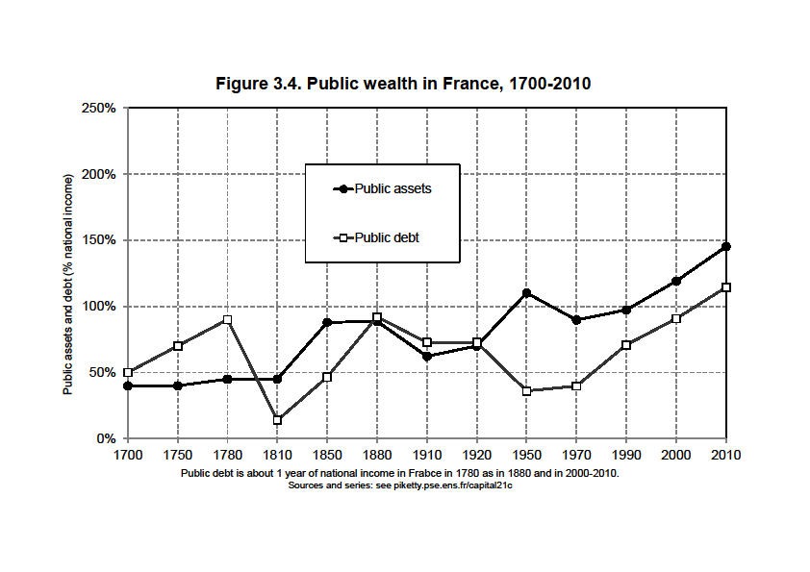

Slide 17
War tributes, debt & state coercion
Rise of public debt in France 1815-1880: war indemnities 1815 + « milliard des émigrés » 1825 (compensation to aristocrats for lost land rent during Revolution) + war tributes to Germany 1870 (about 30% Y in 1815-1825 + 30% Y 1871=most of the rise)
War tributes are very common in history, particular in the context of colonial coercion: France and Spain against Morocco, Britain and France against China (see Truong 2015), etc.
19^{c} = Gold standard = zero inflation: debt had to be repaid in full, so sacralization of public debt and private property had a real meaning
Most importantly, a country trying to default was immediately subject to military pressure, and sometime invasion = the standard justification for colonial expansion
20^{c} = age of inflation and large debt repudiation
21^{c} = back to 19^{c} sacralization of public debt & private property, but with economic/financial/legal threats rather than military?

Slide 18
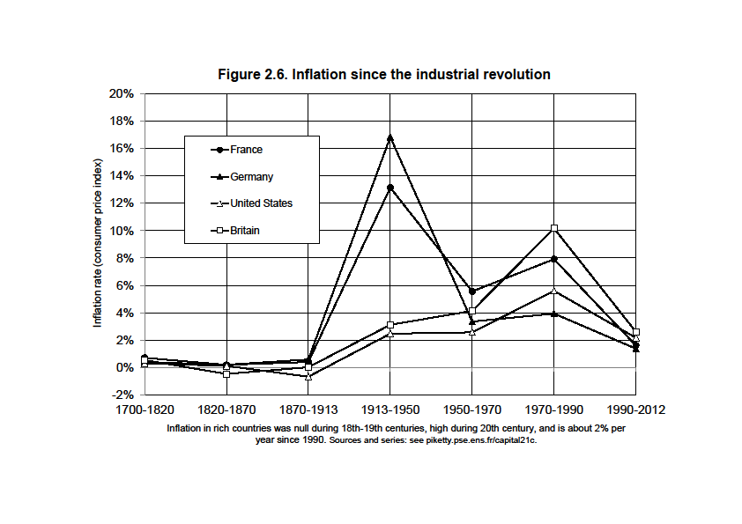

Slide 19
Q.: What is the impact of public debt on capital accumulation?
A.: It depends on how the private saving responds to public deficit
National saving S_{n} = private saving S + public saving S_{g} (<0 if public deficit)
Suppose dS_{g}<0 (public deficit↑)
If dS=0 (no private saving response), then dS_{n}<0 → decline in national wealth W_{n} : in effect public deficits absorb part of private saving (=« crowding out »)
But if dS>0, i.e. private saving increase in order to absorb the extra deficit, then crowding-out might be limited
In case dS=-dS_{g}, then dS_{n}=0: national saving and national wealth are unaffected by public deficit
= apparently what happened in UK 1810-1830: huge public debt, but no decline in private investment; extra private saving by British wealth holders, so that we observe a rise in private wealth, and no decline in national wealth = what Ricardo observes in 1817

Slide 20
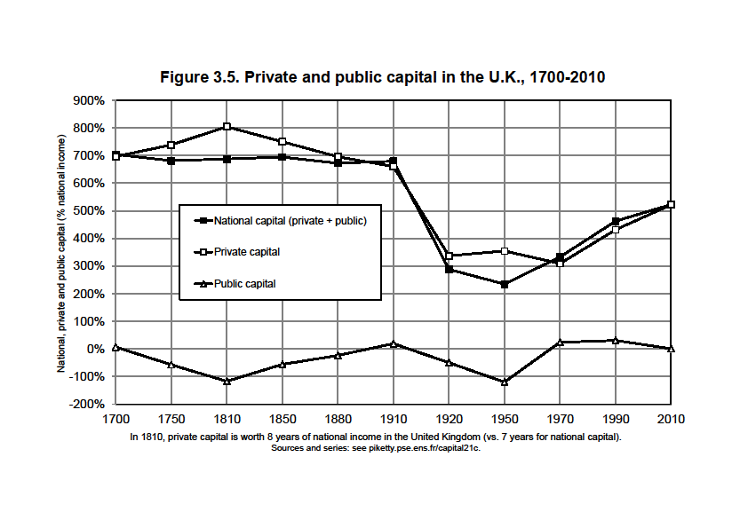

Slide 21
Key question: why was there no crowding out?
Barro 1974: in a representative agent model, rational agents should anticipate that they will pay more taxes in the future if today’s public deficit increase, so they save more in order to make reserves (for themselves or their successors) so as to pay these taxes in the future → the timing of taxes is irrelevant, « debt neutrality » (see also Barro 1987, Clark 2001)
Pb: the representative agent model does not make much sense to study these issues; in 19c Britain, the agents holding public debt (=top 1% or top 10% wealth holders) are not the same as those paying taxes (=the entire population)
Public debt always involves large transfers between different social groups: for high wealth agents, it is better to lend money than to pay taxes… as long as the debt is paid back = big difference between 19c and 20c; will 21c be more like 19c, i.e. debt will be paid back?
Whether the Ricardian equivalence holds depends on the prosperity of private savers, the rate of return that they are being offered, the ability of the govt to convince them that they will be paid back; in 19c UK, r was high, and govt highly credible

Slide 22
France: a mixed economy in 1950-1980
Historically, high public debt in France was always inflated away (more difficult with €)
In 1950, public debt<30% Y, and public assets >120% Y (public buildings + nationalized firms), so that net public wealth close to 100% Y; given that private wealth was close to 200% Y at that time, this means that in effect the govt owned about 1/3 of national wealth (and over 2/3 of large companies)
Same pattern in Germany 1950 (and Britain 1970) = the postwar mixed economy
Rise in public debt + privatization of public assets played a big role in rise of private wealth since 1980

Slide 23
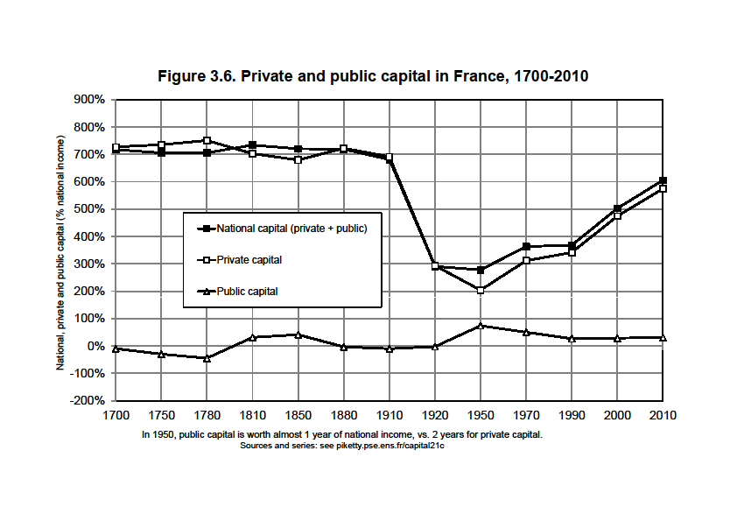

Slide 24
Capital in Germany: stakeholder capitalism?
Same general pattern as in Britain and France
Except that NFA smaller in Germany in 1870-1910 (no colonial empire, late industrialization)
Except that the level of β_{n} is lower in Germany during 1950-2010 period: lower real estate prices (rent control, other regulations, geography?), lower stock market prices (stakeholder capitalism? more on this later)
Except that NFA has been rising a lot in 1990s-2000s

Slide 25
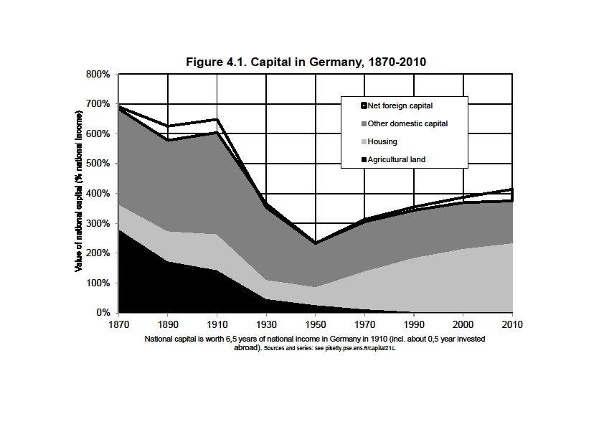

Slide 26
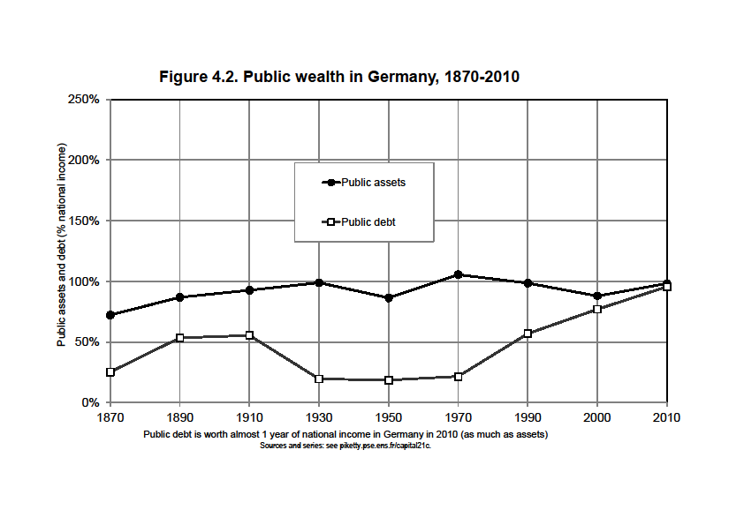

Slide 27
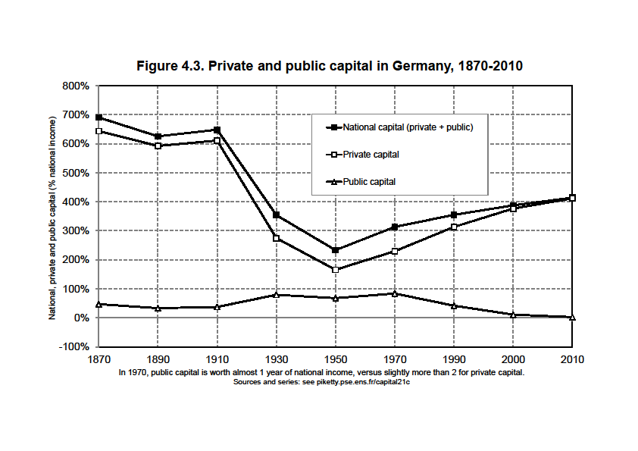

Slide 28
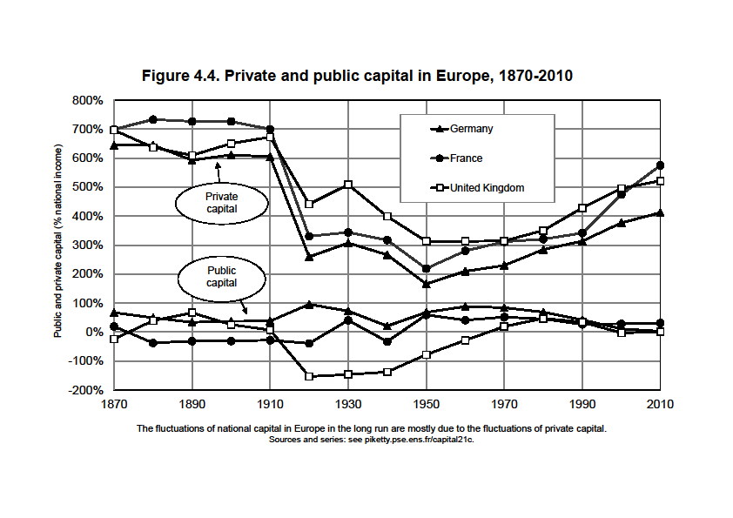

Slide 29
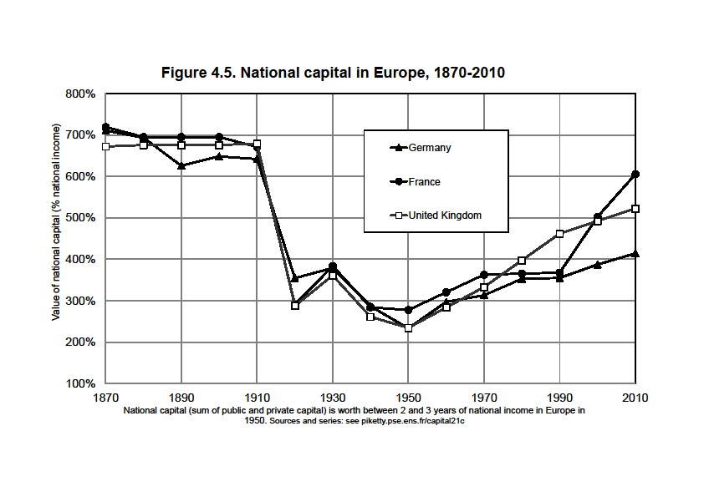

Slide 30
Capital in America: the role of slavery
Very different historical pattern than in Europe
Rising β_{n} during 19c, almost stable in 20c
Level of β_{n} generally smaller than in Europe, particularly in 19c
Two factors: less time to accumulate capital; lower land price (more land in volume, but less land in value)
NFA always close to 0 in US; but <0 in Canada
Southern US before 1865: critical importance of slave capital in private wealth >> see lecture 5 (most extreme illustration of capital as power)

Slide 31
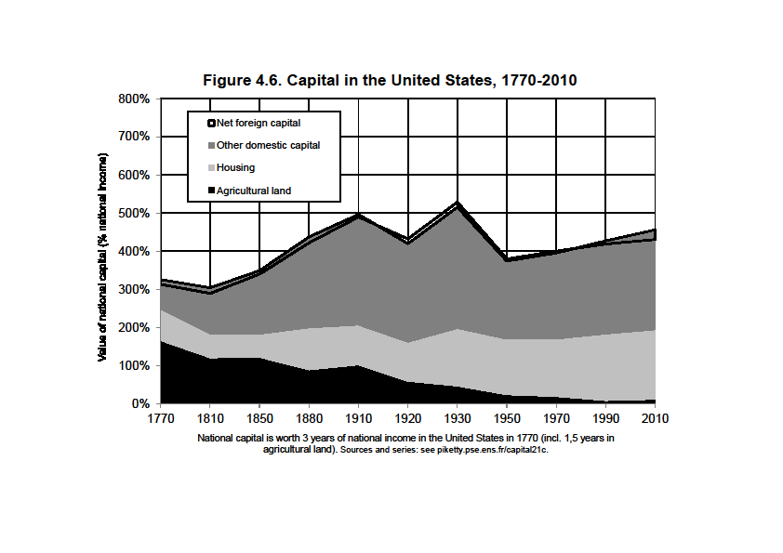

Slide 32
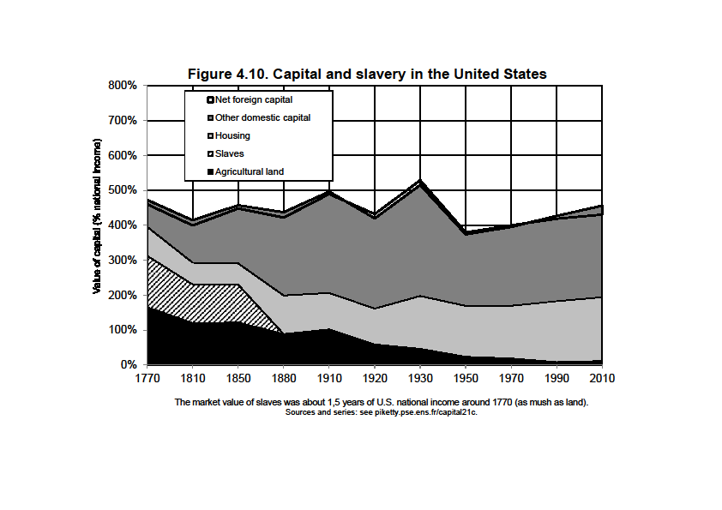

Slide 33
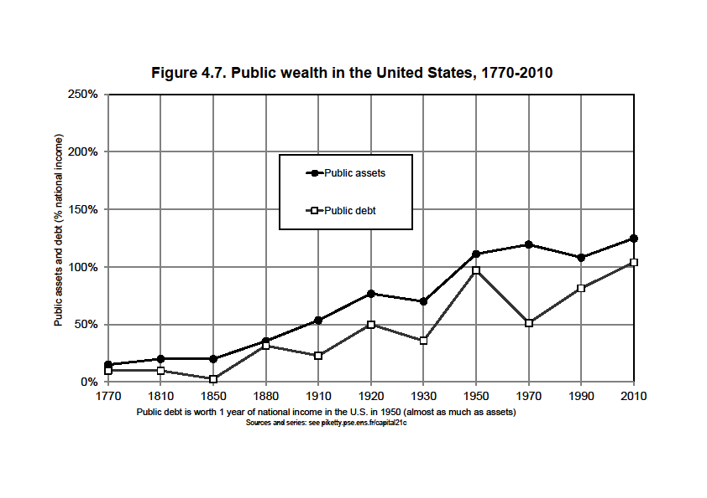

Slide 34
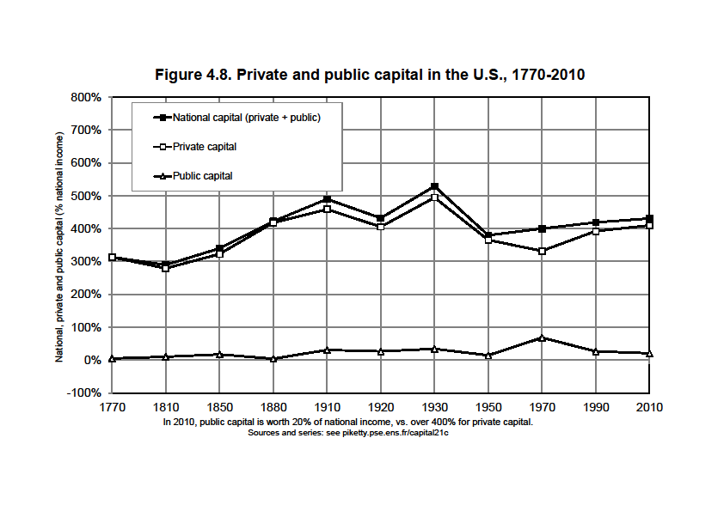

Slide 35
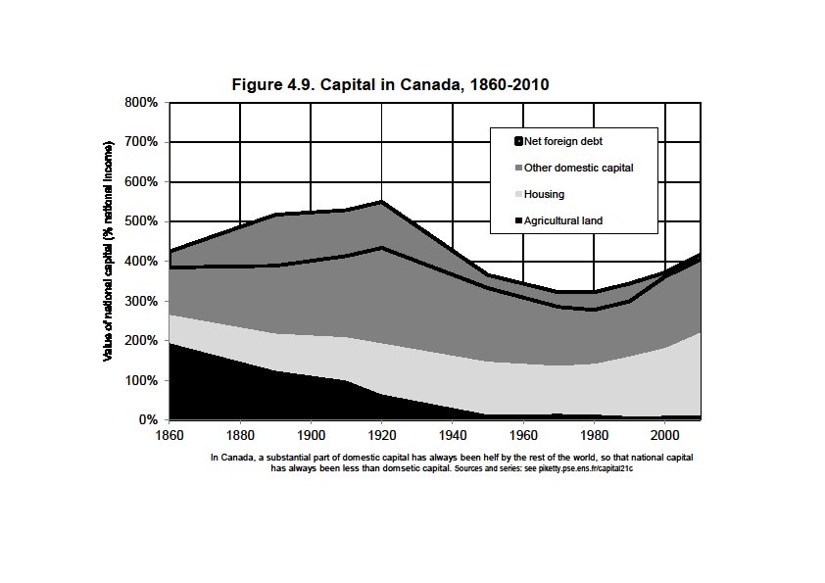

Slide 36
Summing up: what have we learned?
National wealth-income ratios β_{n}=W_{n}/Y followed a large U-shaped curve in Europe: 600-700% in 18c-19c until 1910, down to 200-300% around 1950, back to 500-600% in 2010
U-shaped curve much less marked in the US
Most of the long run changes in β_{n} are due to changes in the private wealth-income ratios β=W/Y
But changes in public wealth-income ratios β_{g}=W_{g}/Y (>0 or <0) also played an important role (e.g. amplified the β decline between 1910 and 1950)
Changes in net foreign assets NFA (>0 or <0) also played an important role (e.g. account for a large part of the β decline between 1910 and 1950)

Slide 37
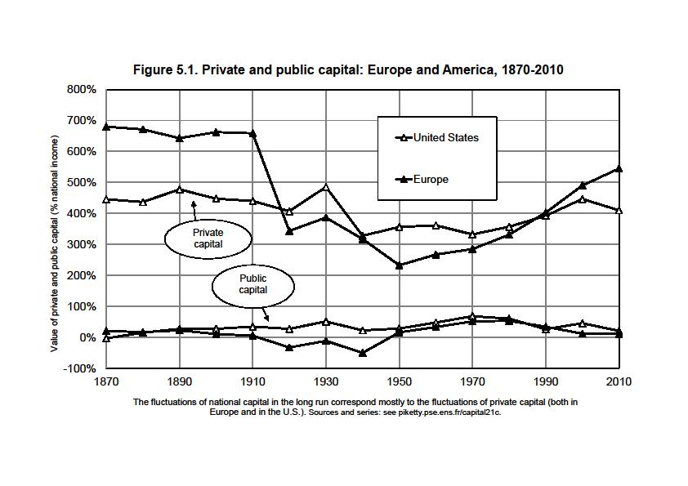

Slide 38
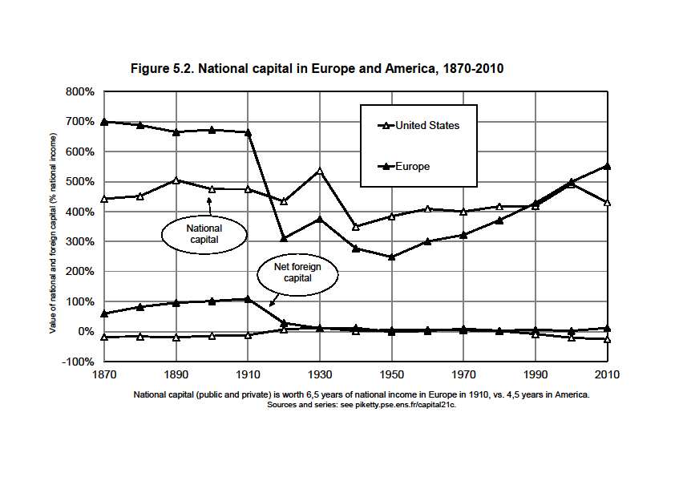

Slide 39
The rise of wealth-income ratios in rich countries : volume or price effects ?
Over 1970-2010 period, the analysis can be extented to top 8 developed economies: US, Japan, Germany, France, UK, Italy, Canada, Australia (see Piketty-Zucman QJE 2014)
Around 1970, β≈200-350% in all rich countries
Around 2010, β≈400-700% in all rich countries
Asset price bubbles (real estate and/or stock market) are important in the short-run and medium-run
But the long-run evolution over 1970-2010 is more than a bubble: it happens in every rich country, and can be partly explained by growth slowdown and the Harrod-Domar-Solow formula β=s/g (higher wealth-income ratio β if higher saving rate s and lower growth rate g)
It can also be explained by a structural price effect: rising land price, or rising power of owners, or rising domain of property?

Slide 40
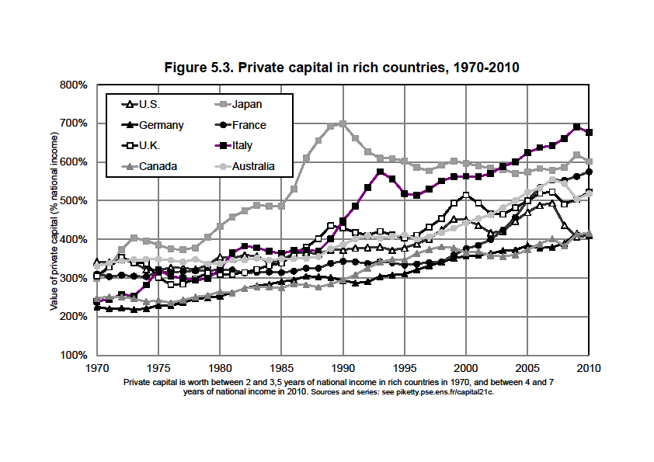

Slide 41
The rise of β would be even larger is we were to divide private wealth W by disposable household income Y_{h} rather than by national income Y
Y_{h} used to be ≈90% of Y until early 20c (=very low taxes and govt spendings); it is now ≈70-80% of Y (=rise of in-kind transfers in education and healh)
β_{h}=W/Y_{h} is now as large as 800-900% in some countries (Italy, Japan, France…)
But in order to make either cross-country or time-series comparisons, it is better to use national income Y as a denominator (=more comprehensive and comparable income concept)

Slide 42
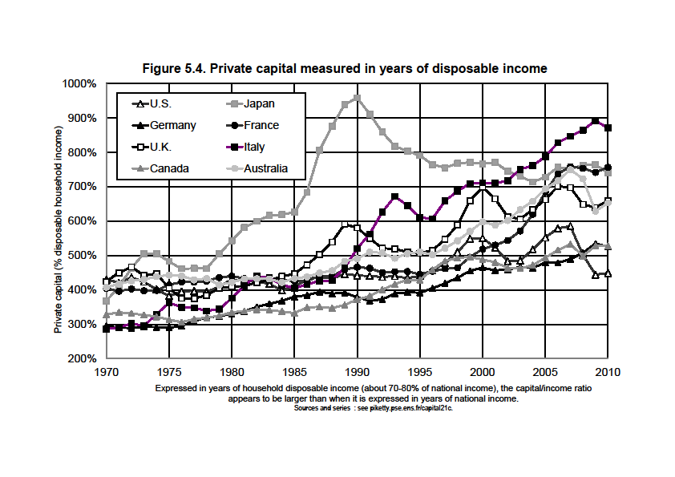

Slide 43
1970-2010: rise of private wealth-income ratio β, decline in public wealth-inccome ratio β_{g}
But the rise in β was much bigger than the decline in β_{g}, so that national wealth-income ratio β_{n}=β+β_{g} rose substantially
Exemple: Italy. β rose from 240% to 680%, β_{g} declined from 20% to -70%, so that β_{n} rose from 260% to 610%. I.e. at most 1/4 of total increase in β can be attributed to a transfer from public to private wealth (privatisation and public debt).

Slide 44
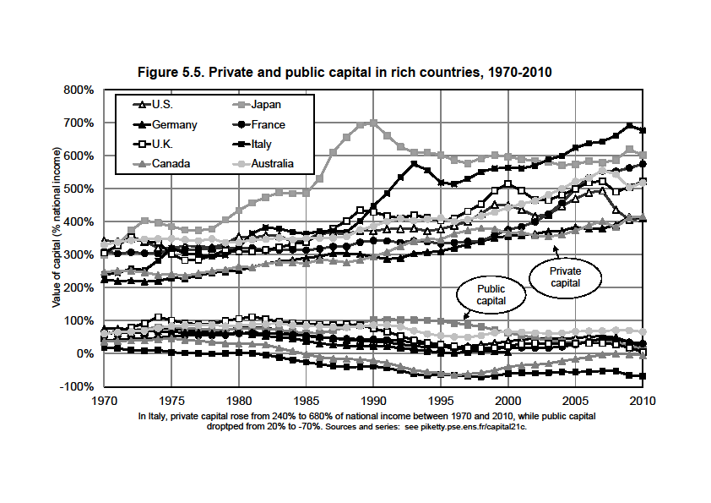

Slide 45
In most countries, NFA ≈ 0, so rise in national wealth-income ratio ≈ rise in domestic capital-output ratio; in Japan and Germany, a non-trivial part of the rise in β_{n} was invested abroad (≈ 1/4)

Slide 46
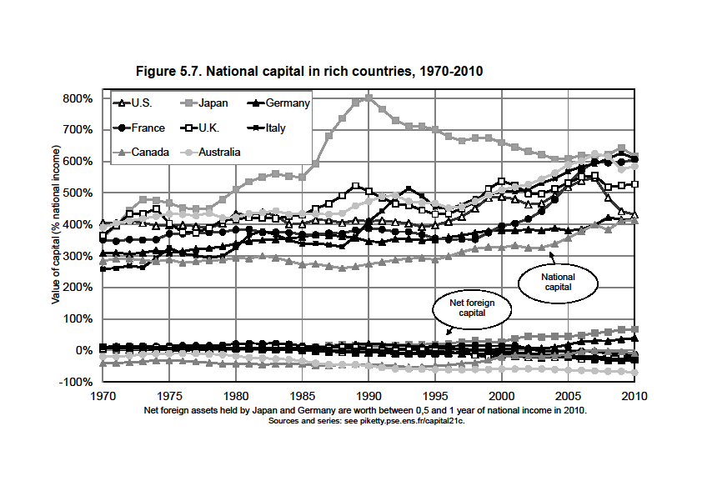

Slide 47
Partial explanation for rise in wealth-income ratio in the very long run: growth slowdown and β = s/g
(Harrod-Domar-Solow steady-state formula)
One-good capital accumulation model: W_{t+1} = W_{t} + s_{t}Y_{t}
→ dividing both sides by Y_{t+1}, we get: β_{t+1} = β_{t} (1+g_{wt})/(1+g_{t})
With 1+g_{wt} = 1+s_{t}/β_{t} = saving-induced wealth growth rate
1+g_{t} = Y_{t+1}/Y_{t} = total income growth rate (productivity+population)
If saving rate s_{t}→ s and growth rate g_{t} → g, then:
β_{t} → β = s/g
E.g. if s=10% & g=2%, then β = 500%: this is the only wealth-income ratio such that with s=10%, wealth rises at 2% per year, i.e. at the same pace as income
If s=10% and growth declines from g=3% to g=1,5%, then the steady-state wealth-income ratio goes from about 300% to 600%
→ the large variations in growth rates and saving rates (g and s are determined by different factors and generally do not move together) explain the large variations in β over time and across countries
(see Piketty-Zucman QJE 2014 & Course notes on wealth models)

Slide 48
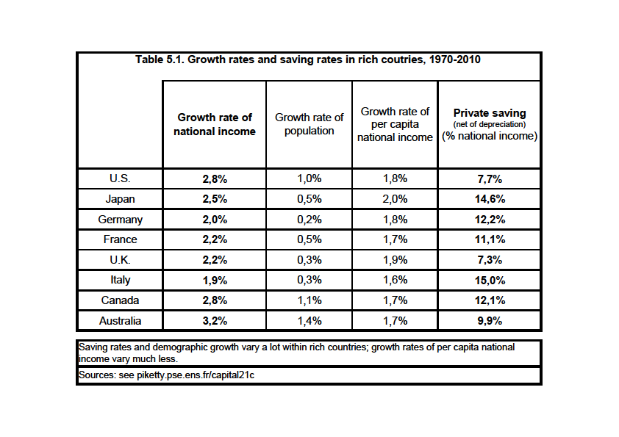

Slide 49
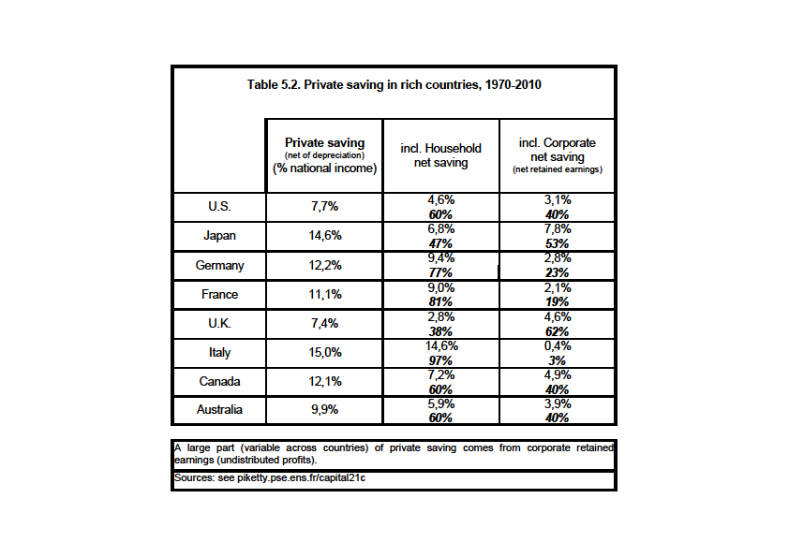

Slide 50
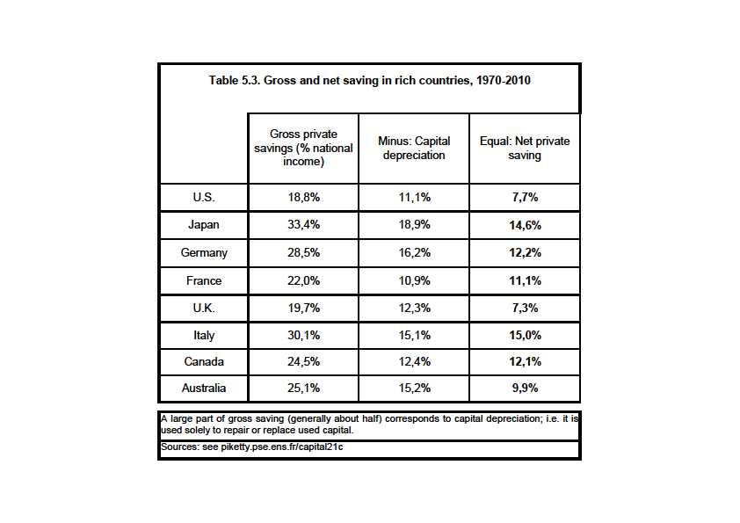

Slide 51
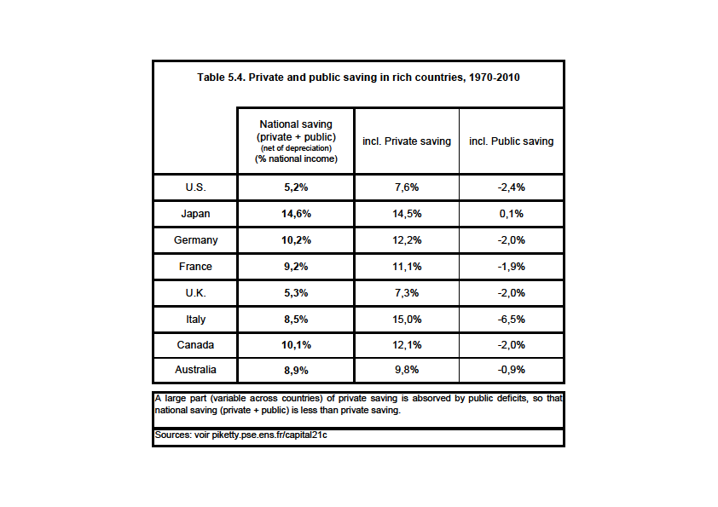

Slide 52
Two-good capital accumulation model: one capital good, one consumption good
Define 1+q_{t} = real rate of capital gain (or capital loss)
= excess of asset price inflation over consumer price inflation
Then β_{t+1} = β_{t} (1+g_{wt})(1+q_{t})/(1+g_{t})
With 1+g_{wt} = 1+s_{t}/β_{t} = saving-induced wealth growth rate
1+q_{t} = capital-gains-induced wealth growth rate (=residual term)
→ Main finding: relative price effects (capital gains and losses) are key in the short and medium run and at local level; volume effects (saving and investment) are probably more important in the long run and at the national or continental level
See the detailed decomposition results for wealth accumulation into volume and relative price effects in Piketty-Zucman, QJE 2014)

Slide 53
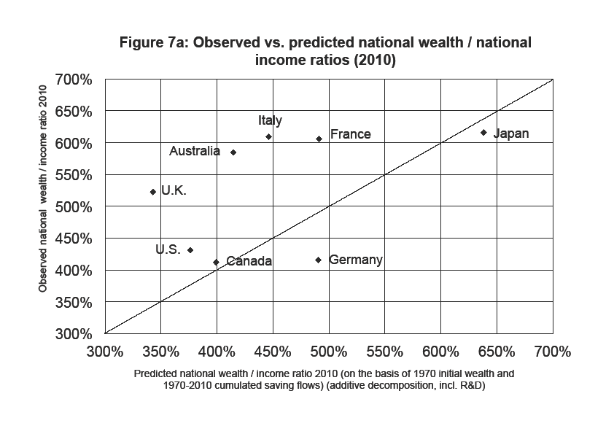

Slide 54
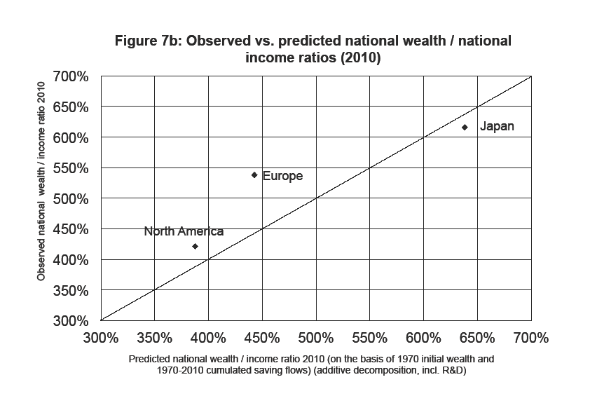

Slide 55
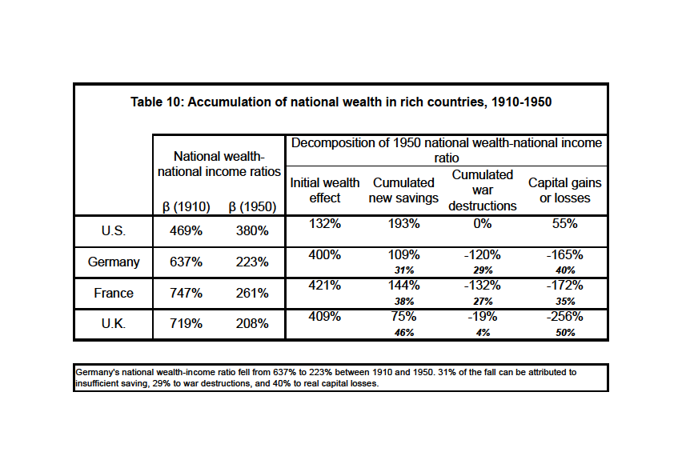

Slide 56
Can land and housing prices also matter in the very long run?
Very difficult to identify pure land prices: hard to measure all past investment and improvment to land, the local infrastructures, etc.
There are good reasons to believe that price effects dominate in the short and medium run, but less so in the long run
However one can also find mechanims explaining why land and housing prices might also matter in the very long run
See e.g Gyourko et al, « Superstar cities », AEJ 2013
See also Schularick et al 2014, « No price like home: global land prices 1870-2012 » : the speed of technical progress in transportation technology has been relatively faster in 1850-1960 than in 1960-2010 (relative to other sectors such as biotech, computer, etc.) (e.g. airplane speed unchanged in recent decades); this can potentially explain the rise of relative land prices in large capital cities in recent decades
More generally, in models with n goods, different speed of technical change can explain any long-run change in relative prices

Slide 57
Market vs book value of corporations: capital and power
So far we used a market-value definition of national wealth W_{n} : corporations valued at stock market prices
Book value of corporations = assets – debt
Tobin’s Q ratio = (market value)/(book value) (>1 or <1)
Residual corporate wealth W_{c} = book value – market value
Book-value national wealth W_{b} = W_{n} + W_{c}
In principe, Q ≈ 1 (otherwise, investment should adjust), so that W_{c} ≈ 0 and W_{b} ≈ W_{n}
But Q can be systematically >1 if immaterial investment not well accounted in book assets
But Q can be systemativally <1 if shareholders have imperfect control of the firm (stakeholder model): this can explain why Q lower in Germany than in US-UK, and the general rise of Q since 1970s-80s

Slide 58
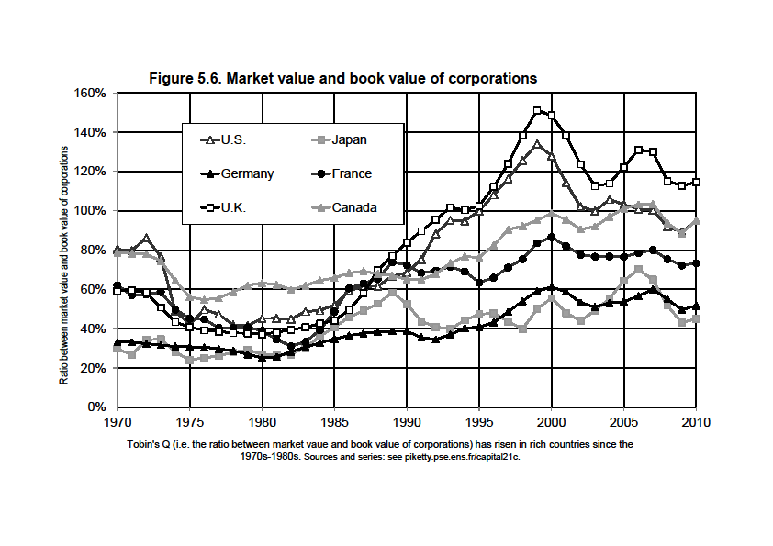

Slide 59
Differences in legal systems, particularly in labor law & company law (stakeholder rights: “codetermination” = power sharing btw shareholders and workers) can explain different levels of Tobin’s Q
See McGaughey 2015 on corporate law & inequality; see also McGaughey 2015 & Schuster 2015 on codetermination in Germany, Sweden and other European countries : more codetermination → lower Tobin’s Q, but this can be good for the long-run investment of workers
Germany: employee representatives make 50% of supervisory board members (but shareholders have decisive vote and pick management board: German two-board system)
Sweden: 3 employees (≈30%) in single board of directors
France since 2013: 1-2 employees (≈10-20%) in board of directors
UK-US: 0 employee in board; shareholders have 100% of seats
One could also grant voting rights to workers in general shareholder meetings (McGaughey): economic democracy yet to be invented

Slide 60
Property regimes in history: from feudal to social

Slide 61
Intellectual property
One key shortcoming of existing balance sheets: intellectual property and immaterial capital (patents, copyrights, research, ideas, culture,..) are taken into account only when they are privately owned, so that a rise in wealth-income ratio might just reflect rising privatization of intellectual property & immaterial k
Major policy issues today:
How long should patents and copyrights last?
Is it possible to have private property rights on basic research articles that were publicly financed?
Is it possible to grant exclusivity rights for digitalization of works that are in public domain (library collections, art works, etc.)?
To what extent did weak IP laws in China and India facilitate world convergence? What would happened if all knowledge was privately owned through strong IP laws?
See e.g. Kapczynski 2015, « Intellectual Property & Inequality »; Boyle 2003 « The Second Enclosure Movement and the Construction of the Public Domain »; Kapczynski 2008

Slide 62
Natural capital and land prices
Other key shortcoming of existing balance sheets: natural ressources (energy, forest, etc.) are usually taken into account only when they are discovered and exploited; climate, air quality, etc. are never taken into account
Can depletion of natural capital (not to mention climate and other environmental damage be larger than the rise of private capital?
Natural capital depletion ≈ 3%-4% of Y at the world level, and 6%-8% Y in low income countries
This can largely undo the effect of positive net saving
See Barbier 2014a, 2014b
See also World Bank Wealth Accounting database
On common property (« commons ») and natural ressources management, see work by E. Olstrom
In the long run, changes in relative price of land and other natural assets can be very important

Slide 63
Capital in developing countries
Main lesson from historical experience of rich countries: wealth-income ratios β and β_{n} have no reason to be stable over time and across countries
Unfortunately, limited balance sheet data for developing countries; key priority for future research: extending http://www.wid.world/ to more countries
See simulations for world capital-income ratio in Capital…, chapter 5 & appendix tables
If global growth slowdown in the future (g≈1,5%) and saving rates remain high (s≈10-12%), then the global β might rise towards 700% (or more… or less…)

Slide 64
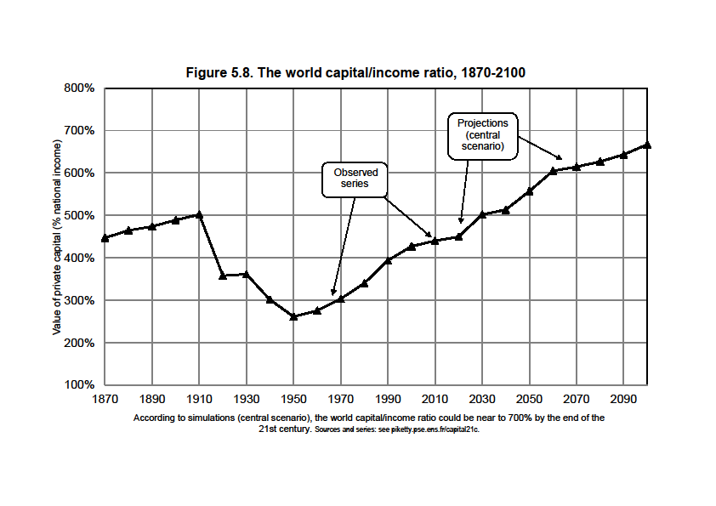

Slide 65
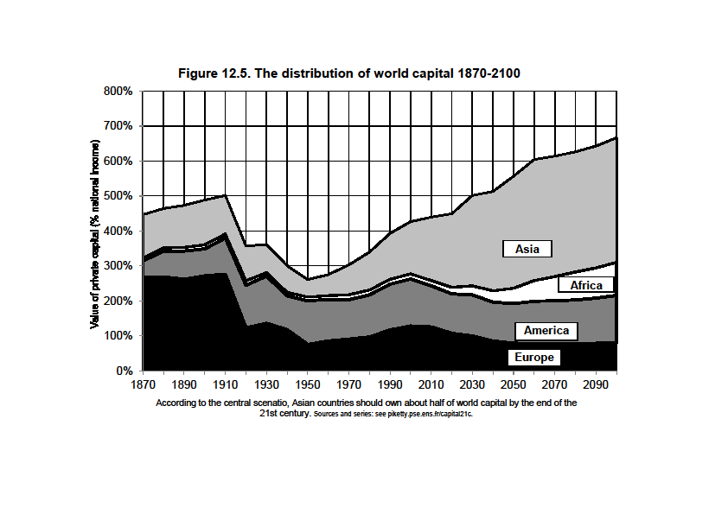

Slide 66
Capital-income ratios β vs. capital shares α
What are the consequences for the share α of capital income in national income? Not simple. Capital is multidimensional: legal system, relative prices and bargaining power matter a lot. One-sector production functions with perfect competition can be useful to think about some of the logical issues, but they are never the full story.
Capital/income ratio β=K/Y
Capital share α = Y_{K}/Y
with Y_{K} = capital income (=sum of rent, dividends, interest, profits, etc.: i.e. all incomes going to the owners of capital, independently of any labor input)
I.e. β = ratio between capital stock and income flow
While α = share of capital income flow in total income flow
By definition: α = r x β
With r = Y_{K}/K = average real rate of return to capital
If β=600% and r=5%, then α = 30% = typical values

Slide 67
In practice, the average rate of return to capital r (typically r≈4-5%) varies a lot across assets and over individuals
Typically, rental return on housing = 3-4% (i.e. the rental value of an appartment worth 100 000€ is generally about 3000-4000€/year) (+ capital gain or loss)
Return on stock market (dividend + k gain) = as much as 6-7% in the long run
Return on bank accounts or cash = as little as 1-2% (but only a small fraction of total wealth)
Average return across all assets and individuals ≈ 4-5%

Slide 68
The Cobb-Douglas production function
Cobb-Douglas production function: Y = F(K,L) = K^{α} L^{1-α}
With perfect competition, wage rate v = marginal product of labor, rate of return r = marginal product of capital:
r = F_{K} = α K^{α-1} L^{1-α} and v = F_{L} = (1-α) K^{α} L^{-α}
Therefore capital income Y_{K} = r K = α Y
& labor income Y_{L} = v L = (1-α) Y
I.e. capital & labor shares are entirely set by technology (say, α=30%, 1-α=70%) and do not depend on quantities K, L
Intuition: Cobb-Douglas ↔ elasticity of substitution between K & L is exactly equal to 1
I.e. if v/r rises by 1%, K/L=α/(1-α) v/r also rises by 1%. So the quantity response exactly offsets the change in prices: if wages ↑by 1%, then firms use 1% less labor, so that labor share in total output remains the same as before

Slide 69
The limits of Cobb-Douglas
Economists like Cobb-Douglas production function, because they like simple stories, and because capital shares sometime seem to be approximately stable
However it is only an approximation: in practice, capital shares α vary in the 20-40% range over time and between countries (or even sometime in the 10-50% range)
In 19c, capital shares were closer to 40%; in 20c, they were closer to 20-30%; structural rise of human capital (i.e. exponent α↓ in Cobb-Douglas production function Y = K^{α} L^{1-α} ?), or purely temporary phenomenon ?
Over 1970-2010 period, capital shares have increased from 15-25% to 25-30% in rich countries : very difficult to explain with Cobb-Douglas framework

Slide 70
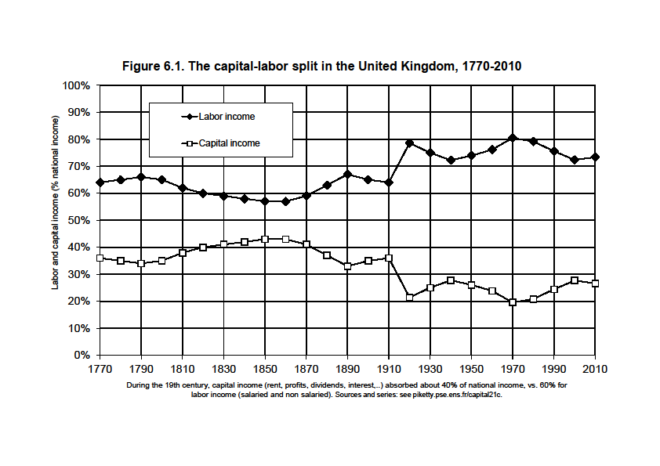

Slide 71
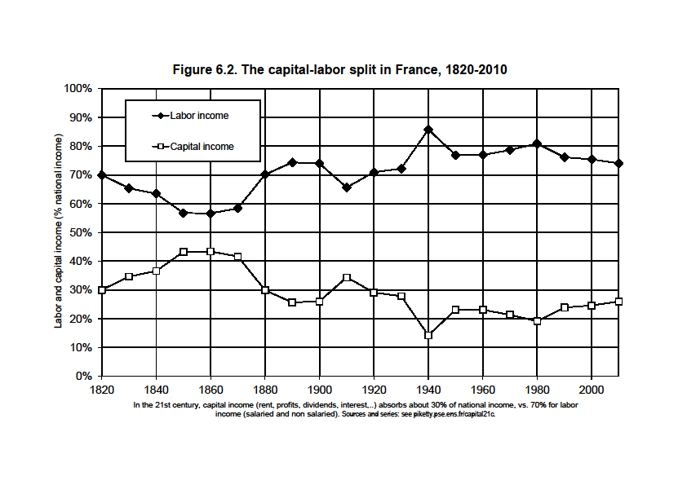

Slide 72
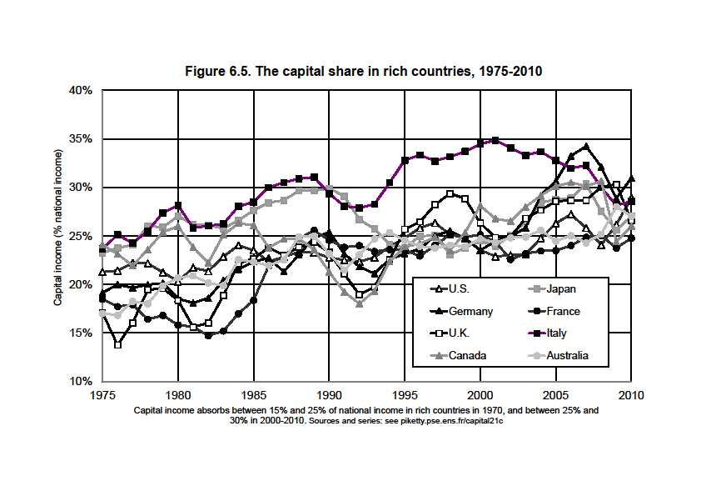

Slide 73
The CES production function
CES = a simple way to think about changing capital shares
CES : Y = F(K,L) = [a K^{(σ-1)/σ} + b L^{(σ-1)/σ} ]^{σ/(σ-1)}
with a, b = constant
σ = constant elasticity of substitution between K and L
σ →∞: linear production function Y = r K + v L
(infinite substitution: machines can replace workers and vice versa, so that the returns to capital and labor do not fall at all when the quantity of capital or labor rise) ( = robot economy)
σ →0: F(K,L)=min(rK,vL) (fixed coefficients) = no substitution possibility: one needs exactly one machine per worker
σ →1: converges toward Cobb-Douglas; but all intermediate cases are also possible: Cobb-Douglas is just one possibility among many
Compute the first derivative r = F_{K} : the marginal product to capital is given by
r = F_{K} = a β^{-1/σ} (with β=K/Y)
I.e. r ↓ as β↑ (more capital makes capital less useful),
but the important point is that the speed at which r ↓ depends on σ

Slide 74
With r = F_{K} = a β^{-1/σ}, the capital share α is given by:
α = r β = a β^{(σ-1)/σ}
I.e. α is an increasing function of β if and only if σ>1 (and stable iff σ=1)
The important point is that with large changes in the volume of capital β, small departures from σ=1 are enough to explain large changes in α
If σ = 1.5, capital share rises from α=28% to α =36% when β rises from β=250% to β =500%
= more or less what happened since the 1970s
In case β reaches β =800%, α would reach α =42%
In case σ =1.8, α would be as large as α =53%

Slide 77
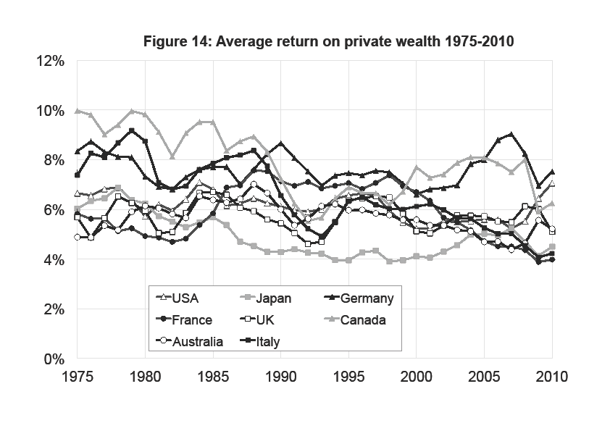

Slide 78
Measurement problems with capital shares
In many ways, β is easier to measure than α
In principle, capital income = all income flows going to capital owners (independanty of any labor input); labor income = income flows going to labor earners (independantly of any capital input)
But in practice, the line is often hard to draw: family firms, self-semployed workers, informal financial intermediation costs (=the time spent to manage one’s own portfolio)
If one measures the capital share α from national accounts (rent+dividend+interest+profits) and compute average return r=α/β, then the implied r often looks very high for a pure return to capital ownership: it probably includes a non-negligible entrepreneurial labor component, particularly in reconstruction periods with low β and high r; the pure return might be 20-30% smaller (see estimates)
One should use two-sector models Y=qY_{h}+Y_{b} (housing + business; q = relative housing price); return to housing = closer to pure return to capital (or n-sector models)

Slide 81
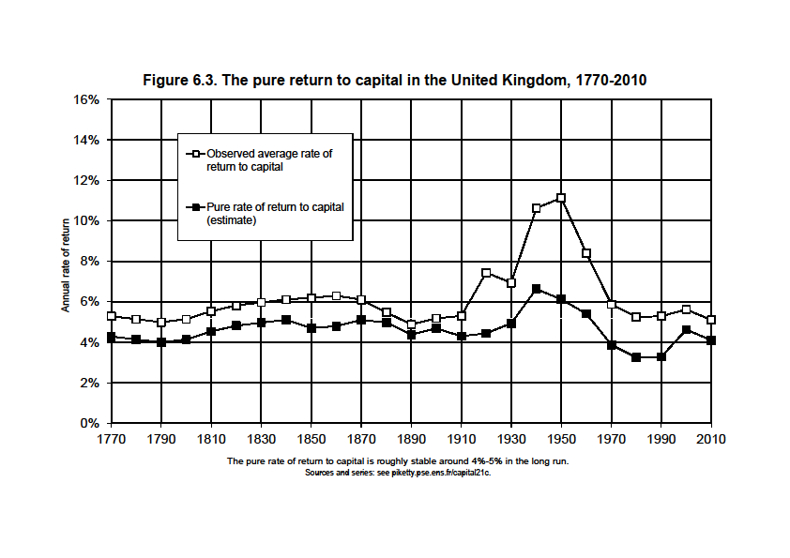

Slide 82
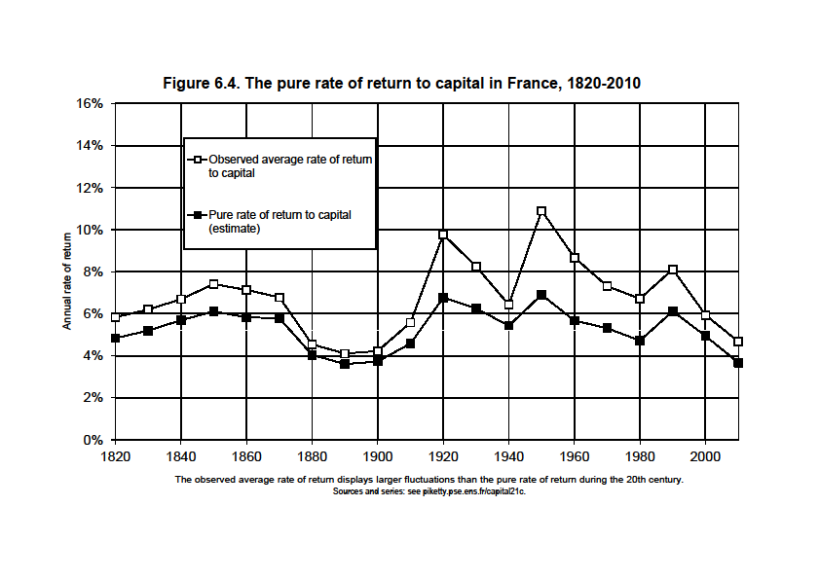

Slide 83
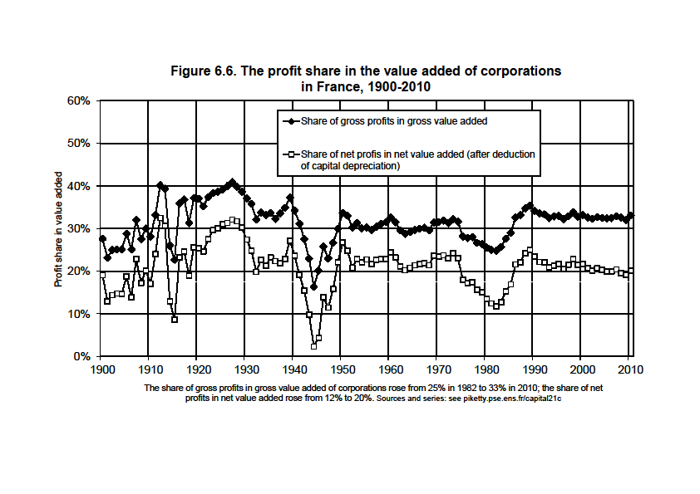

Slide 84
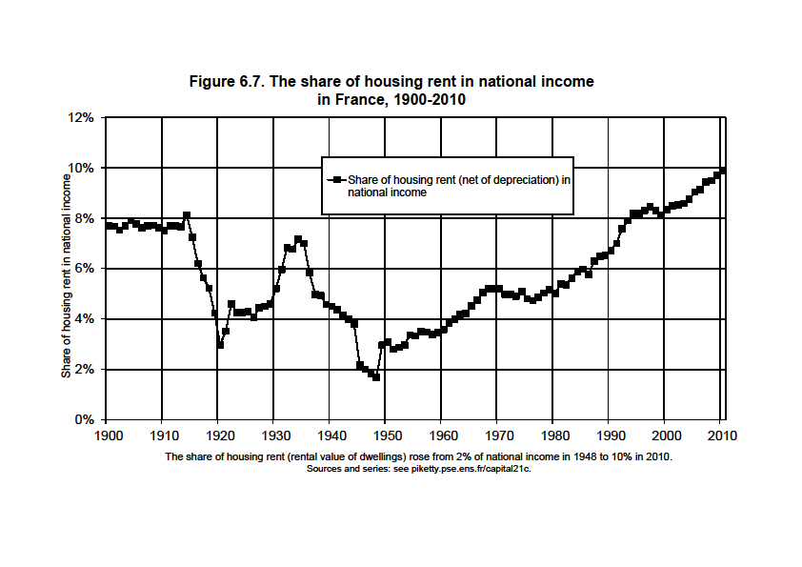

Slide 85
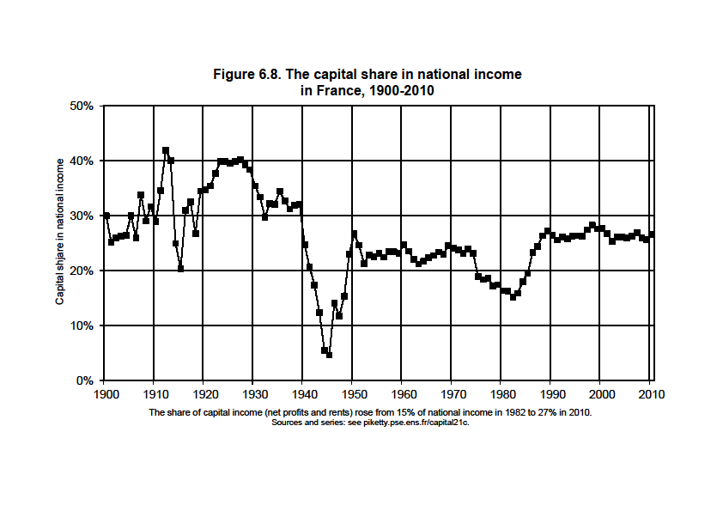

Slide 86
Recent work on capital shares
Imperfect competition and globalization: see Karabarmounis-Neiman 2013 , « The Global Decline in the Labor Share »; see also Karabarmounis-Neiman 2014
Atkinson-Summers: Y=F(K₁,AL+BK₂)
Public vs private firms: see Azmat-Manning-Van Reenen 2011, « Privatization and the Decline of the Labor Share in GDP: A Cross-Country Aanalysis of the Network Industries »
K shares and CEO pay : see Pursey 2013,«CEO Pay and Factor shares: Bargaining effects in US corporations 1970-2011 »
Capital shares in developing countries: under-studied issue
Capital share α is often v. high in poor countries (40-50% instead of 20-30%), but why: low bargaining power of labor, and/or natural ressources, and/or measurement pb? Lots of missing data; see e.g. ILO Global Wage Report 2014-15

