Slide 1
Economic History
(Master PPD & APE, Paris School of Economics)
Thomas Piketty
Academic year 2016-2017
Course Notes on Theoretical Models of Wealth Accumulation and Concentration
(check on line for updated versions)

Slide 2
Roadmap of course notes
How can we explain aggregate accumulation, i.e. the equilibrium level of β = W/Y?
The pure lifecycle model
The dynastic model
The random-shocks model: explaining the relation between wealth concention & r-g
Explaining the long-run evolution of inheritance & share of inherited wealth
For more details on these theoretical models, see Piketty-Zucman, « Wealth & Inheritance in the Long Run », Handbook of Income Distribution 2015

Slide 3
How can we explain β = W/Y?
We first need a theory of why people own wealth: if economic agents only care about current consumption, then they should not own any wealth, i.e. β=0. So we need a dynamic model (at least two periods) where agents care about the future.
OLG model: agents maximize U(c_{t} ,c_{t+1} ), where c_{t} = young-age consumption (working age) & c_{t+1} = old-age consumption
Depending on utility function U(.,.) (rate of time preference, etc.), demographic parameters, etc., one obtains different saving rates and long run β (see « Modigliani triangle » formula)
Pb with the pure life-cycle model: individuals are supposed to die with zero wealth; in the real world, inherited wealth is also important
Models with utility for bequest: U(c_{t} ,w_{t+1} ), where c_{t} = lifetime consumption (young + old) & w_{t+1} = bequest (wealth) left to next generation
Depending on the strength of the bequest motive in utility function U(c,w), one can obtain any saving rate and long run β

Slide 4
Harrod-Domar-Solow formula: β=s/g
Exemple: if agents maximize U(c_{t},Δw_{t}=w_{t+1}-w_{t}), then with U(c,Δ)=c^{1-s} Δ^{s}, we get a fixed saving rate s_{t}=s, and β_{t}→ β = s/g
(i.e. Max U(c_{t},Δw_{t}) under c_{t}+Δw_{t}≤y_{t} → Δw_{t} = s y_{t} )
More generally, this is what we get in any one-good capital accumulation model, whatever the saving motives and utility fonctions behind the saving rate s_{t} :
I.e. assume that: W_{t+1} = W_{t} + s_{t}Y_{t}
→ dividing both sides by Y_{t+1}, we get: β_{t+1} = β_{t} (1+g_{wt})/(1+g_{t})
With 1+g_{wt} = 1+s_{t}/β_{t} = saving-induced wealth growth rate
1+g_{t} = Y_{t+1}/Y_{t} = total income growth rate (productivity+population)
If saving rate s_{t}→ s and growth rate g_{t} → g, then:
β_{t} → β = s/g
Exemple: if s=10%, g=2%, β_{t} → β = 500%
This is a pure accounting identity: β = 500% is the only wealth-income ratio such that a saving rate of 10% of income corresponds to a growth rate of 2% of the capital stock
Intuition: the more you save, the more you accumulate, especially in a slow-growth economy
(on these models, see Piketty-Zucman 2015 & Piketty-Zucman 2014 section 3)

Slide 5
Another special case: the dynastic model
Pure dynastic model = model with infinite horizon and fixed rate of time preference = individuals behave as if they were infinitely lived
Discrete time version: U_{t} = ∑_{t≥0} U(c_{t})/(1+θ)^{t} (θ = rate of time preference)
Budget constraint: ∑_{t≥0} c_{t}/(1+r)^{t} ≤ ∑_{t≥0} y_{t}/(1+r)^{t}
r_{t} = rate of return = = f’(k_{t}) = borrowing interest rate (perfect capital markets)
Closed economy, representative agent: ind. wealth w_{t} = per capita capital stock k_{t}
First-order condition: U’(c_{t+1})/U’(c_{t})=(1+θ)/(1+r)
Assume U(c)= c^{1-γ}/(1-γ), i.e. U’(c)= c^{-γ} , (U(c)=log(c) if γ=1)
FO condition: c_{t+1} =c_{t} [(1+r)/(1+θ)]^{1/γ}
Intuition: if r > θ, then agents want to postpone consumption to the future (conversely if r < θ), and all the more so if γ close to 0, i.e. U(c) close to linear
γ = curvature of U(c) (risk aversion coefficient), 1/ γ = intertemporal elasticity of substitution
Steady-state growth path: y_{t} = y₀ (1+g)^{t}, k_{t} = k₀ (1+g)^{t} , c_{t} = c₀ (1+g)^{t}
→ 1+r = (1+θ) x (1+g)^{γ} (with continuous time: r = θ + γ g )
→ if g=0, then r=θ (>g) : rate of return is entirely determined by preferences

Slide 6
With Cobb-Douglas production function y=f(k)=k^{α} , then r=f’(k)=αk^{α-1} , so that capital income rk=αy, i.e. capital-income ratio β=k/y= α/r
I.e. if r = θ + γ g , then β=α/(θ + γ g)
Exemple: if g=0, θ=5% and α=25%, then β= α/θ =500%
I.e. if lower θ (more patient), higher β
In effect, in the dynastic model, agents save a fraction g/r of their capital income rk, so that their wealth rises at rate g, like the rest of the economy (i.e. with g=1% and r=5%, they save 1/5=20% of their capital income, and eat the rest
→ saving rate s = α g/r
capital-income ratio β = s/g= α/r =g=0
= special case of Harrod-Domar-Solow formula

Slide 7
To summarize: Harrod-Domar-Solow formula β = s/g is a pure accounting formula and is valid with any saving motive and utility function
Wealth increase in the utility function: Max U(c_{t},Δw_{t}=w_{t+1}-w_{t})
→ if U(c,Δ)=c^{1-s} Δ^{s}, then fixed saving rate s_{t}=s, β_{t}→ β = s/g
(i.e. Max U(c_{t},Δw_{t}) under c_{t}+Δw_{t}≤y_{t} → Δw_{t} = s y_{t} )
Total wealth or bequest in the utility function: Max U(c_{t},w_{t+1})
→ if U(c,w)=c^{1-s} w^{s}, then w_{t+1}=s(w_{t} + y_{t}), β_{t} → β = s/(g+1-s) = s’/g
(with s’=s(1+β)-β = corresponding saving rate out of income)
Pure OLG lifecycle model: saving rate s determined by demographic structure (more time in retirement → higher s), then β_{t}→ β = s/g
Dynastic utility:
Max Σ U(c_{t})/(1+θ)^{t} , with U(c)=c^{1-1/γ}/(1-1/γ)
→ unique long rate rate of return r_{t} → r = θ +γg > g
→ long run saving rate s_{t}→ s = αg/r, β_{t} → β = α/r = s/g
(on these models, see Piketty-Zucman 2014 section 3)

Slide 8
The pure lifecycle model
Modigliani triangle formula: useful formula to compute the quantity of pension wealth that one needs to accumulate for old-age purposes (as a fonction of demographic and economic parameters)
Pure life-cycle model = individuals die with zero wealth (no inheritance), wealth accumulation is entirely driven by life-cycle motives (i.e. savings for retirement)
Simplest model to make the point: fully stationary model n=g=r=0 (zero population growth, zero economic growth, zero interest rate = capital is a pure storage technology and has no productive use)
(see Modigliani, “Life Cycle, Individual Thrift and the Wealth of Nations”, AER 1986)
Age profile of labor income:
Note Y_{La} = labor income at age a
Y_{La} =Y_{L}>0 for all A<a<A+N (A = adulthood; A+N = retirement age)
Y_{La} = 0 for all A+N<a<A+D (A+D = age at death)

Slide 9
I.e. people become adult and start working at age A, work during N years, retire at age A+N, and die at age A+D: labor length = N, retirement length = D-N
(say: A=20, A+N=60, A+D=70, i.e. N=40, D-N=10 : N/D = 40/50 = 80%, i.e. they spend 80% of their adult life working and 20% in retirement)
Per capita (adult) national income Y = NY_{L}/D
Preferences: full consumption smoothing
(say, U = ∑_{A<a<A+D} U(C_{a})/(1+θ)ª, with θ=0)
Everybody fully smoothes consumption to C=NY_{L}/D (= per capita output Y)
In order to achieve this they save during labor time and dissave during retirement time
Note S_{a}= savings (= Y_{La} – C)
We have: S_{a} = (1-N/D)Y_{L} >0 for all A<=a<=A+N
S_{a} = -NY_{L}/D <0 for all A+N<=a<=A+D
I.e. agents save during their working life; during retirement, they consume their past saving and die with zero wealth

Slide 10
Note W_{a}= wealth at age a
We get the following wealth accumulation equation:
W_{a}=(a-A)(1-N/D)Y_{L} for A<a<A+N
W_{a}= N(1-N/D)Y_{L}-(a-A-N)NY_{L}/D for A+N<a<A+D
>>> “hump-shaped” (inverted-U) age-wealth profile,
Maximum wealth at age a=A+N, with W_{a}=N(1-N/D)Y_{L}
Then W_{a} back to 0 for a=A+D
Average wealth is given by (simple triangle area formula):
W = N/D x N(1-N/D)Y_{L}/2 + (D-N)/D x N(1-N/D)Y_{L}/2
I.e. average W = (D-N)Y/2

Slide 11
Proposition: Aggregate wealth/income ratio W/Y = (D-N)/2 = half of retirement length = “Modigliani triangle formula”
E.g. if retirement length D-N = 10 years, then W/Y = 500%
(and if D-N = 20 years, then W/Y=1000%…)
Lessons from Modigliani triangle formula:
(1) pure life-cycle motives (no bequest) can generate large and reasonable wealth/income ratios
(2) aggregate wealth/income ratio is independant of income level and solely depends on demographics (previous authors had to introduce relative income concerns in order to avoid higher savings and accumulation in richer economies)
Pb = one never observes so much licecycle wealth (pension funds = at most 100-150% Y) (public pensions, inconsistencies..)

Slide 12
Note that in this stationary model, aggregate savings = 0: i.e. at every point in time positive savings of workers are exactly offset by negative savings of retirees; but this is simply a trivial consequence of stationnarity: with constant capital stock, no room for positive steady-state savings
Extension to population growth n>0 : then the savings rate s is >0: this is because younger cohorts (who save) are more numerous than the older cohorts (who dissave)
Check: with population growth at rate n>0, proportion of workers in the adult population = (1-exp(-nN))/(1-exp(-nD)) (> N/D for n>0)
I.e. s(n) = 1 - (N/D)/ [(1-exp(-nN))/(1-exp(-nD))] >0
Put numbers: in practice this generates savings rates that are not so small, e.g. for n=1% this gives s=4,5% for D-N=10yrs retirement, and s=8,8% for D-N=20yrs retirement (keeping N=40yrs)
Wealth accumulation: W/Y = s/n = s(n)/n, i.e. wealth/income ratio = savings rate/population growth
>> for n=0, W/Y = (D-N)/2; for n>0, W/Y < (D-N)/2; i.e. W/Y rises with retirement length D-N, but declines with population growth n

Slide 13
Put numbers into the formula: W/Y=452% instead of 500% for N=40,D-N=10,n=1%.
Intuition: with larger young cohorts (who have wealth close to zero), aggregate wealth accumulation is smaller; mathematically, s(n) rises with n, but less than proportionally; of course things would be reversed if N was small as compared to D, i.e. if young cohorts were reaching their accumulation peak very quickly
Also, this result depends upon the structure of population growth: aging-based population growth generates a positive relationship between population growth and wealth/income ratio, unlike in the case of generational population growth

Slide 14
Extension to economic growth g>0 : then s>0 for the same reasons as the population growth: young cohorts are not more numerous, but they are richer (they have higher lifetime labor income), so they save more than the old dissave
Extension to positive capital return r>0 : other things equal, the young need to save less for their old days (thanks to the capital income Y_{K}=rW; i.e. now Y=Y_{L}+Y_{K}); if n=g=0 but r>0, then one can easily see that aggregate consumption C is higher than aggregate labor income Y_{L}, i.e. aggregate savings are smaller than aggregate capital income, i.e. S<Y_{K}, i.e. savings rate s=S/Y < capital share α = Y_{K}/Y
(s<α = typically what we observe in practice, at least in countries with n+g small)
Main limitations of the lifecycle model: it generates too much pension wealth and too little wealth inequality. I.e. in the lifecycle model, wealth distribution is simply the mirror image of income distribution - while in practice wealth distribution is always a lot more unequal than income distribution.
Obvious culprit: the existence of inherited wealth and of multiplicative, cumulated effects induced by wealth transmission over time and across generations. This can naturally generate much higher wealth concentration.

Slide 15
The dynastic model
Pure dynastic model = individuals maximize dynastic utility functions, as if they were infinitely lived; death is irrelevant in their wealth trajectory, so that they die with positive wealth, unlike in the lifecycle model:
Dynastic utility function: U_{t} = ∑_{t≥0} U(c_{t})/(1+θ)^{t} (U’(c)>0, U’’(c)<0)
Infinite-horizon, discrete-time economy with a continuum [0;1] of dynasties.
For simplicity, assume a two-point distribution of wealth.
Dynasties can be of one of two types: either they own a large capital stock k_{t}^{A}, or they own a low capital stock k_{t}^{B} (with k_{t}^{A} > k_{t}^{B}).
The proportion of high-wealth dynasties is equal to λ (and the proportion of low-wealth dynasties is equal to 1-λ), so that the average capital stock in the economy k_{t} is given by:
k_{t} = λk_{t}^{A} + (1-λ)k_{t}^{B}

Slide 16
Output is given by a standard production function Y_{t} = F(K_{t},L_{t})
Output per labor unit is given by y_{t}=Y_{t} /L_{t}= f(k_{t}) (f’(k)>0, f’’(k)<0), where k_{t}=K_{t}/L_{t} = average capital stock per capita of the economy at period t. Markets for labor and capital are assumed to be fully competitive, so that the interest rate r_{t} and wage rate v_{t} are always equal to the marginal products of capital and labor:
r_{t} = f’(k_{t}) and v_{t} = f(k_{t}) - r_{t}k_{t}
Proposition: (1) In long-run steady-state, the rate of return r and the average capital stock k are uniquely determined by the utility function and the technology (irrespective of initial conditions): in steady-state, r is necessarily equal to θ, and k must be such that : f’(k)=r=θ
(2) Any distribution of wealth (k^{A} , k^{B}) such as average wealth = k is a steady-state
The result comes directly from the first-order condition:
U’(c_{t})/ U’(c_{t+1}) = (1+r_{t})/(1+θ)
I.e. if the interest rate r_{t} is above the rate of time preference θ, then agents choose to accumulate capital and to postpone their consumption indefinitely (c_{t}<c_{t+1}<c_{t+2}<…) and this cannot be a steady-state.
Conversely, if the interest rate r_{t} is below the rate of time preference θ, agents choose to desaccumulate capital (i.e. to borrow) indefinitely and to consume more today (c_{t}>c_{t+1}>c_{t+2}>…). This cannot be a steady-state either.

Slide 17
Note: if f(k) = k^{α} (Cobb-Douglas), then long run β = k/y = α/r
Note: in steady-state, s=0 (zero growth, zero savings)
Average income: y = v + rk = f(k) = average consumption
High-wealth dynasties: income y^{A} = v + rk^{A} (=consumption)
Low-wealth dynasties: income y^{B} = v + rk^{B} (=consumption)
>>> everybody works the same, but some dynasties are permanently richer and consume more
Dynastic model = completely different picture of wealth accumulation than lifecycle model
In the pure dynastic model, wealth accumulation = pure class war
In the pure lifecycle model, wealth accumulation = pure age war
In pure dynastic model, any wealth inequality is self-sustaining
(including slavery: assume huge dynastic debt k^{B} =-v/r) (Graeber)
In pure lifecycle model, zero wealth inequality (if zero labor inequality)

Slide 18
Dynastic model with positive (exogenous) productivity growth g: Y_{t} = F(K_{t},H_{t}) with H_{t} = (1+g)^{t} L_{t} = human capital
Modified Golden rule: r = θ + σg
With: 1/σ = IES (intertemporal elasticity of substitution) = constant coefficient if U(c) = c^{1-σ}/(1-σ)
(σ = curvature of U(.) = risk aversion coefficient)
Typically σ >1, so r = θ + σg > g
But even if σ >1, r has to be > g in the dynastic, infinite-horizon model: otherwise transversality condition is violated (present value of future incomes = infinite)
In steady-state, i.e. dynasties save a fraction g/r of their capital income (and consume the rest), so that their capital stock grows at rate g, i.e. at the same rate as labor productivity and output
Aggregate saving rate s = α g/r < α
Aggregate wealth-income ratio β = s/g = α/r

Slide 19
Where does the modified Golden rule come from?
This comes directly from the first-order condition:
U’(c_{t})/ U’(c_{t+1}) = (1+r_{t})/(1+θ)
With U(c) = c^{1-σ}/(1-σ), U’(c)= c^{-σ} → c_{t+1}/c_{t} = [(1+r_{t})/(1+θ)]^{1/σ}
Intuition: the desired consumption growth rate rate rises with r_{t} (high r_{t} = it is worth postponing consumption; low r_{t} = it is worth consuming more now), and all the more so if the IES is high
In steady-state, consumption must grow at the same rate as the size of the economy: as t→∞, c_{t+1}/c_{t}→ 1+g
Therefore 1+r_{t} → 1+r = (1+θ) (1+g)^{σ}
With θ, g small (or in continuous time models), this is equivalent to :
r ≈ θ + σg
In effect, if r > θ + σg, then agents want their consumption to rise faster than g (→ too much k accumulation, so that r_{t}↓); while if r < θ + σg, then agents want their consumption to rise less fast than g (→ too much borrowing, so that r_{t}↑)

Slide 20
Is it suprising that r > g for ever?
No: this is obvious with g=0 : r = θ > 0
This is also what standard economic models predict with positive growth g>0
And this is what we always observe in human history (at least in the absence of capital shocks, wars, taxation, etc., see below )
Typically, during 19c: g = 1%, r = 5%, s = 8%, β = s/g = 800%, α = r β = 40%
Wealth holders simply need to save a fraction g/r = 20% of their capital income so that their wealth rises by 1% per year, i.e. as fast as national income
This is what wealth is here for: if you need to reinvest all your capital income in order to preserve your relative wealth position, then what’s the point of holding wealth?

Slide 21
The random-shocks model
Pb with the dynastic model = any level of inequality can be self-sustaining (zero mobility)
(other pb = unclear whether r = θ in the real word; in fact, it is unclear whether real-word agents really have a θ : dynamic inconsistencies, hyperbolic discounting, see e.g. Giglio et al 2013)
In the real world, there is always positive weatlh mobility, because there are all sorts of random shocks: demographic (number of children, age at death, etc.), rates of return, bequest tastes, labor productivities, etc.
Models with « ergodic » shocks = there’s always a positive probability to move from any two wealth levels w_{ti} and w_{t+1i}
Consequently there always exists a unique long-run, steady-state distribution of wealth φ(w); but for given shocks the inequality of this steady-state distribution is an increasing function of r – g
(where r = net-of-tax rate of return, g = growth rate)

Slide 22
Finite-horizon, bequest-in-the-utility-function model = middle ground with pure lifecycle model and infinite-horizon dynastic model = more flexible and suitable model to study wealth dynamics
Simplified version of the wealth-in-the-utility, finite-horizon model, with random shocks on saving tastes:
- each generation lives exactly one period
- each individual i in generation t receives labor income y_{Lt} + capitalized inherited wealth (1+r)w_{ti} , and maximizes V_{ti}(c,w)=(1-s_{ti})log(c)+s_{ti}log(w) (or equivalently V_{i}(c,w)=c^{sti}w^{1-sti}) in order to allocate his total ressources between consumption c_{ti} and end-of-life wealth w_{t+1i}
→ Individual-level transition equation for wealth: w_{t+1i} = s_{ti} [y_{Lt} + (1+r) w_{ti} ]
with: s_{ti} = saving taste=randomly drawn from a distribution with mean s=E(s_{ti})
Aggregate transition equation: w_{t+1} = s [y_{Lt} + (1+r) w_{t}] = s [y_{t} + w_{t}]
with y_{t} = f(k_{t}) + r (w_{t} - k_{t}) = national income ≈ (1+g)^{t} y₀ in the long run
→ β_{t}=w_{t}/y_{t} → β = s/(g+1-s) = s’/g (with s’=s(1+β)-β )
Q.: Where does the wealth distribution φ(w) converge to?
A.: φ → Pareto distribution with exponent ↑ as var(s_{ti}) and r-g ↑

Slide 23
Define z_{ti}=w_{ti}/w_{t} = normalized wealth and ω=s(1+r)/(1+g)<1
The transition equation can be rewritten:
z_{t+1i} = s_{ti}/s [ (1-ω) + ω z_{ti} ]
Assume binomial random tastes:
s_{ti}=s*>0 with proba p>0 ("wealth-lovers")
s_{ti}=0 with proba 1-p ("consumption-lovers")
s=E(s_{ti})=ps*
If s_{ti}=0 , then z_{t+1i}=0 → children with consumption-loving parents receive no bequest
If s_{ti}=s*, then z_{t+1i} = s*/s [(1-ω) + ω z_{ti} ] → children with wealth-loving parents receive positive bequests growing at rate ω/p across generations
→ after many successive generations with wealth-loving parents (or more generally with high demographic or returns shocks), inherited wealth can be very large
Non-explosive aggregate path: ω <1
Non-explosive aggregate path with unbounded distribution of normalized inheritance: ω <1<ω*=ω/p

Slide 24
Therefore the steady-state distribution φ(z) looks as follows:
z=z₀=0 with proba 1-p (children with zero-wealth-taste parents)
z=z₁=(1-ω )/p with proba (1-p)p (children with wealth-loving parents but zero-wealth-taste grand-parents)
...
z=z_{k+1}=(1-ω)/p + (ω/p)z_{k} > z_{k} with proba (1-p)p^{k+1} (children with wealth-loving ancesters during the past k+1 generations)
We have:
z_{k} = [(1-ω)/(ω -p)] [ (ω/p)^{k} - 1 ] ≈ [(1-ω)/(ω-p)] (ω/p)^{k} as k→+∞
1-Φ(z_{k}) = proba(z≥z_{k}) = ∑_{k'>k} (1-p)p^{k'} = p^{k}
That is, as z→+∞, log[1-Φ(z)] ≈ a( log[z₀] - log[z] ), i.e. 1-Φ(z) ≈ (z₀/z)ª
With Pareto coefficient a = log[1/p]/log[ω/p] >1
and inverted Pareto coefficient b=a/(1-a) >1

Slide 25
For given p:
As ω →1 , a =log[1/p]/log[ω/p] →1 and b→+∞ (infinite inequality)
I.e. an increase in ω =s(1+r)/(1+g) means a larger wealth reproduction rate ω* for wealth-lovers, i.e. a stronger amplification of inequality
(conversely, as ω →p , a→+∞ and b→1 (zero inequality)
For given ω : as p→0 , a→1 and b→+∞ (infinite inequality) (a vanishingly small fraction of the population gets an infinitely large shock)
(conversely, as p→ ω, a→+∞ and b→1 (zero inequality)
Proposition: The inequality of inheritance is an increasing function of r-g
Note. What matters in the formula is the net-of-tax rate of return: bequest taxes - and more generally capital taxes - reduce the rate of wealth reproduction, and therefore reduce steady-state wealth concentration.
Key finding: small changes in r – g can have huge impact on long-run inequality
(see Piketty-Zucman “Wealth and Inheritance in the Long-Run”, 2014, section 5.4 for mathematical details and simple empirical calibration)

Slide 26
Note 3. The same ideas and formulas for Pareto coefficients work for different kinds of shocks.
Primogeniture: shock = rank at birth; the richest individuals are the first born sons of first born sons of first born sons etc.; see Stiglitz Econometrica 1969
Family size: shock = number of siblings; the richest individuals are the single children of single children of single children etc.; see Cowell 1998 (more complicated formula
Rates of return: shock = r_{ti} instead of s_{ti} = exactly the same mutiplicative wealth process as with taste shocks → Pareto upper tails in the limit, see e.g. Benhabib-Bisin-Zhu 2011, 2013, Nirei 2009
Note 4. With primogeniture (binomial shock), the formula is exactly the same.
See e.g. Atkinson-Harrison 1978 p.213 (referred to in Atkinson-Piketty-Saez 2011 p.58), who generalize the Stiglitz 1969 formula and get: a = log(1+n)/log(1+sr)
This is the same formula as a = log[1/p]/log[ω*]: 1+n = population growth, so probability that a good shock occurs - i.e. being the eldest son = 1/(1+n) = p;
1+sr = net-of-tax reproduction rate in case a good shock occurs = ω*.

Slide 27
Note 5. The Cowell 1998 result is more complicated because families with many children do not return to zero (unless infinite number of children), so there is no closed form formula for the Pareto coefficient a, which must solve the following equation: ∑ (p_{k}k/2) (2ω/k)ª= 1, where p_{k}= fraction of parents who have k children, with k=1,2,3,etc., and ω = average generational rate of wealth reproduction.
Note 6. More generally, one can show that for any random multiplicative process z_{t+1i}= ω_{ti}z_{ti}+ε_{ti} , where µ_{ti}= i.i.d. multiplicative shock with mean ω=E(ω_{ti})<1, ε_{ti}=additive shock (possibly random), then the steady-state distribution has a Pareto upper tail with coefficient a, which must solve the following equation: E(ω_{ti}ª)=1 (see Nirei 2009, p.9 and Nirei-Aoki 2014)
Special case: p (ω/p)ª=1, i.e. a=log(1/p)/log(ω/p).
More generally, as long as ω_{ti}>1 with some positive probability, there exists a unique a>1 s.t. E(ω_{ti}^{α})=1.
One can easily see that for a given average ω=E(ω_{ti})<1, a→1 if the variance of shocks goes to infinity (and a→∞ if the variance goes to zero).

Slide 28
Explaining the long run evolution of inheritance
The multiplicative r-g process is already powerful with fine horizon; but it is even more powerful with inheritance; otherwise the process starts over again at each generation (wealth inequality can still be very unequal if large multiplicative shocks and long life span)
What evidence do we have? French data is particularly good and allows to compute the inheritance flow in two independant ways: fiscal flow vs economic flow (for full details, see « On the long-run evolution of inheritance: France 1820-2050 » QJE 2011)
The economic flow of inheritance can be computed by using the following formula: b_{y} = µ m β

Slide 29
The economic flow of inheritance can be computed by using the following formula: b_{y} = µ m β
with b_{y} = B/Y, B = aggregate annual flow of inheritance (bequest + inter vivos gifts), Y = national income
β = W/Y = aggregate wealth-income ratio
m = mortality rate (if people never die, there’s no inheritance..)
µ = ratio between average wealth at death and average wealth of the living (if pure lifecycle mode, people die with no wealth: µ=0)
If β = 600%, m=1,5%, µ=100%, then b_{y} = 9%
If β = 600%, m=1,5%, µ=200%, then b_{y} = 18%
We have analyzed the evolution of β in lectures 2-4
The long run evolution of m is pretty clear: as life expectancy goes from 60 to 80 year-old, adult mortality rates go from m=1/40=2,5% to m=1/60=1,7% (for constant population)
What about the evolution of µ ?

Slide 30
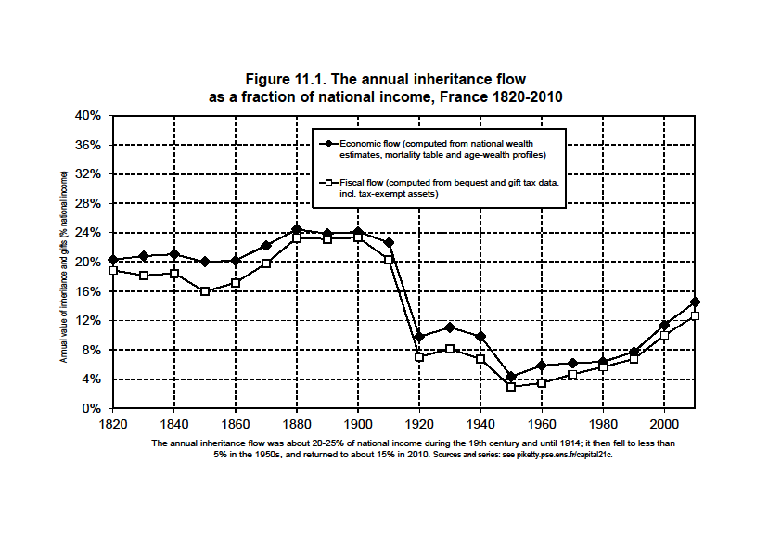

Slide 31
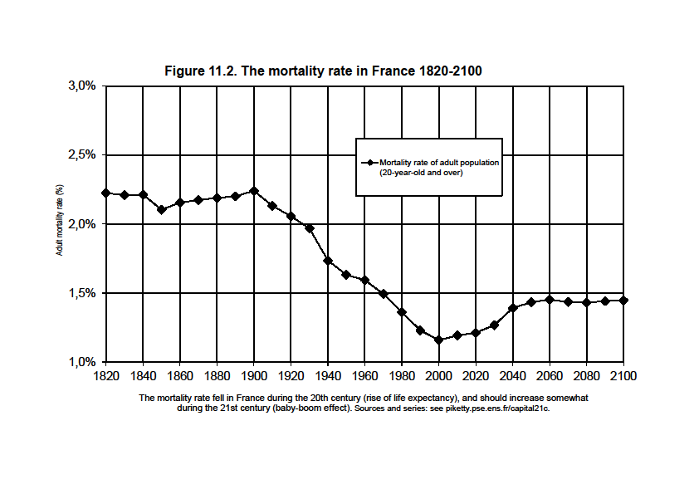

Slide 32
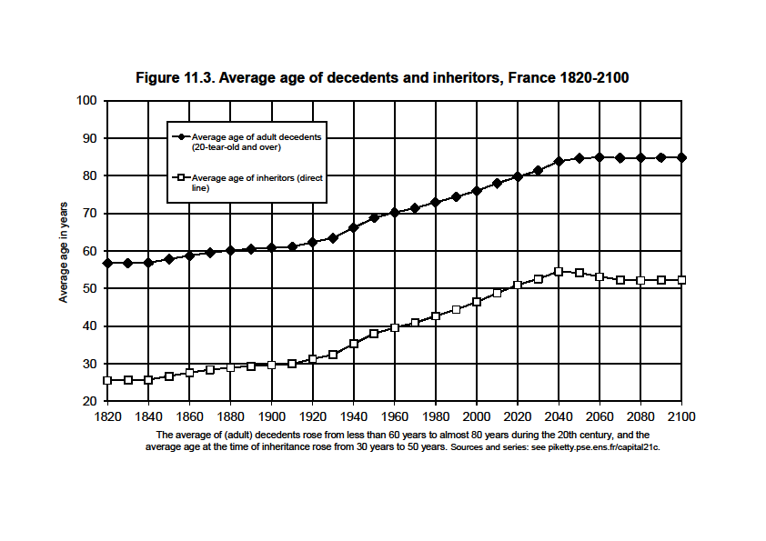

Slide 33
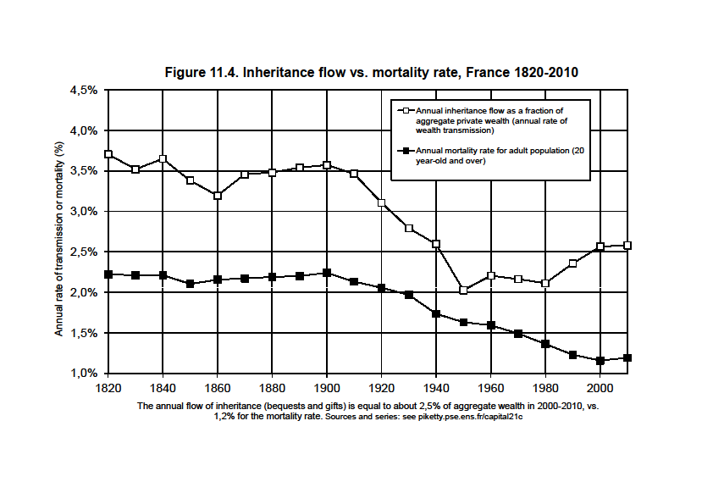

Slide 34
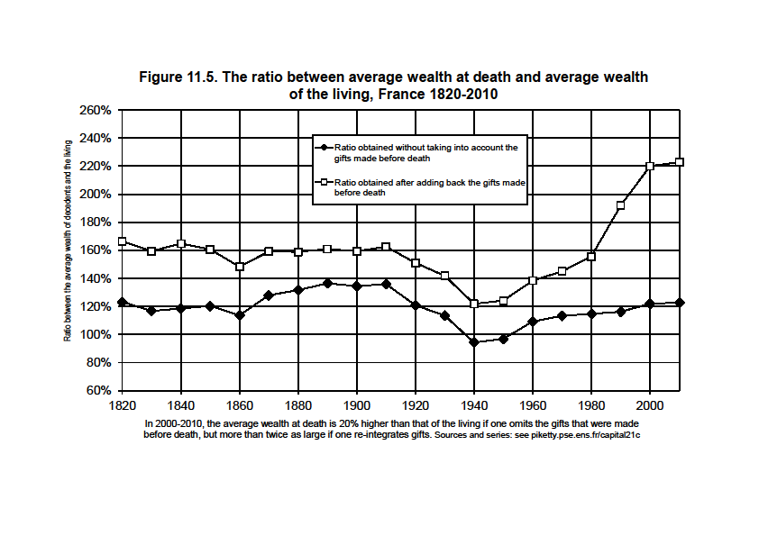

Slide 35
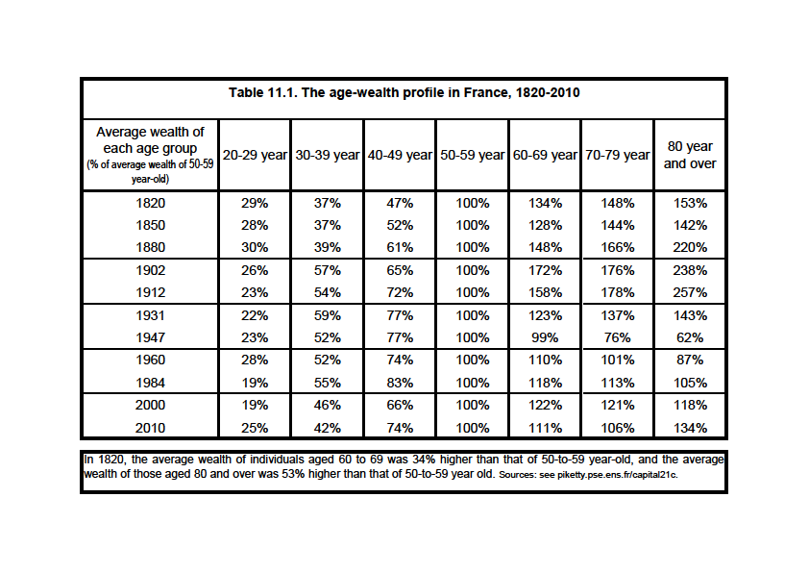

Slide 36
How is steady-state µ determined?
One can show that for given saving behavior, µ is an increasing function of r – g
Intuition: higher r – g makes inheritance more important; young workers are relatively poor until they inherit; in aging societies, wealth also tends to get older and older, so that the rise of µ tends to compensate the decline in m
As g→0, µ →(D-A)/H, so that µ x m → 1/H
(with D = age at death, A = age at adulthood, H = generation length ≈ 30 years: b_{y} = µ m β → β/H ≈ 20% if β ≈ 600ù)
Simple simulations: by assuming constant average saving rates by age group, one can replicate relatively well the 1810-2010 evolution of the aggregate inheritance flow in France; the future depends very much on r - g

Slide 37
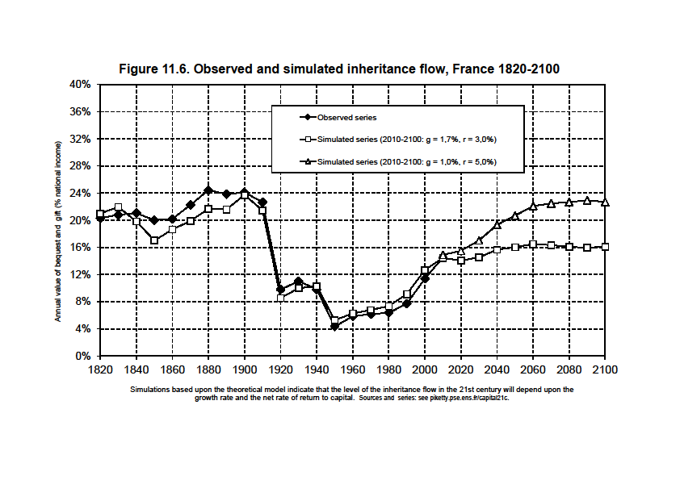

Slide 38
In order to go from the annual flow of inheritance b_{y}=B/Y to the share of the cumulated stock of inheritance in aggregate wealth φ=W_{B}/W, one needs dynamic, individual-level data
Simplified definition of φ : compare inheritance flow b_{y}=B/Y with saving rate s=S/Y;
If s≈10% and b_{y}≈5%, then self-made wealth dominates inherited wealth (=mid 20c period)
But if s≈10% and b_{y}≈20%, then inherited wealth dominates self-made wealth (19c and 21c)
T. Piketty, G. Zucman, “Wealth and Inheritance in the Long-Run”, Handbook of Income Distribution, 2014

Slide 39
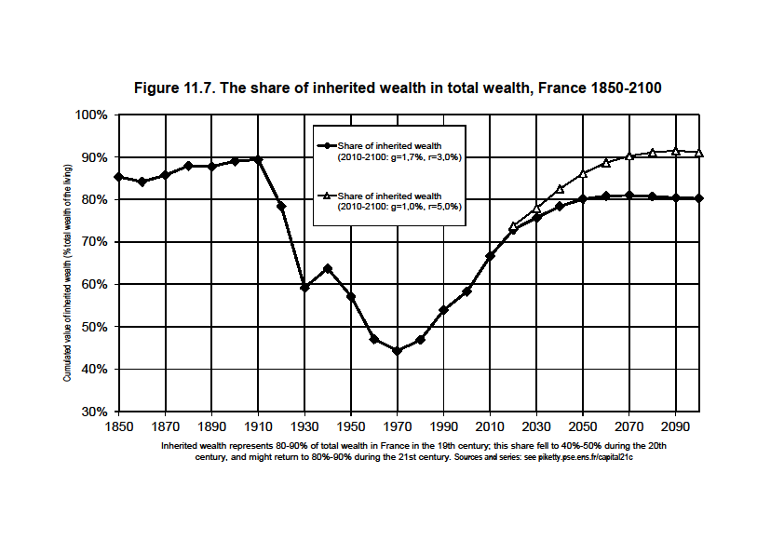

Slide 40
Aggregate inheritance is (almost) back to 19c levels
But the concentration of inheritance is not back to 19c levels: the bottom 50% is as poor as before, but the middle 40% now owns 20-30% of W
Today, there are fewer very large inheritors than in 19c; and there are more large and middle-large inheritors
This is a class model that is less unequal in some ways and more unequal in others; it is novel form of inequality, more merit-based in some ways, and more violent for loosers in others

Slide 41
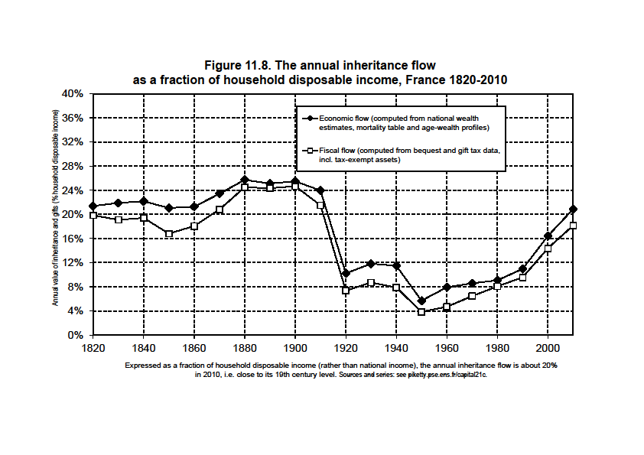

Slide 42
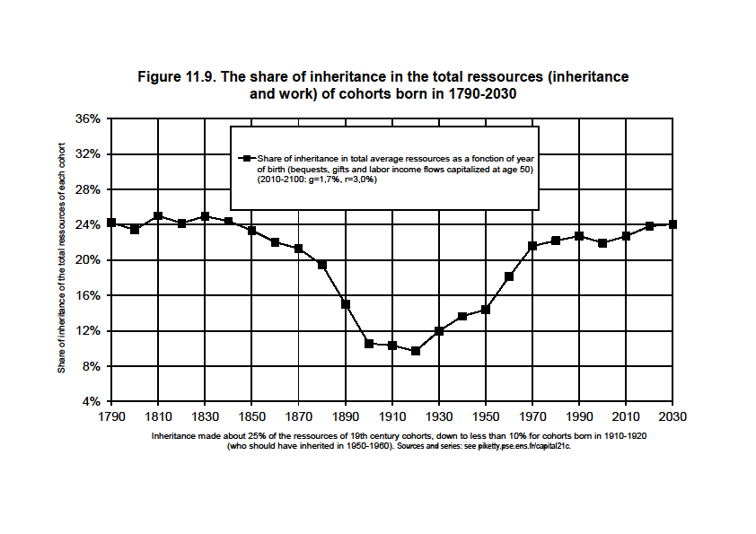

Slide 43
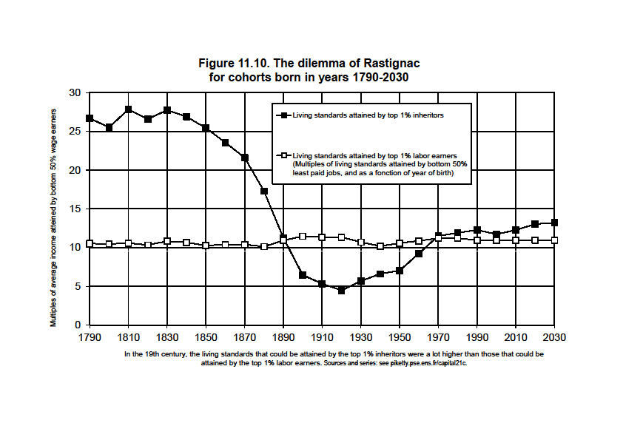

Slide 44
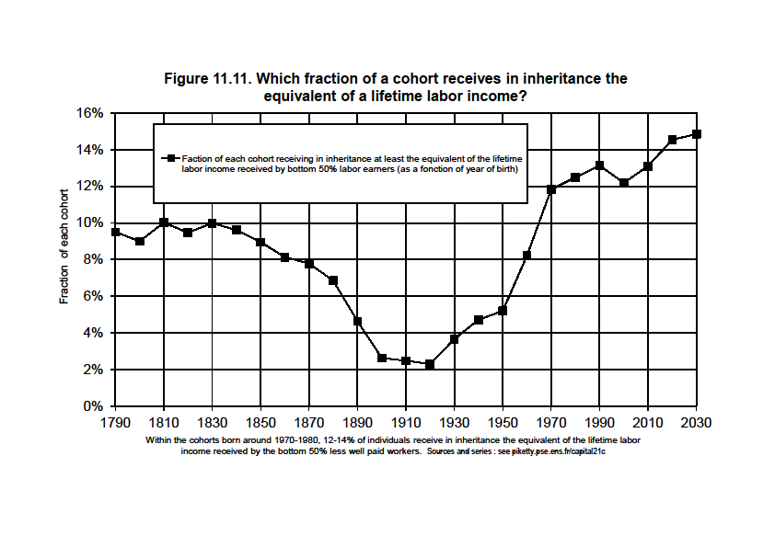

Slide 45
Existing international evidence (Germany, UK, Sweden,…) suggests that France is relatively representative of what might be happening in other countries; and possibly in the entire world in the very long run if g decline everywhere

Slide 46
