Slide 1
Inequality in Europe – and what the EU could do about it
Thomas Piketty
Paris School of Economics
EUSA Conference, Boston, March 6 2015

Slide 2
This lecture: three points
1. Inequality in the long-run: over the course of the 20th century, Europe has become more egalitarian than the US ➔ institutions and policies matter
2. But the European social state is fragile: lack of fiscal union, tax competition, public debt crisis, rise of nationalism
3. EU institutions need to be fundamentally transformed in order to address this: Euro-chamber
(see « Manifesto for a Euro political union »)

Slide 3
1. Inequality in the long run
Here I will present some results based upon Capital in the 21st century (Harvard University Press, March 2014)
This book studies the global dynamics of income and wealth distribution since 18^{c} in 20+ countries; I use historical data collected over the past 15 years with Atkinson, Saez, Postel-Vinay, Rosenthal, Alvaredo, Zucman, and 30+ others; I try to shift attention from rising income inequality to rising wealth inequality
All data series are available in a technical appendix available on line: see http://piketty.pse.ens.fr/capital21c

Slide 4
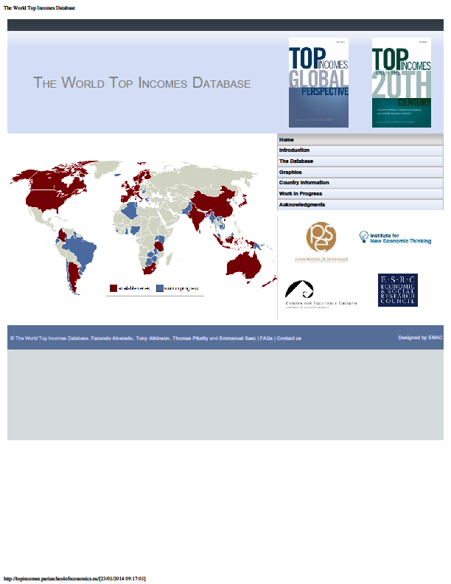

Slide 5
Three facts about inequality in the long-run: income inequality, wealth-inequality, wealth-income ratios
(Piketty-Saez, « Inequality in the long run », Science 2014)
Fact n°1: in 1900-1910, income inequality was higher in Europe than in the United States; in 2000-2010, it is a lot higher in the United States

Slide 10
The rise in US inequality in recent decades is mostly due to rising inequality of labor income
It is due to a mixture of reasons: changing supply and demand for skills; race between education and technology; globalization; more unequal to access to skills in the US (rising tuitions, insufficient public investment); unprecedented rise of top managerial compensation in the US (changing incentives, cuts in top income tax rates); falling minimum wage in the US
➔ institutions and policies matter

Slide 11
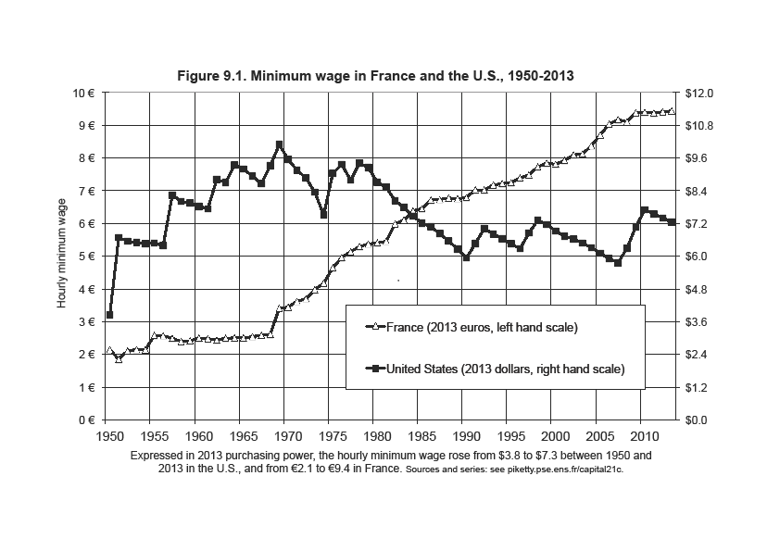

Slide 12
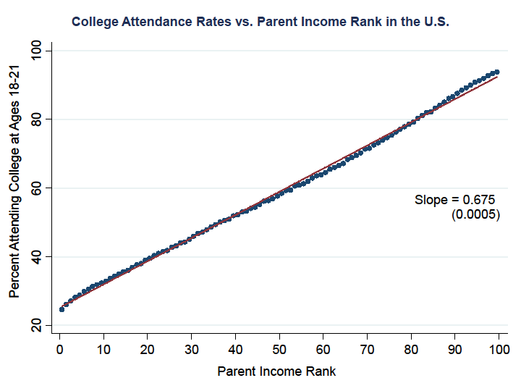

Slide 13
Fact n°2: wealth inequality is always a lot higher than income inequality; it is now higher in the US than in Europe
Fact n°3: wealth inequality is less extreme today than a century ago in Europe, although the total capitalization of private wealth relative to national income has now recovered from the 1914-1945 shocks
There’s nothing bad with high wealth-income ratio (as long as there’s a strong middle class share in total wealth), but this creates new policy challenges, particularly for Europe

Slide 16
2. European social state is fragile
European social state relies on high tax/GDP ratio
Rising tax competition and lack of fiscal union make it difficult to sustain high tax levels and to maintain fiscal consent: consensus about tax fairness is fragile
Top personal income tax rates have fallen more in the US then in Europe, but corporate tax rates have fallen a lot more in Europe
Without a common euro-corporate tax, effective tax rates on large corporations are likely to ➔ 0%

Slide 17
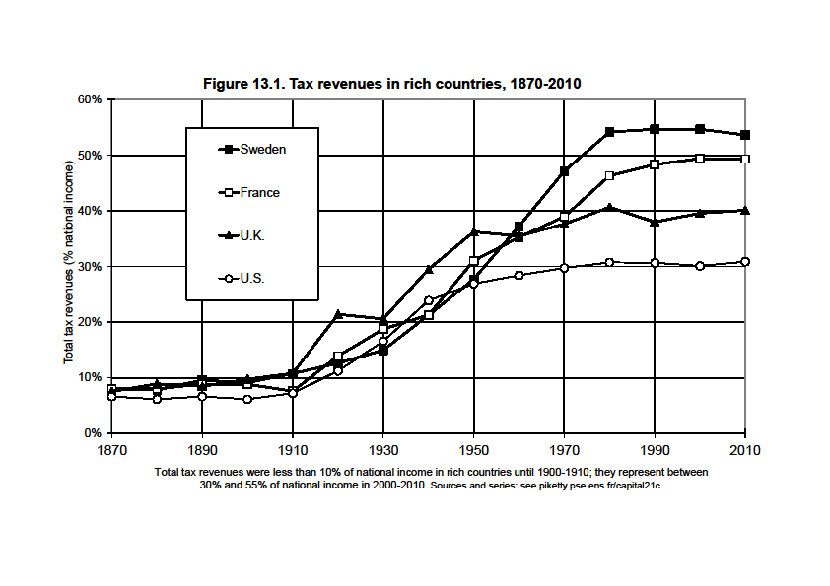

Slide 18
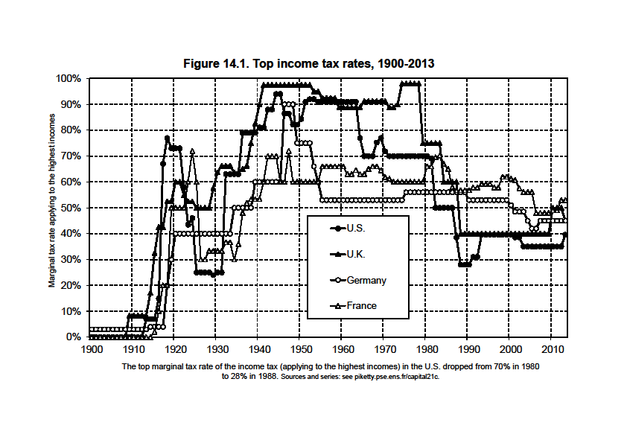

Slide 20
Rise of European private wealth-income ratios is not bad in itself… except that financial and real-estate bubbles need to be properly regulated
➔ new policy challenges (prudential regulation, access to property for young generations, return of inheritance)

Slide 22
Rise of European private wealth-income ratios is not bad in itself… except that it is partly due to transfers from public to private wealth: privatization of public assets at low prices, rise of public debt
public debt crisis, lack of confidence in Euro-zone institutions, recession, unemployment
(GDP 2015 < GDP 2007 ; lost decade)
structural pb: a single currency with 18 diff. public debt, 18 diff. interest rates, 18 diff. tax systems = a very bad and unstable system

Slide 23
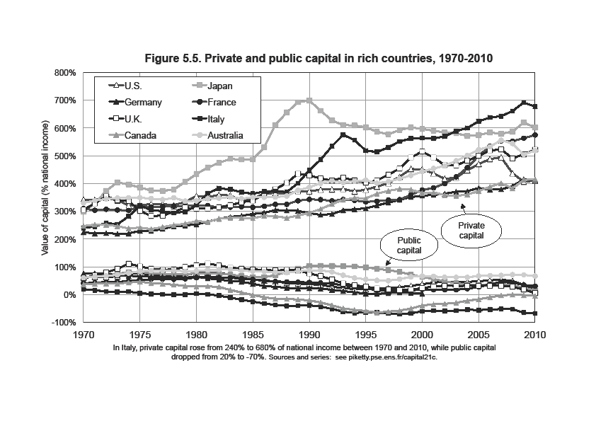

Slide 24
3. What can the EU do about this?
See « Manifesto for a Euro political union »
Common corporate tax, fight against tax havens, etc.: EU is perceived by lower social groups as being pro-capital; this needs to be reversed
Common redemption fund for all euro-zone public debts >60% GDP: separate country accounts, but common interest rate
Public-private investment plan in universities, innovation, green technologies

Slide 25
In order to adopt these policies, one needs to fundamentally transform the existing EU institutional architecture: with unanimity rule for fiscal issues, it is impossible to do anything; the system of automatic rules and sanctions for choice of deficit level is not working
In order to adopt these policies (corporate tax base and rate, level of the deficit, euro-zone budget, etc.) under majority rule, one needs a euro-zone parliament
Best option: Euro-chamber based upon members of national parliaments (in proportion to each country’s population: say, 40 NMPs from Germany, 30 NMPs from France, etc.)

Slide 26
Is the Euro-chamber the same as pre-1979 EP?
No : Euro-chamber would have substantial legistative powers (pre-1979 EP was a deliberative assembly)
Europe has yet to invent its own original form of bicameralism: even if one day all countries adopt the euro (this will take time…), it makes sense to have two separate chambers: (1) a European Parliament elected directly by the citizens of all member countries, and (2) a Euro Chamber representing the member countries through their national parliaments
This is a way to force NMPs to become European law makers and to stop complaining about Europe
Councils of heads of states or finance ministers will never work like a parliamentary chamber: you cannot represent a 80million or 60million country with 1 individual

Slide 27
Is this realistic?
Yes. E.g. if France and Italy were putting this propoal on the table, then ultimately a compromise would be worked out with Germany
Pb: national governments have spent a lot of energy since 2012 trying to pretend that the new 2012 treaty (fiscal compact) is working; in order to change their discourse, maybe we need a big shock
Greek electoral shock not enough? Do we need to wait until Spanish elections in late 2015? Or French regional elections? Or new financial panic?

