Slide 1
Capital in the 21st century
Thomas Piketty
Paris School of Economics
Storrs Lecture, Yale Law School, March 9 2015

Slide 2
This presentation is based upon Capital in the 21st century (Harvard University Press, March 2014)
This book studies the global dynamics of income and wealth distribution since 18^{c} in 20+ countries; I use historical data collected over the past 15 years with Atkinson, Saez, Postel-Vinay, Rosenthal, Alvaredo, Zucman, and 30+ others; I try to shift attention from rising income inequality to rising wealth inequality
The book includes four parts:
Part 1. Income and capital
Part 2. The dynamics of the capital/income ratio
Part 3. The structure of inequalities
Part 4. Regulating capital in the 21st century
In this presentation I will present some results from Parts 2 & 3, focusing upon the long-run evolution of capital/income ratios and wealth concentration (all graphs and series are available on line:
see http://piketty.pse.ens.fr/capital21c )

Slide 3
This presentation: three points
1. The long-run dynamics of income inequality. The end of the Kuznets curve, the end of universal laws. Country-specific institutions and policies matter.
2. The return of a patrimonial (or wealth-based) society in the Old World (Europe, Japan). Wealth-income ratios seem to be returning to very high levels in low growth countries. The metamorphosis of capital.
3. The future of wealth concentration: with high r - g during 21^{c} (r = net-of-tax rate of return, g = growth rate), then wealth inequality might reach or surpass 19^{c} oligarchic levels. Need for for more transparency.

Slide 4
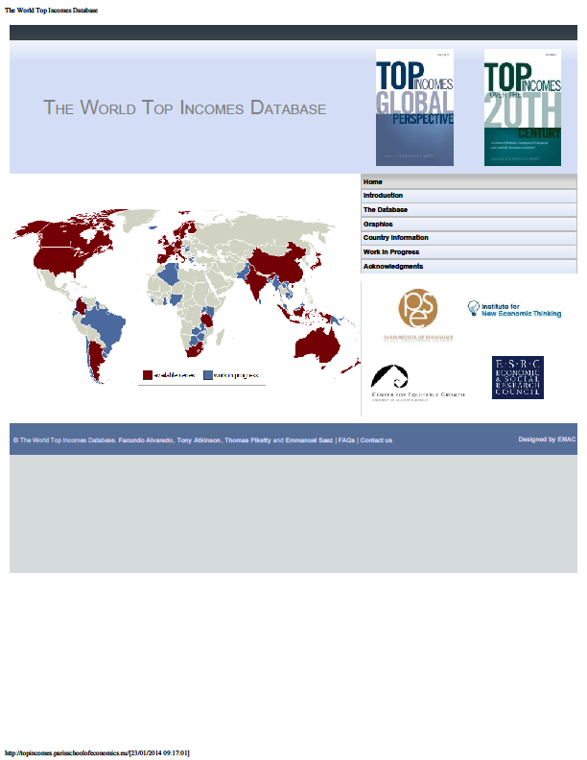

Slide 5
Three facts about inequality in the long-run: income inequality, wealth-inequality, wealth-income ratios
(Piketty-Saez, « Inequality in the long run », Science 2014)
Fact n°1: in 1900-1910, income inequality was higher in Europe than in the United States; in 2000-2010, it is a lot higher in the United States

Slide 10
The rise in US inequality in recent decades is mostly due to rising inequality of labor income
It is due to a mixture of reasons: changing supply and demand for skills; race between education and technology; globalization; more unequal to access to skills in the US (rising tuitions, insufficient public investment); unprecedented rise of top managerial compensation in the US (changing incentives, cuts in top income tax rates); falling minimum wage in the US
➔ institutions and policies matter

Slide 11
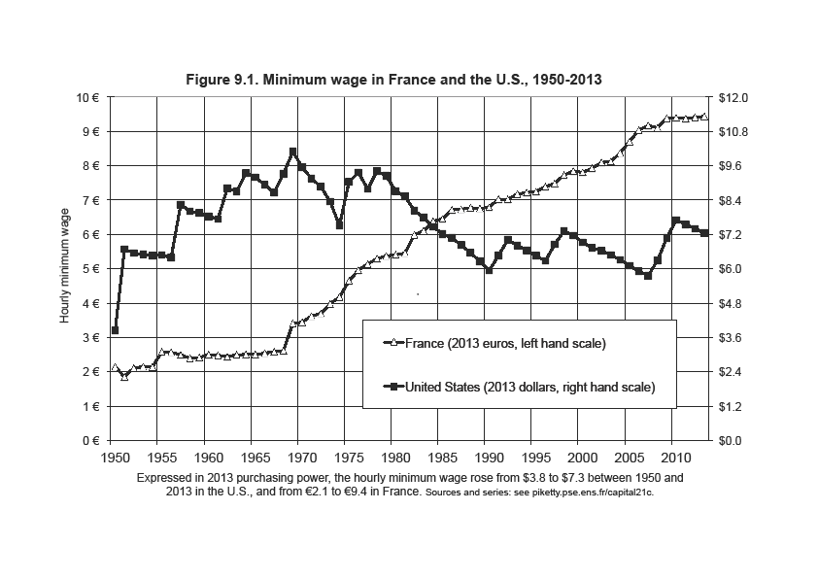

Slide 12
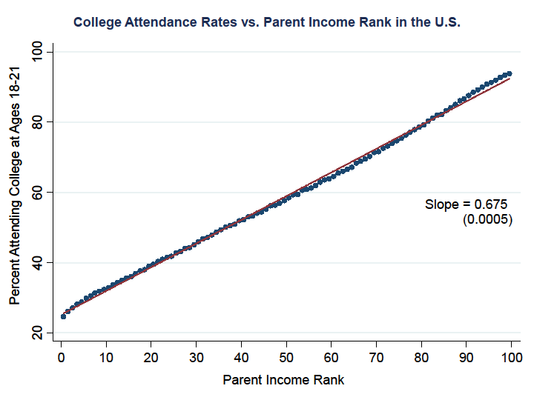

Slide 13
This presentation: three points
1. The long-run dynamics of income inequality. The end of the Kuznets curve, the end of universal laws.
2. The return of a patrimonial (or wealth-based) society in the Old World (Europe, Japan). Wealth-income ratios seem to be returning to very high levels in low growth countries. Intuition: in a slow-growth society, wealth accumulated in the past can naturally become very important. In the very long run, this can be relevant for the entire world. Not bad in itself, but new challenges. The metamorphosis of capital call for new regulations of property relations.
3. The future of wealth concentration: with high r - g during 21^{c}, then wealth inequality might reach or surpass 19^{c} oligarchic levels.

Slide 14
Fact n°2: wealth inequality is always a lot higher than income inequality; it is now higher in the US than in Europe
Fact n°3: wealth inequality is less extreme today than a century ago in Europe, although the total capitalization of private wealth relative to national income has now recovered from the 1914-1945 shocks

Slide 17
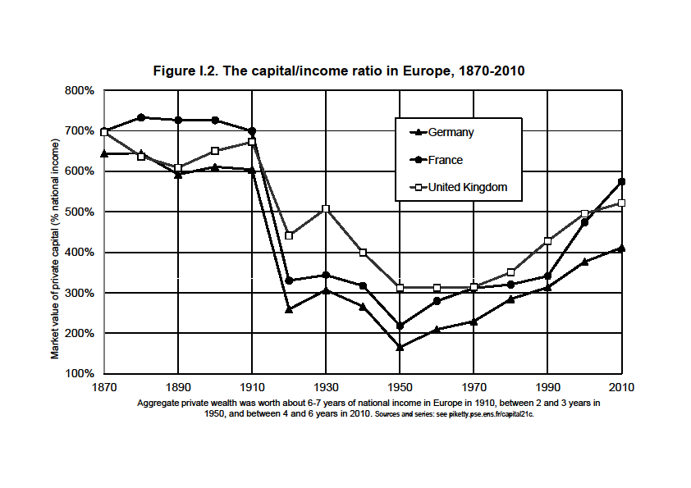

Slide 18
The metamorphosis of capital
There’s nothing bad with high wealth-income ratios (postwar reconstruction, growth slowdown), but this creates new policy challenges: financial regulation, real estate bubbles, return of inheritance
➔ A multidimensional approach to the history of capital and property relations: from land to business assets, foreign assets, real estate, public debt, immaterial capital, etc.

Slide 19
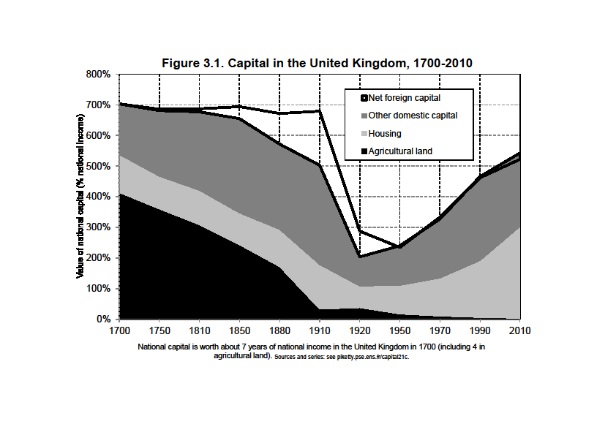

Slide 20
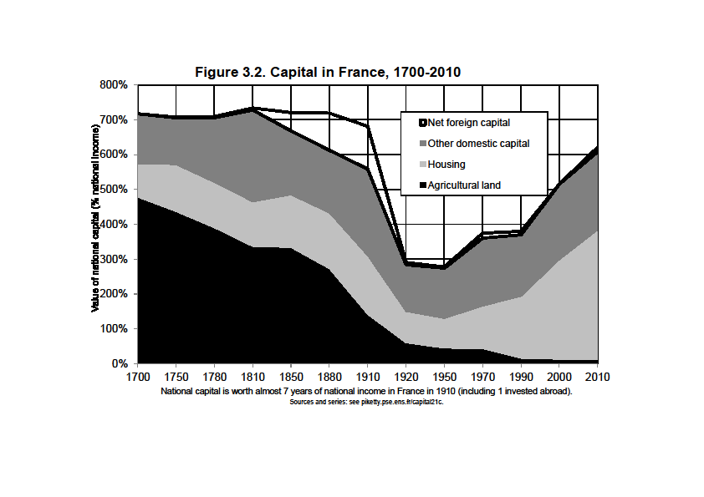

Slide 21
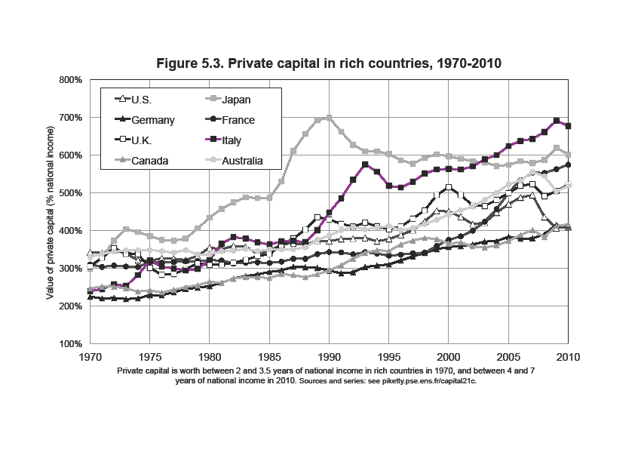

Slide 23
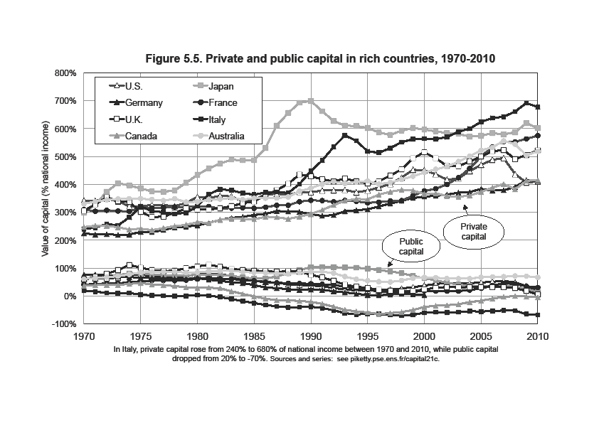

Slide 24
Capital & inequality in America
Inequality in America = a different structure as in Europe: more egalitarian in some ways, more inegalitarian in others
The New World in the 19th century: the land of opportunity (capital accumulated in the past matters less than in Europe; perpetual pop. growth as a way to reduce the level of inherited wealth and wealth concentration)… and also the land of slavery: extreme form of property relation
Northern US were in many ways more egalitarian than Old Europe; but Southern US were more inegalitarian
We still have the same ambiguous relationship of America with inequality today: in some ways more merit-based; in other ways more violent (« meritocratic extremism »)

Slide 26
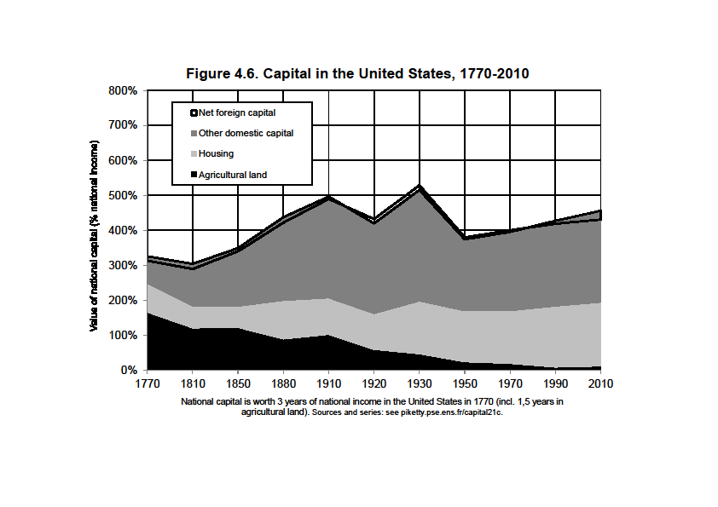

Slide 27
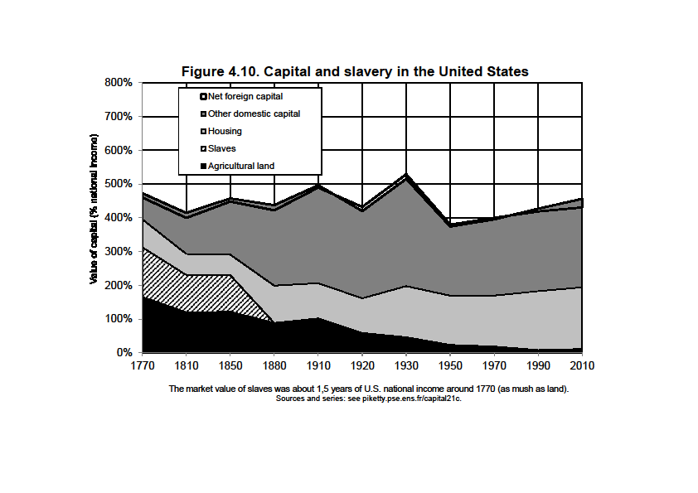

Slide 28
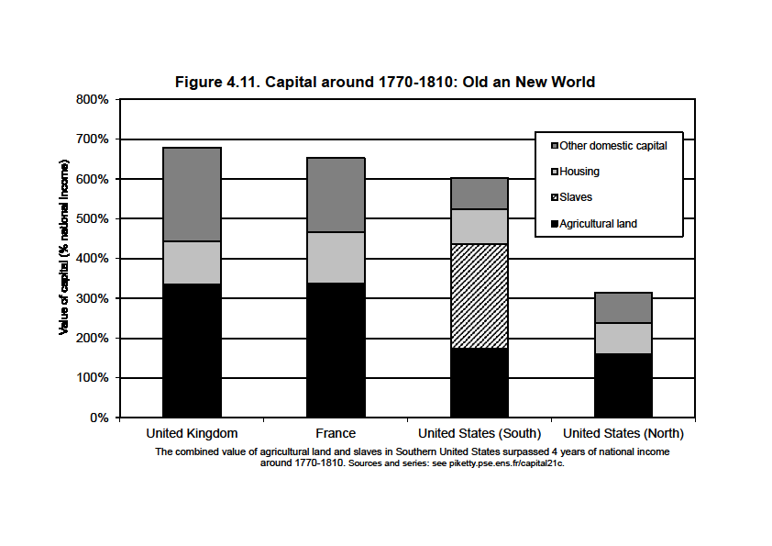

Slide 29
Capital & inequality in Germany
Lower market values of capital assets in Germany: lower real estate prices, and lower stock market capitalization of corporations
Stakeholder capitalism: shareholders have to share power with worker representatives, regional govt, etc., so that the market value is much less than book value of corporation
Apparently this does not prevent German companies from producing good cars
This clearly illustrates that market and social values of capital can differ; property relations are socially, legally and historically determined

Slide 30
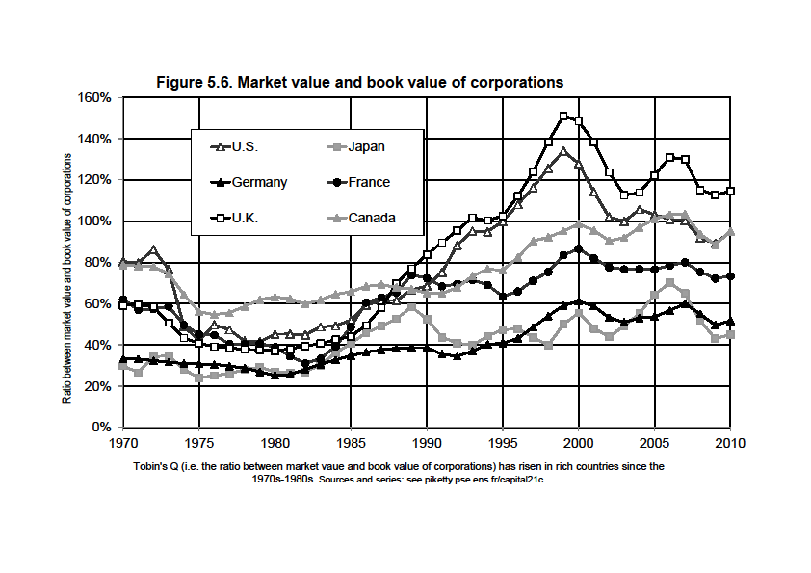

Slide 31
This presentation: three points
1. The long-run dynamics of income inequality. The end of the Kuznets curve, the end of universal laws. Country-specific institutions and policies matter.
2. The return of a patrimonial (or wealth-based) society in the Old World (Europe, Japan). Wealth-income ratios seem to be returning to very high levels in low growth countries.
3. The future of wealth concentration: with high r - g during 21^{c} (r = net-of-tax rate of return, g = growth rate), then wealth inequality might reach or surpass 19^{c} oligarchic levels. Conversely, suitable institutions can allow to democratize wealth. Strong need for more transparency about global wealth dynamics and cross-border financial assets, in rich countries as well as in emerging countries (China, Latin America, Africa).

Slide 33
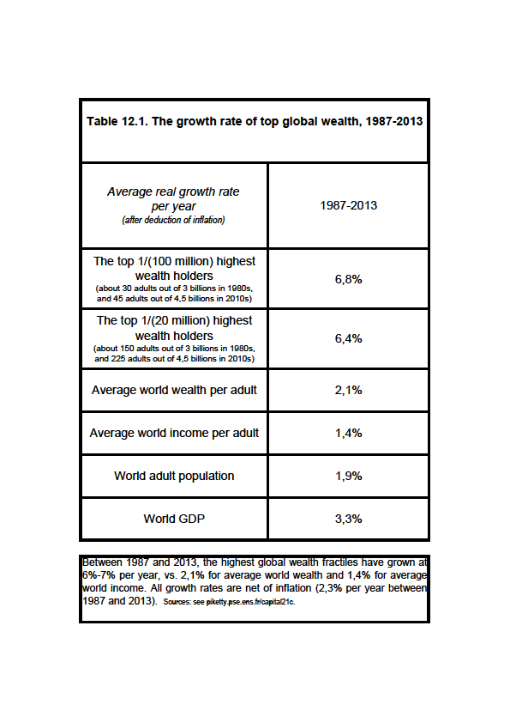

Slide 34
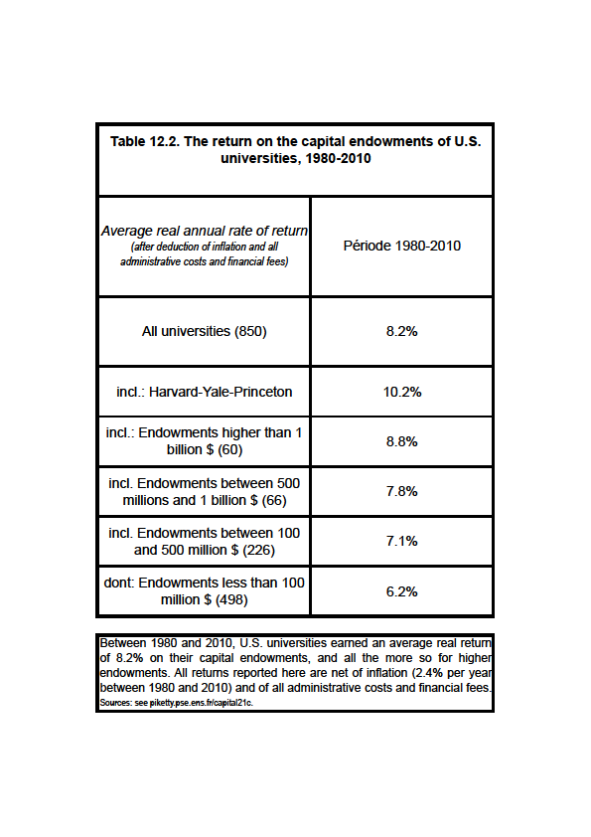

Slide 35
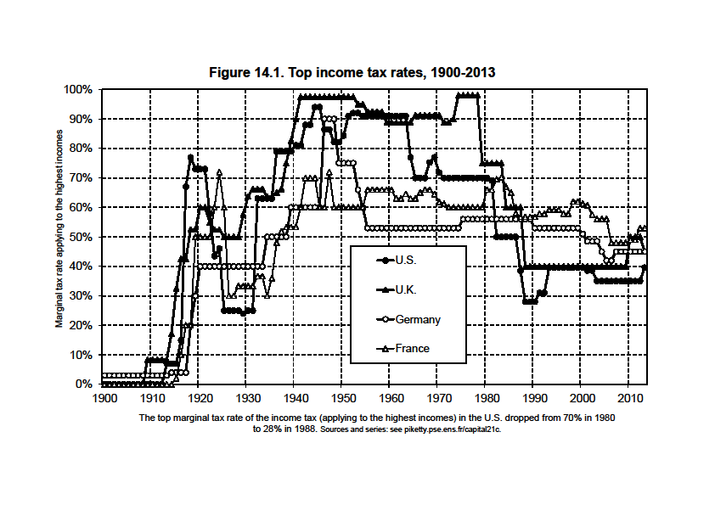

Slide 36
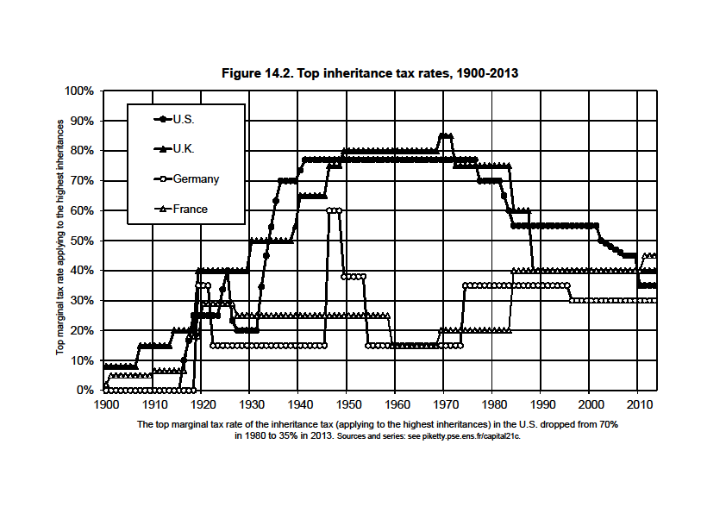

Slide 37
Conclusions
The history of income and wealth inequality is deeply political, social and cultural; it involves beliefs systems, national identities and sharp reversals
In a way, both Marx and Kuznets were wrong: there are powerful forces pushing in the direction of rising or reducing inequality; which one dominates depends on the institutions and policies that different societies choose to adopt
High r-g can push toward high wealth concentration, but many other forces are also important
The ideal solution: progressive taxation, social state, financial transparency, economic democracy
Other solutions involve authoritarian political & capital controls (China, Russia), or perpetual population growth (US)
US high-inequality trap: oligarchic capture, or lack of historical experience with oligarchy ?

Slide 38
Supplementary slides
(long lecture version)

Slide 39
The return of a wealth-based society
Wealth = capital K = everything we own and that can be sold on a market (net of all debts) (excludes human K, except in slave societies)
In textbooks, wealth-income & capital-ouput ratios are supposed to be constant. But the so-called « Kaldor facts » actually rely on little historical evidence.
In fact, we observe in Europe & Japan a large recovery of β=K/Y in recent decades:
β=200-300% in 1950-60s → β=500-600% in 2000-10s
(i.e. average wealth K was about 2-3 years of average income Y around 1950-1960; it is about 5-6 years in 2000-2010)
(with β≈600%, if Y≈30 000€ per capita, then K≈180 000€ per capita)
(currently, K ≈ half real estate, half financial assets)
Are we heading back to the β=600-700% observed in the wealth-based societies of 18^{c}-19^{c} ? Or even more?

Slide 42
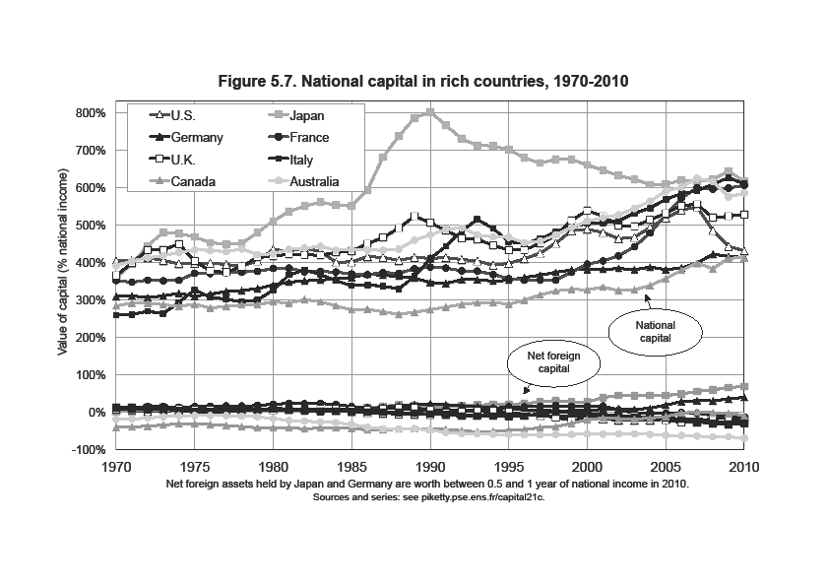

Slide 45
The simplest way to think about this is the following: in the long-run, β=s/g with s = (net-of-depreciation) saving rate
and g = economy’s growth rate (population + productivity)
With s=10%, g=3%, β≈300%; but if s=10%, g=1,5%, β≈600%
= in slow-growth societies, the total stock of wealth accumulated in the past can naturally be very important
→ capital is back because low growth is back
(in particular because population growth↓0)
→ in the long run, this can be relevant for the entire planet
Note: β=s/g = pure stock-flow accounting identity; it is true whatever the combination of saving motives

Slide 46
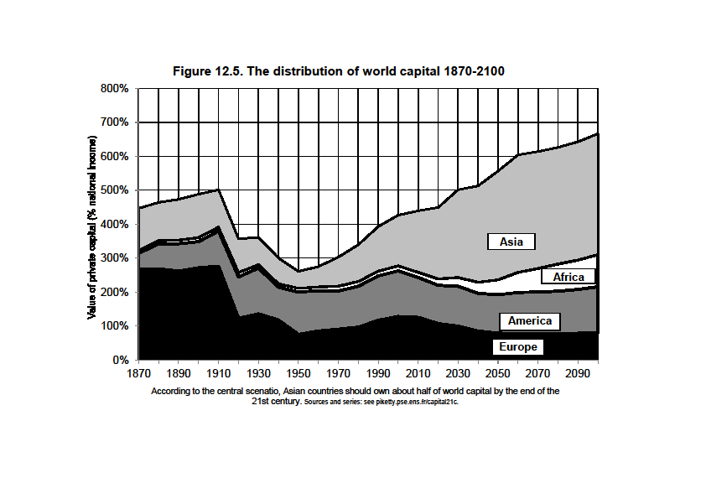

Slide 47
Will the rise of capital income-ratio β also lead to a rise of the capital share α in national income?
If the capital stock equals β=6 years of income and the average return to capital is equal r=5% per year, then the share of capital income (rent, dividends, interest, profits, etc.) in national income equals α = r x β = 30%
Technically, whether a rise in β also leads to a rise in capital share α = r β depends on the elasticity of substitution σ between capital K and labor L in the production function Y=F(K,L)
Intuition: σ measures the extent to which workers can be replaced by machines (e.g. Amazon’s drones)
Standard assumption: Cobb-Douglas production function (σ=1) = as the stock β↑, the return r↓ exactly in the same proportions, so that α = r x β remains unchanged, like by magic = a stable world where the capital-labor split is entirely set by technology
But if σ>1, then the return to capital r↓ falls less than the volume of capital β↑, so that the product α = r x β ↑
Exactly what happened since the 1970s-80s: both the ratio β and the capital share α have increased

Slide 48
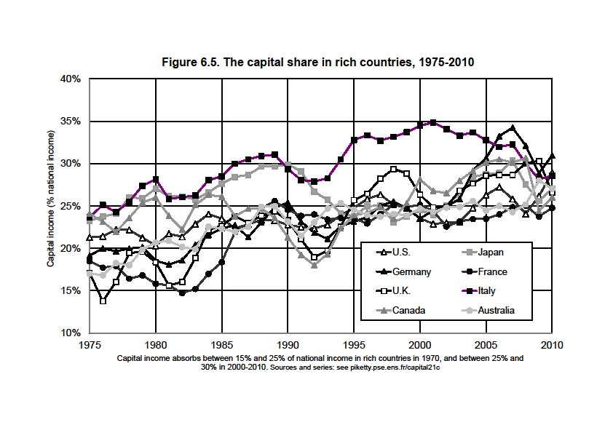

Slide 49
With a large rise in β, one can get large rise in α with a production function F(K,L) that is just a little bit more substituable than in the standard Cobb-Douglas model (say if σ=1,5 instead of 1)
Maybe it is natural to expect σ↑over the course of history: more and more diversified uses for capital; extreme case: pure robot-economy (σ=infinity)
Less extreme case: there are many possible uses for capital (machines can replace cashiers, drones can replace Amazon’s delivery workers, etc.), so that the capital share α↑ continuously; there’s no natural corrective mechanism for this
The rise of β and α can be a good thing (we could all devote more time to culture, education, health…, rather than to our own subsistance), assuming one can answer the following question: who owns the robots?

Slide 50
The future of wealth concentration
In all European countries (UK, France, Sweden…), wealth concentration was extremely high in 18^{c}-19^{c} & until WW1:
about 90% of aggregate wealth for top 10% wealth holders
about 60% of aggregate wealth for top 1% wealth-holders
= the classic patrimonial (wealth-based) society: a minority lives off its wealth, while the rest of the populaton works (Austen, Balzac)
Today wealth concentration is still very high, but less extreme:
about 60-70% for top 10%; about 20-30% for top 1%
the bottom 50% still owns almost nothing (<5%)
but the middle 40% now owns 20-30% of aggregate wealth
= the rise of a patrimonial middle class
How did it happen, and will it last? Will the patrimonial middle class expend, or will it shrink?

Slide 51
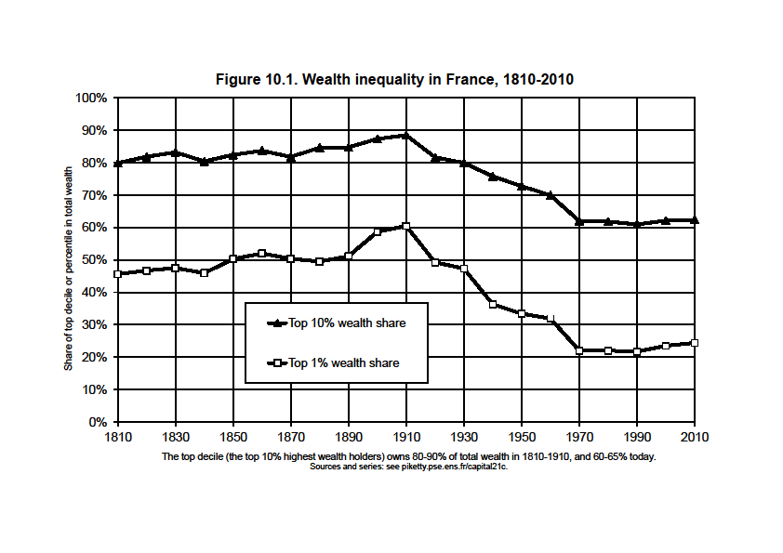

Slide 52
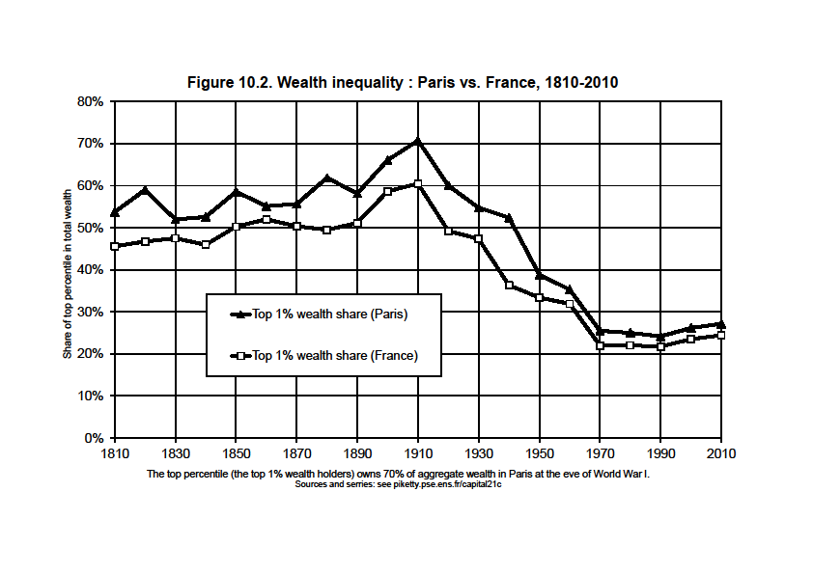

Slide 53
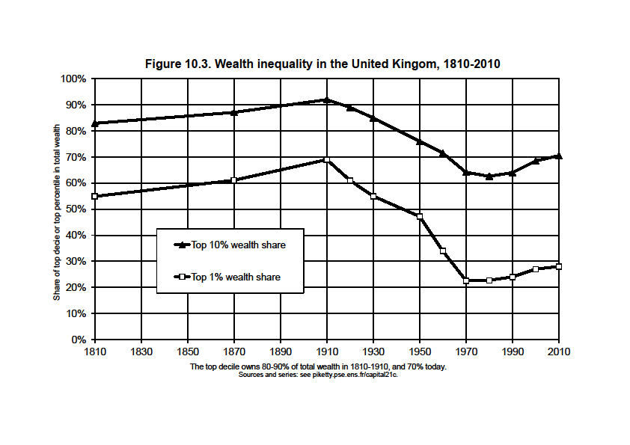

Slide 54
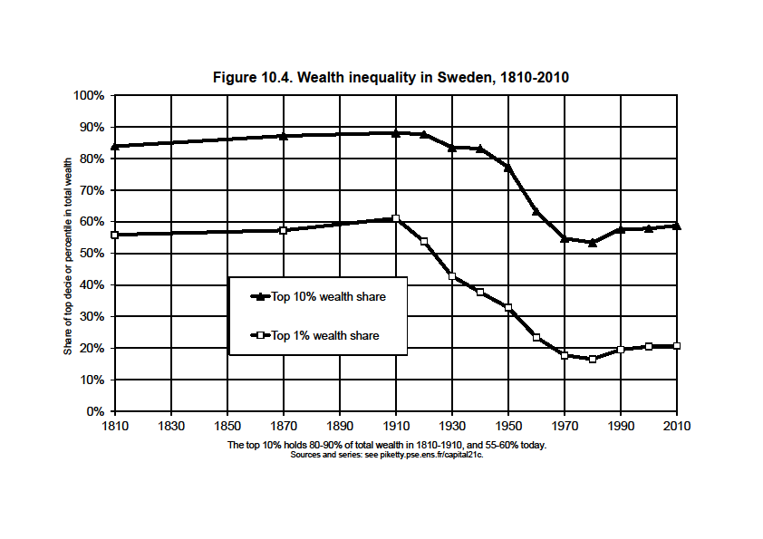

Slide 55
Key finding: there was no decline in wealth concentration prior to World War shocks; was it just due to shocks?
Q.: Apart from shocks, what forces determine the long-run level of wealth concentration?
A.: In any dynamic, multiplicative wealth accumulation model with random individual shocks (tastes, demographic,returns, wages,..), the steady-state level of wealth concentration is an increasing function of r - g
(with r = net-of-tax rate of return and g = growth rate)
With growth slowdown and rising tax competition to attract capital, r - g might well rise in the 21^{c} → back to 19^{c} levels
Future values of r also depend on technology (σ>1?)
Under plausible assumptions, wealth concentration might reach or surpass 19^{c} record levels: see global wealth rankings

Slide 56
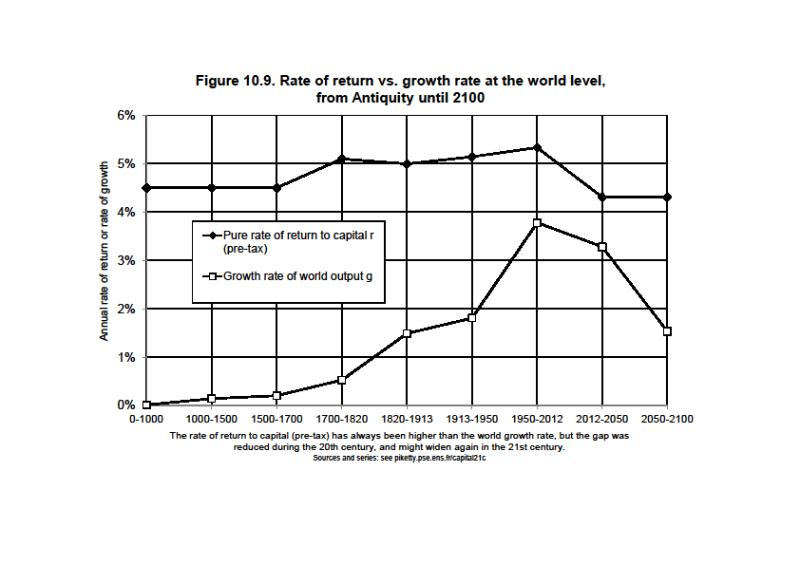

Slide 57
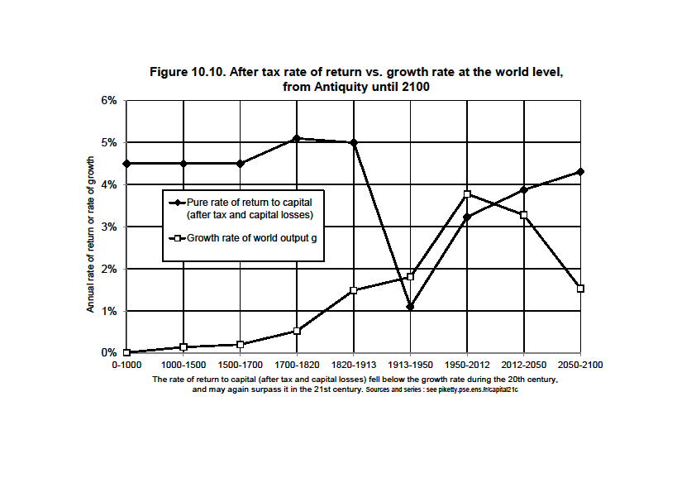

Slide 58
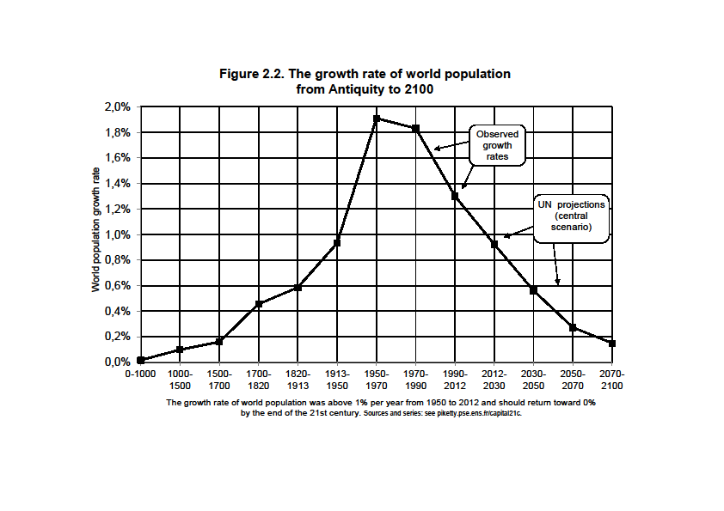

Slide 59
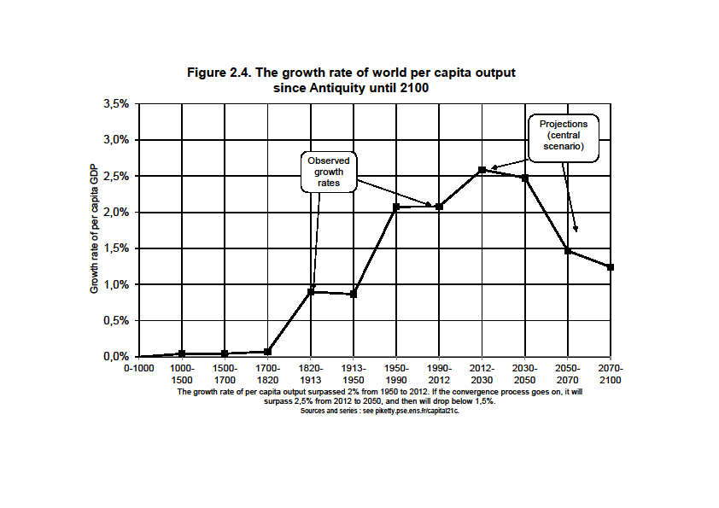

Slide 60
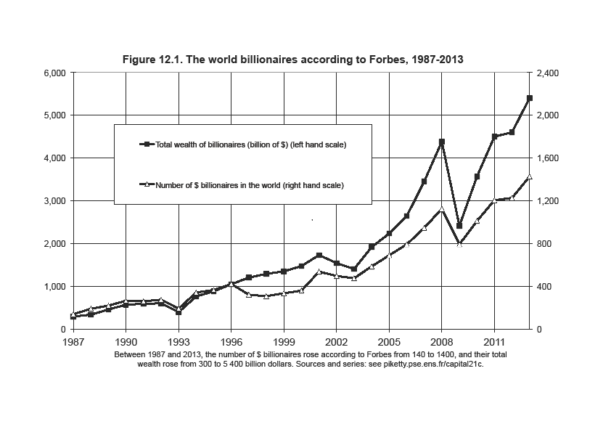

Slide 61
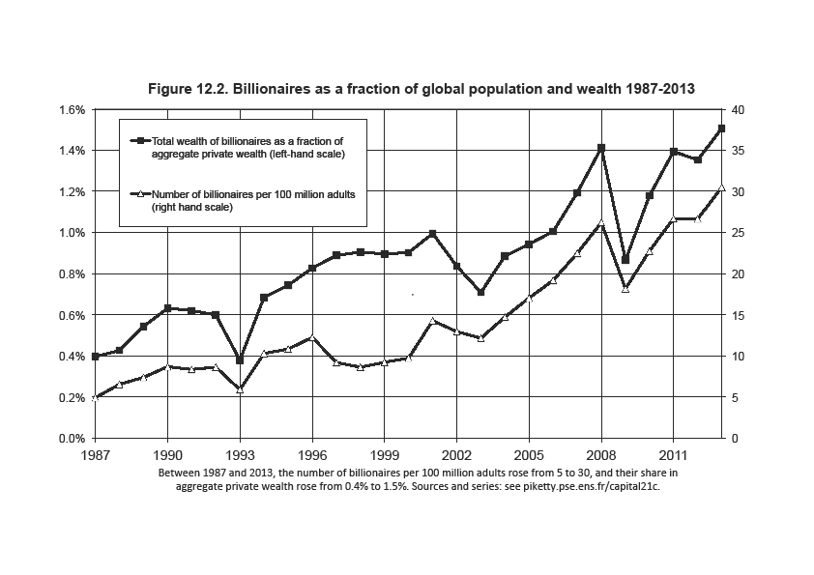

Slide 62
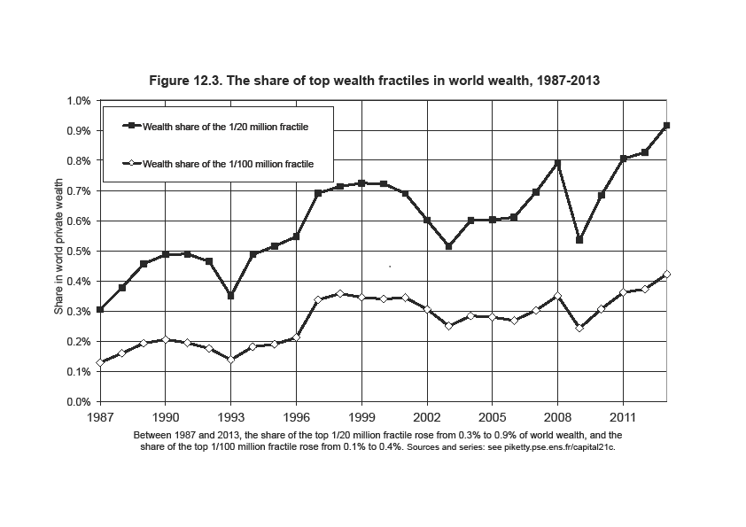

Slide 65
Capital & inequality in America
Inequality in America = a different structure as in Europe: more egalitarian in some ways, more inegalitarian in some other dimensions
The New World in the 19th century: the land of opportunity (capital accumulated in the past mattered much less than in Europe; perpetual demographic growth as a way to reduce the level of inherited wealth and wealth concentration)… and also the land of slavery
Northern US were in many ways more egalitarian than Old Europe; but Southern US were more inegalitarian
We still have the same ambiguous relationship of America with inequality today: in some ways more merit-based; in other ways more violent (« meritocratic extremism »)

Slide 68
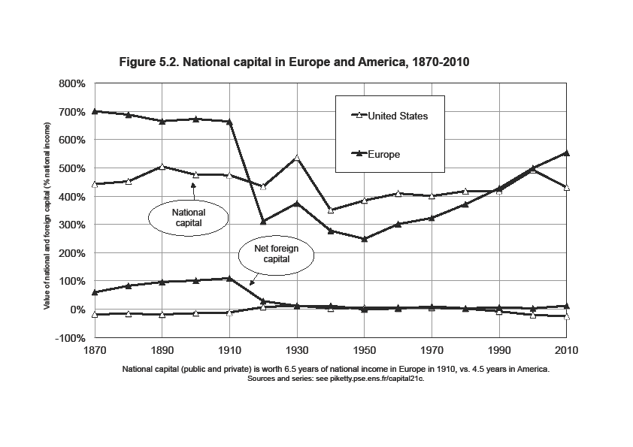

Slide 71
The US distribution of income has become more unequal than in Europe over the course of the 20th century; it is now as unequal as pre-WW1 Europe
But the structure of inequality is different: US 2013 has less wealth inequality than Europe 1913, but higher inequality of labor income

Slide 72
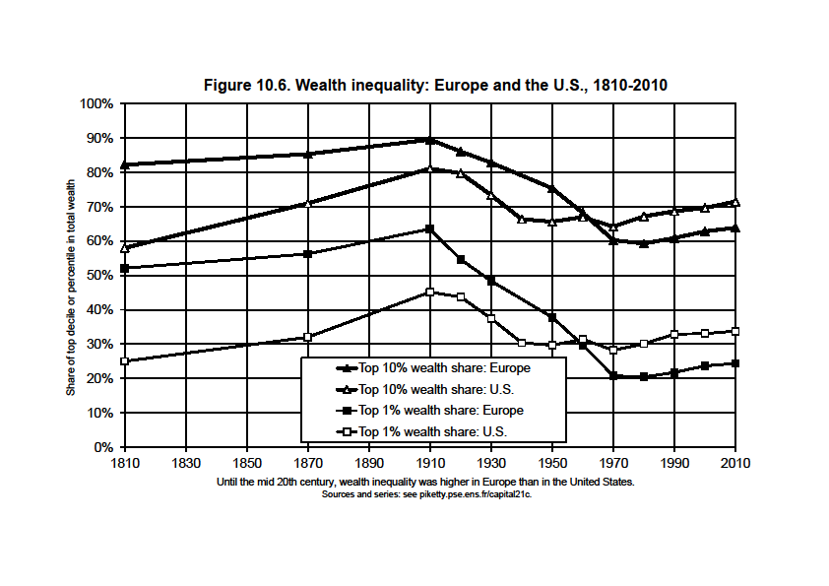

Slide 73
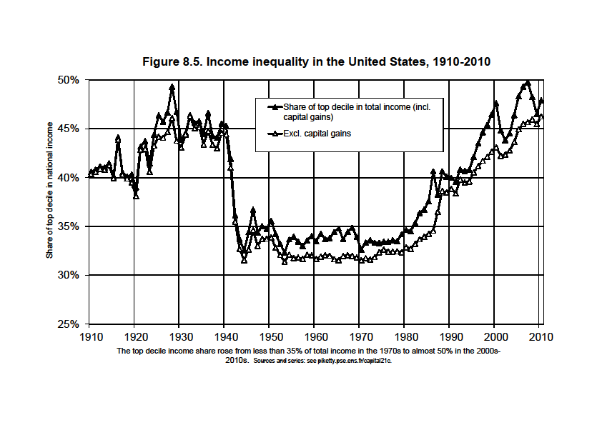

Slide 74
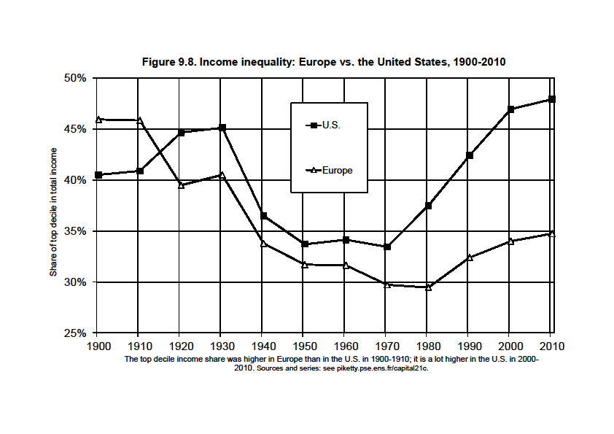

Slide 75
Higher inequality of labor income in the US could reflect higher inequality in education investment; but it also reflects a huge rise of top executive compensation that it very hard to explain with education and productivity reasonning alone
In the US, this is sometime described as more merit-based: the rise of top labor incomes makes it possible to become rich with no inheritance (≈Napoleonic prefets)
Pb = this can be the worst of all worlds for those who are neither top income earners nor top successors: they are poor, and they are depicted as dump & undeserving (at least, nobody was trying to depict Ancien Regime inequality as fair)
It is unclear whether rise of top incomes has a lot to do with merit or productivity: sharp decline in top tax rates & rise of CEO bargaining power are more convincing explanations; chaotic US history of social norms regarding inequality

Slide 76
